Slide 1




Materials Data Facility -
Data Services to Advance Materials Science Research
Ian Foster (foster@uchicago.edu)
Ben Blaiszik (blaiszik@uchicago.edu),
Kyle Chard, Rachana Ananthakrishnan, Steven Tuecke, UChicago
Michael Ondrejcek, Kenton McHenry, John Towns, NCSA
materialsdatafacility.org
globus.org

Slide 2
Outline
Overview
  MDF
  Globus quick introduction
Data Publication
  Key MDF features
  Publication walk-through
  Lessons Learned / Pipeline Analysis
Materials Resource Registration
Next Steps
APIs

Slide 3
What is MDF?
We are developing services to make it more simple for materials datasets and resources to be ...
Published
Identified
Described
Curated
Verifiable
Accessible
Preserved
and
Discovered
Searched
Browsed
Shared
Recommended
Accessed

Slide 4

Data Service Infrastructure
+
+
Publication
Discovery
APIs
+
Data Interaction
And Viz
Resource Registration
+ - Initial Foci

Slide 5
Publication
Opened to external users in mid Feb 2016
Identify datasets with persistent identifiers (e.g. DOI)
Describe datasets with appropriate metadata, and provenance
Curate dataset metadata and data composition
Verify dataset contents over time
Preserve critical datasets in a state that increases transparency, replicability, and helps encourage reuse
APIs

Slide 6
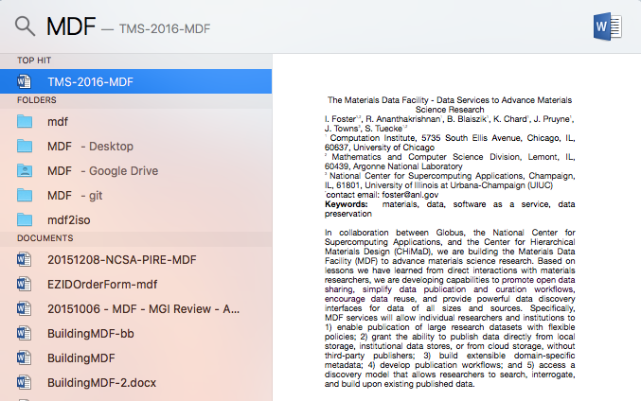
Discovery
Coming late 2016-ish
Search and query datasets in modern ways – e.g. via indexed metadata rather than remembering file paths
Discover distributed materials resources (more later)
Future...
Spotlight for all data you have access to regardless of location

Slide 7
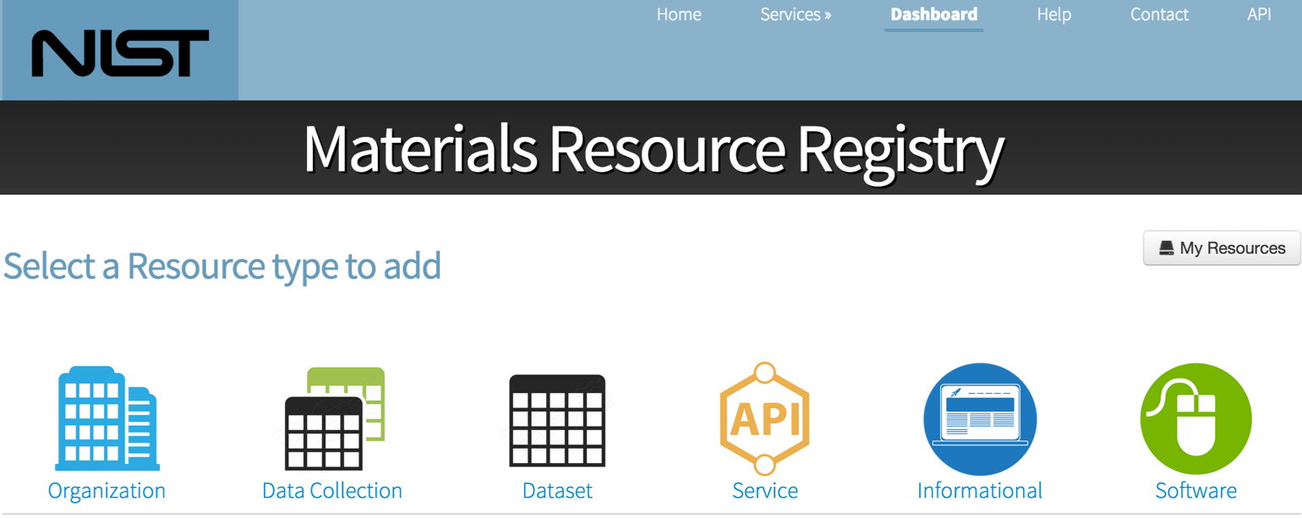
Resource Registration
Coming Q2 2016 via collaboration w/ NIST
Find existing, widely distributed, materials resources
MDF will run an instance of MRR, currently populating before making widely available
APIs
[Dima, Youssef, et al. @ NIST]

Slide 8
Globus Background

Slide 9
Globus Platform-as-a-Service (PaaS)
Identity management
User
groups
create and manage a unique identity linked to external identities for authentication
Manage user group creation and administration flows
Share data with user groups
Data publication
Data
transfer
Data
sharing
High-performance data transfer from a web browser
Optimize transfer settings and verify transfer integrity
Add your laptop to the Globus cloud with Globus Connect Personal
Share directly from your storage device (laptop or cluster)
File and directory-level ACLs

Slide 10
Globus Background
Endpoint
E.g. laptop or server running a Globus client (e.g. Dropbox client)
Enables advanced file transfer and sharing
Currently GridFTP, future GridFTP + HTTP
Some Key Features
REST API for automation and interoperability
Web UI for convenience
Optimizes and verifies transfers
Handles auto-restarts
Battle tested with big data

Slide 11
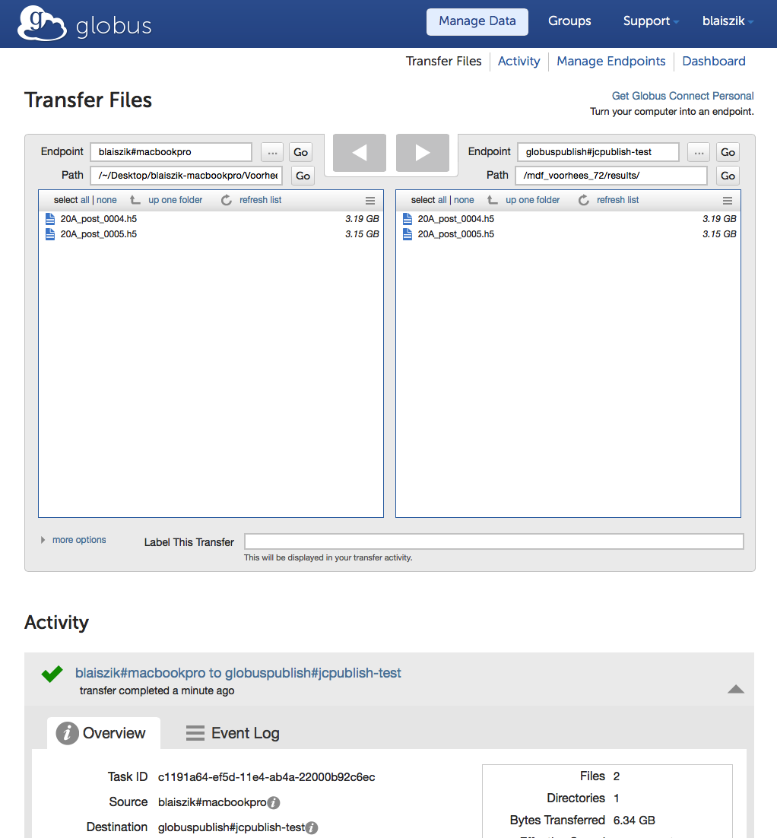
Globus Background
Endpoint
E.g. laptop or server running a Globus client (e.g. Dropbox client)
Enables advanced file transfer and sharing
Currently GridFTP, future GridFTP + HTTP
Some Key Features
REST API for automation and interoperability
Web UI for convenience
Optimizes and verifies transfers
Handles auto-restarts
Battle tested with big data

Slide 12
Where are we Now?
Data Publication

Slide 13
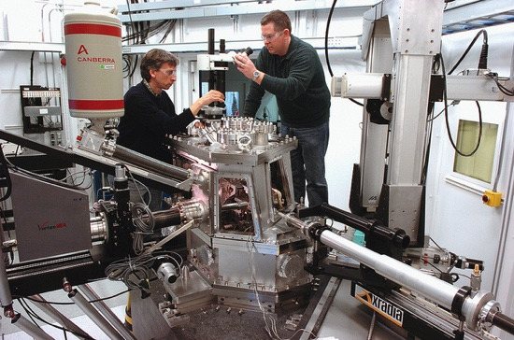
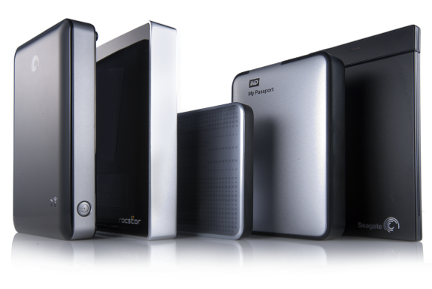
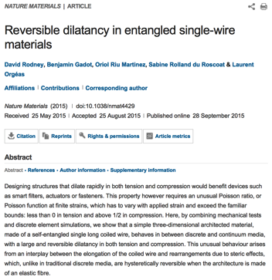
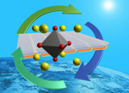
Materials Data Publication/Discovery is Often a Challenge
  Data Collection
  Data Storage and Process
  Publication
Notes:
Bring it back to tangible. Showcase examples of candidate MDF datasets, and explain how they are currently stored on local, unnetwokred hard drives without proper description. MDF unifies and captures these datasets into a highly available location with appropriate description and identification

Slide 14
Materials Data Publication/Discovery is Often a Challenge
  Want to Publish
  Want to Discover / Use
  Data Collection
  Data Storage and Process
  Publication
  ?
  ?
  ?
  Need networked storage, sometimes many TB
  Need to uniquely identify data for search/cite
  Need custom metadata descriptions
  Need a data curation workflow
  Need automation capabilities
Notes:
Bring it back to tangible. Showcase examples of candidate MDF datasets, and explain how they are currently stored on local, unnetwokred hard drives without proper description. MDF unifies and captures these datasets into a highly available location with appropriate description and identification

Slide 15

Materials Data Publication/Discovery is Often a Challenge
  Want to Publish
  Want to Discover / Use
  Data Collection
  Data Storage and Process
  Publication
  Need storage, sometimes many TB
  Need to uniquely identify data for search/cite
  Need custom metadata descriptions
  Need a data curation workflow
  Need automation capabilities
  ?
  ?
  ?
Notes:
Bring it back to tangible. Showcase examples of candidate MDF datasets, and explain how they are currently stored on local, unnetwokred hard drives without proper description. MDF unifies and captures these datasets into a highly available location with appropriate description and identification

Slide 16
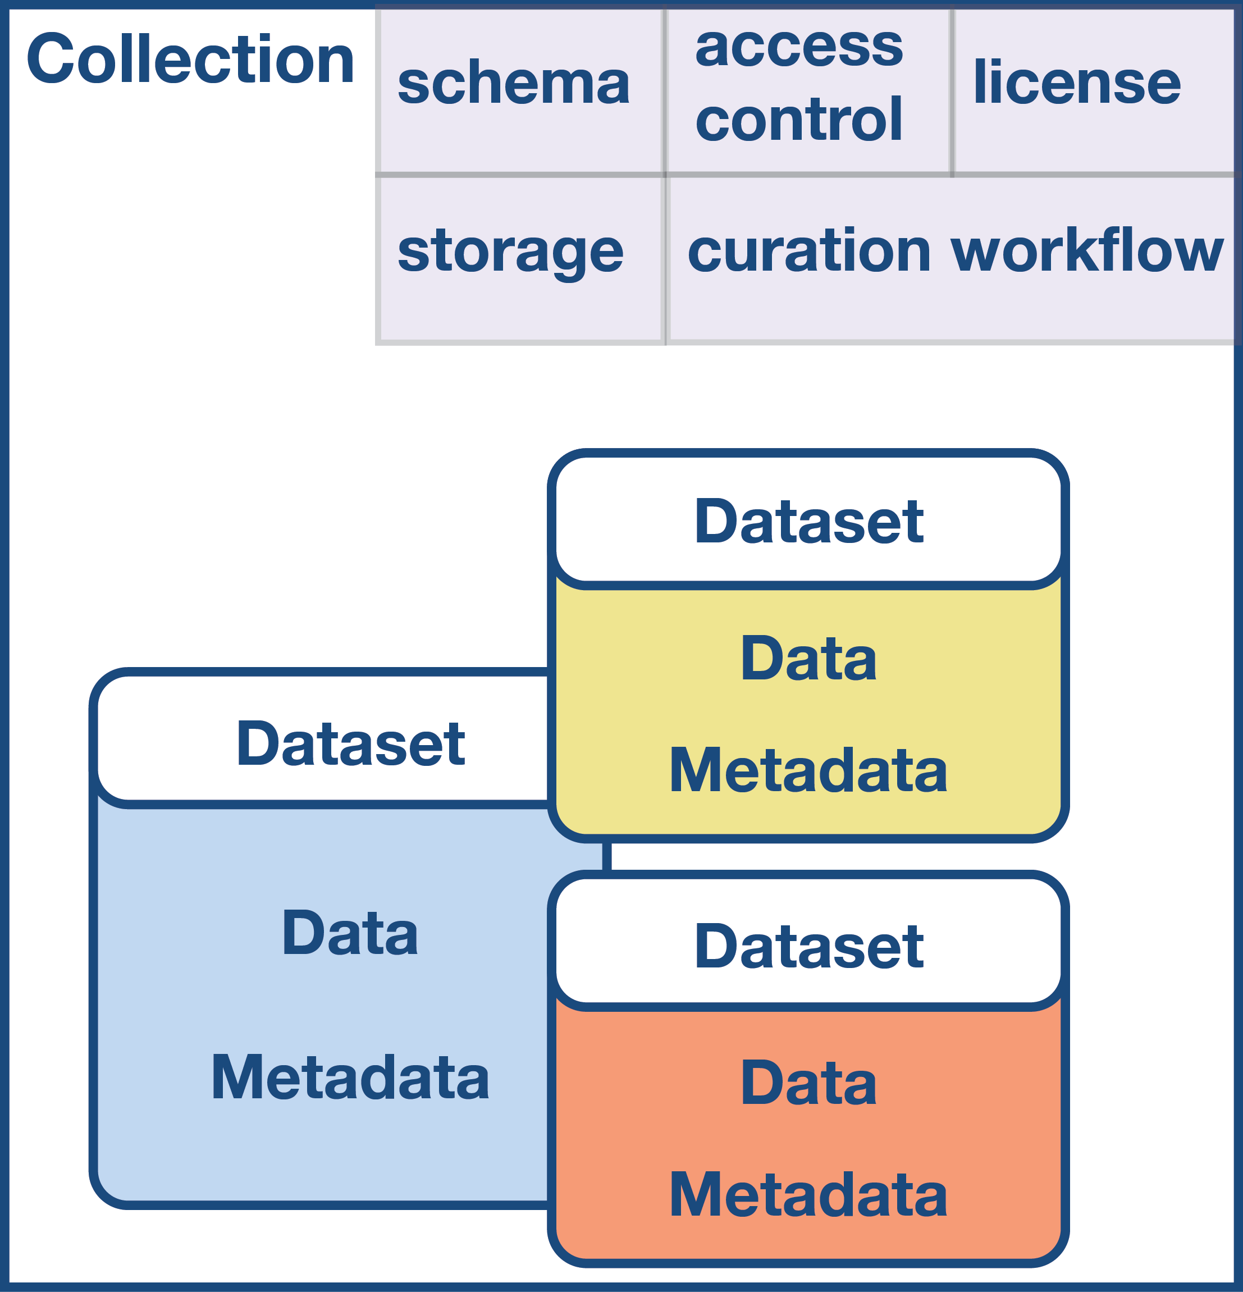
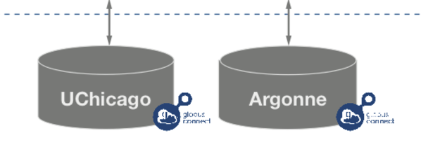
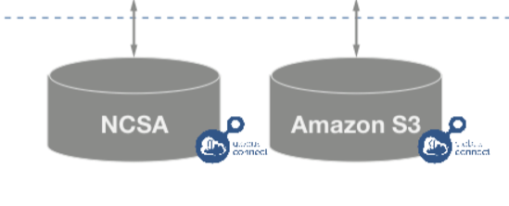
Collection Model
  Collections might be a research group or a research topic...
Collections have specified
  Mapping to storage endpoint
    Currently handled as automatically created shared endpoints
  Metadata schemas
  Access control policies
  Licenses
  Curation workflows
Collections contain
  Datasets
    Data
    Metadata
Metadata Persistence
  Metadata log file with dataset
  Metadata replicated in search index

Slide 17


Publish Large Datasets
Leverages Globus production capabilities for file transfer (i.e. dataset assembly), user authentication, and access control groups
100s of TB of reliable storage @ NCSA, and more storage at Argonne
  Globus endpoint at ncsa#mdf on Nebula
  Expandable to many PBs as necessary
  Automated tape backup for reliability (in progress)
Researchers can optionally use your own local or institutional storage

Slide 18

Uniquely Identify Datasets
Associate a unique identifier with a dataset
  DOI, Handle
Improve dataset discovery and citability
  Aligning incentives and understanding the culture will be critical to driving adoption
Future...
Your work has been cited 153 times in the last year
Researchers from 30 institutions have downloaded your datasets

Slide 19


Share Data with Flexible ACLs
Share data publicly, with a set of users, or keep data private
Leverage Curation Workflows
Collection administrators can specify the level of curation workflow required for a given collection e.g.
  No curation
  Curation of metadata only
  Curation of metadata and files

Slide 20

Customize Metadata
Build a custom metadata schema for your specific research data
Re-use existing metadata schemas
Working in conjunction with NIST researchers to define these schemas
Can we build a system that allows schema:
  Inheritance
    E.g. a schema “polymers” might inherit and expand upon the “base material” of NIST
  Versioning
    E.g. Understand contextually how to map fields between versions
  Dependence
    E.g. Allows the ability to build consensus around schemas
Future...

Slide 21
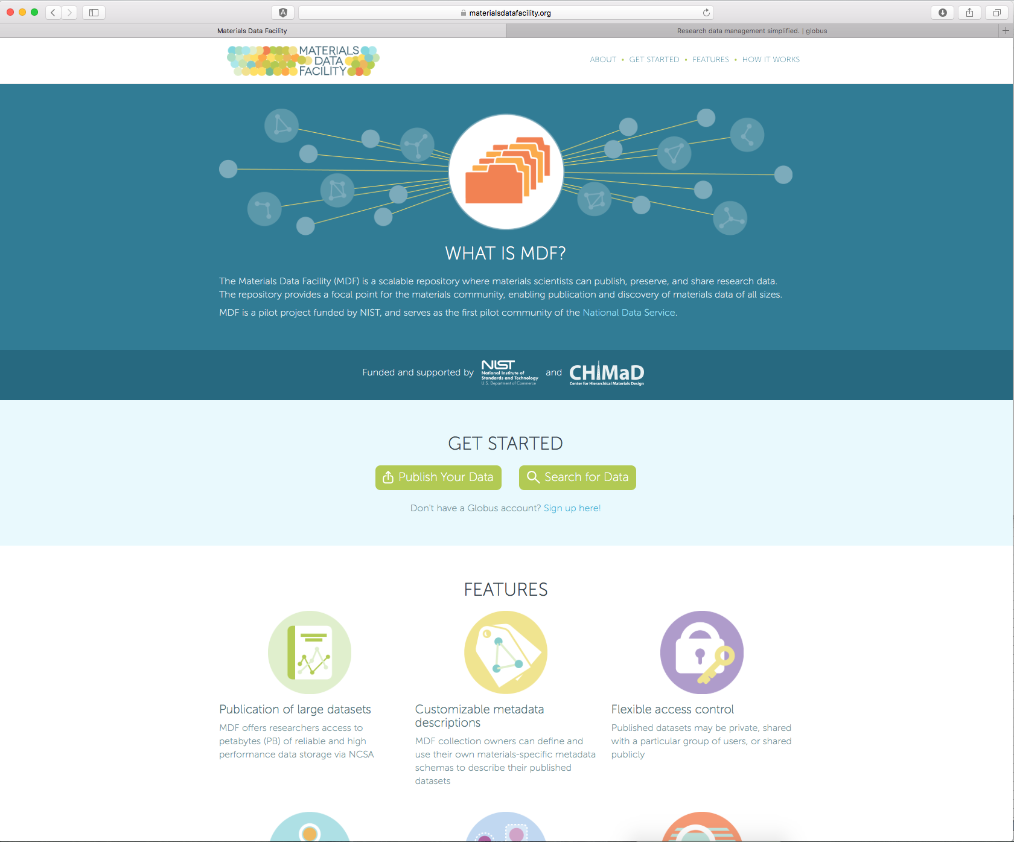
MaterialsDataFacility.org
To get started,
contact Ben Blaiszik
blaiszik@uchicago.edu

Slide 22
MDF Submission Walkthrough

Slide 23
Example Use Case
Publishing Big, Remote Data
Collected multi TB
of data at a light source
Bundle the data with metadata and provenance
Want a citable DOI to share the raw and derived data with the community
Want their data to be discoverable by free text search and custom metadata

Slide 24
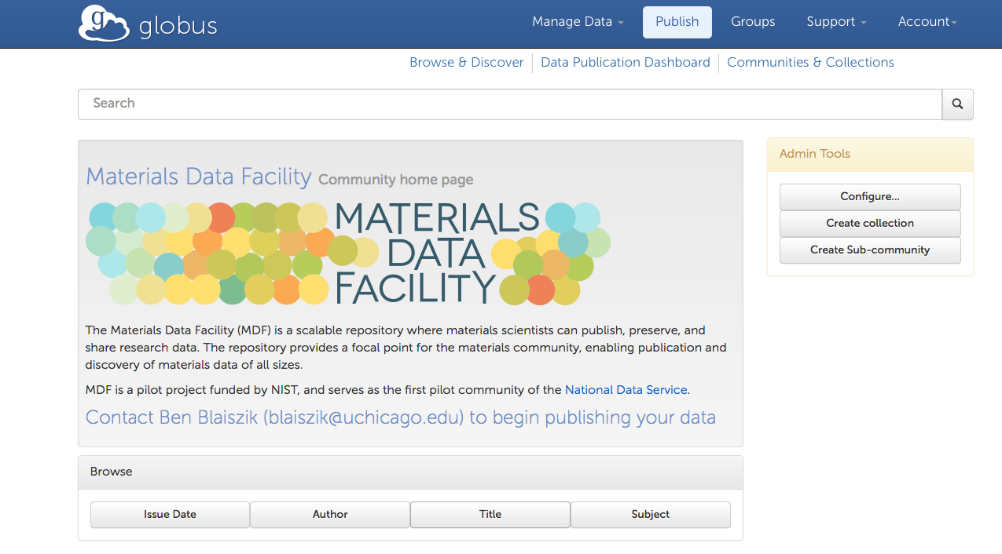
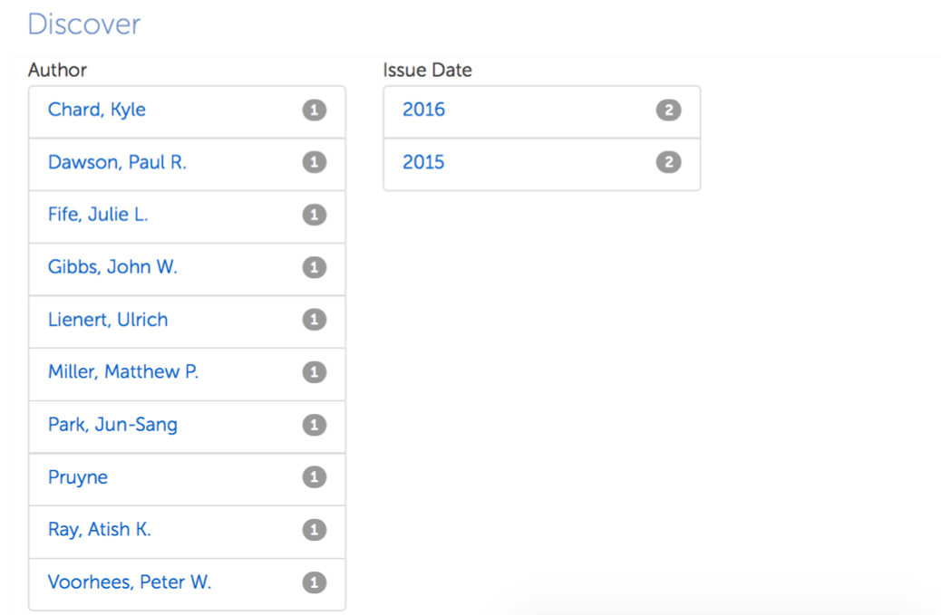
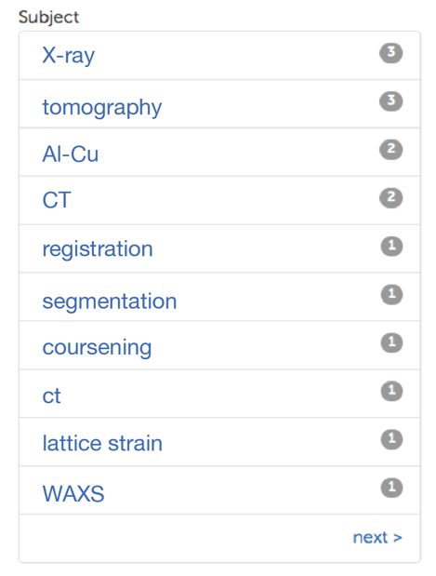
MDF Collection Home

Slide 25
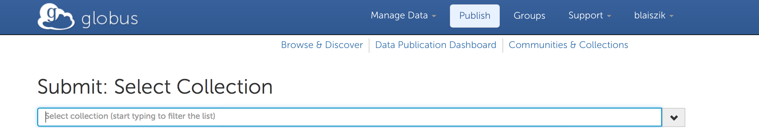
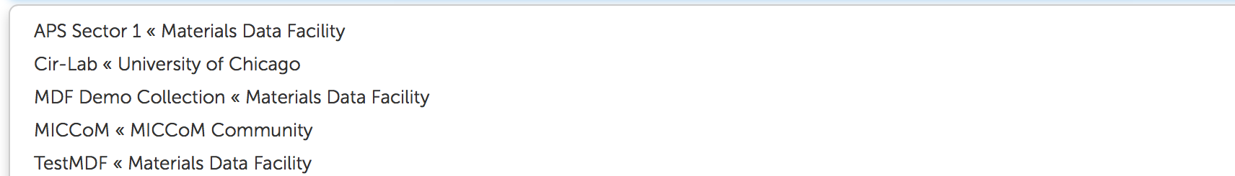
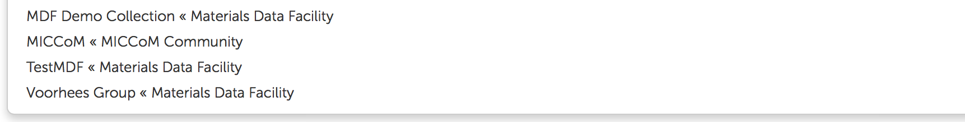
MDF Collections
Recall: Policies Set at the Collection Level
Required metadata, schemas
Data storage location
Metadata curation policies

Slide 26
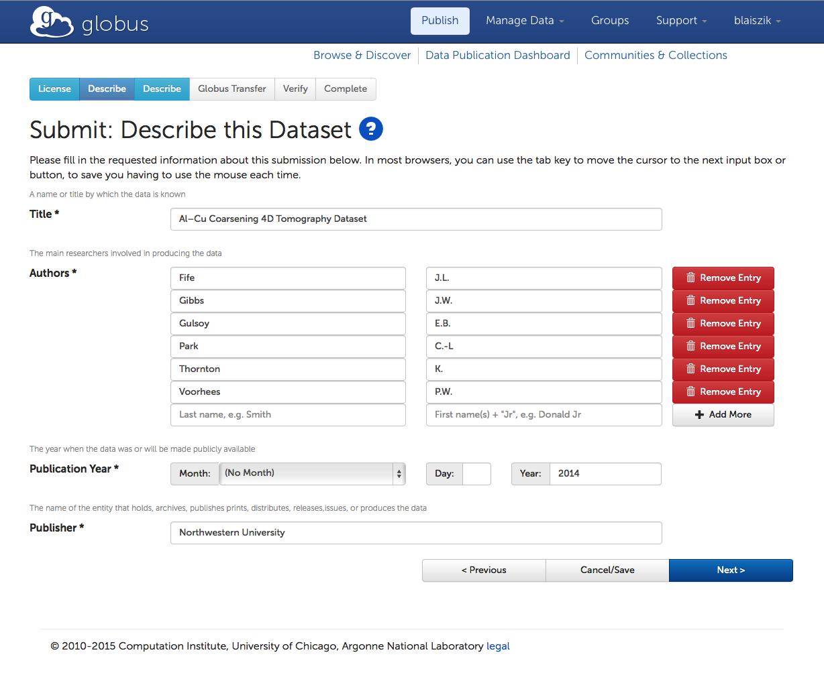
MDF Metadata Entry
Scientist or representative describes the data they are submitting
For this collection Dublin Core and a custom metadata template are required

Slide 27
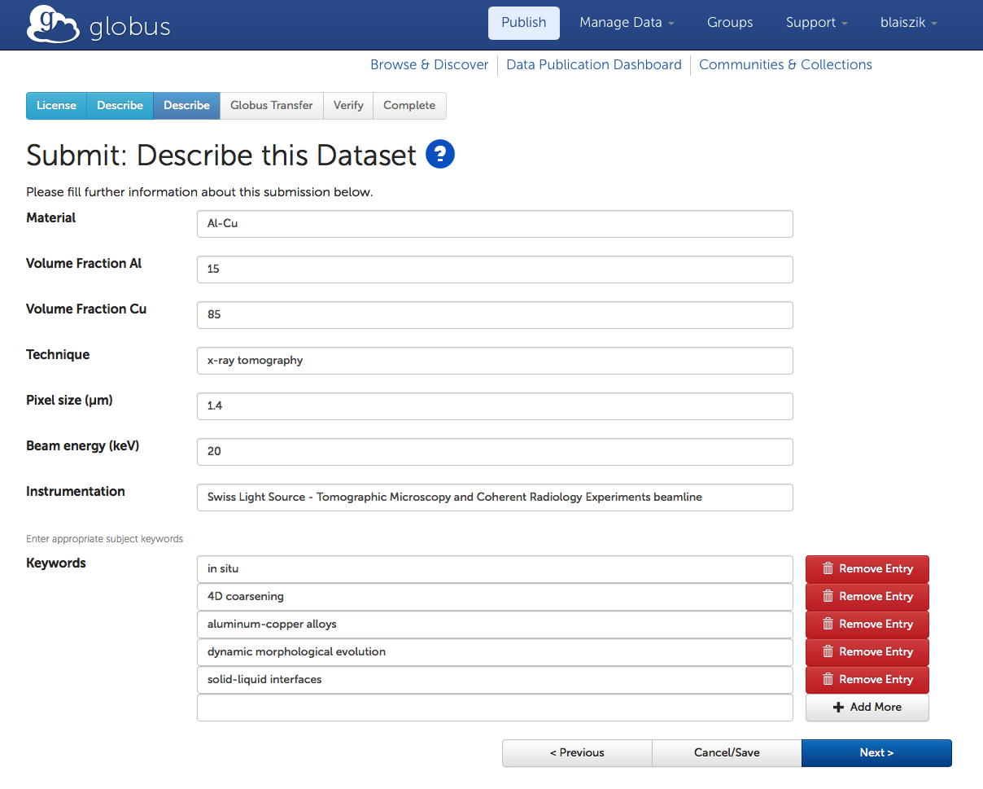
MDF Custom Metadata
Scientist or representative describes the data they are submitting
For this collection Dublin Core and a custom metadata template are required

Slide 28
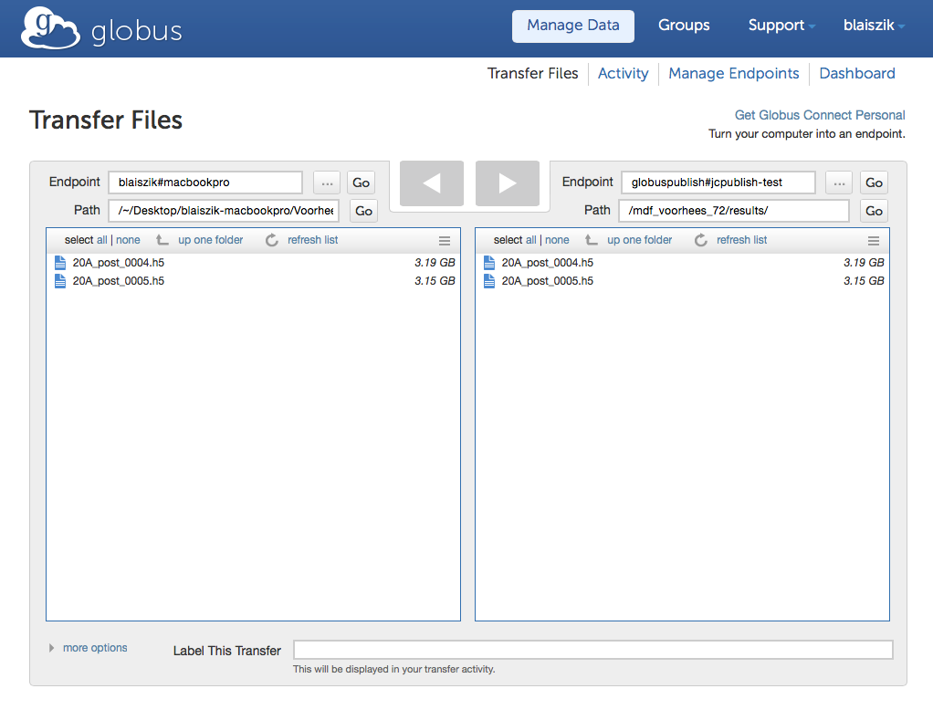
Dataset Assembly
Shared endpoint is auto-created on collection-specified data store
Scientist transfers dataset files to a unique publish endpoint
Dataset may be assembled over any period of time
When submission is finished, dataset will be rendered immutable via checksum
(e.g. NWU)
Materials Data
Facility
(UIUC Nebula)

Slide 29
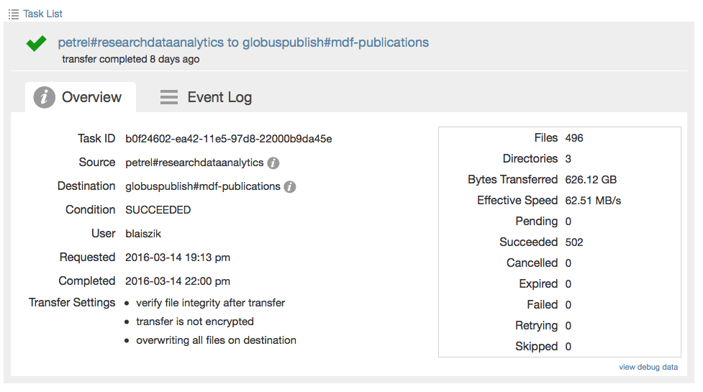
Dataset Assembly
Shared endpoint is auto-created on collection-specified data store
Scientist transfers dataset files to a unique publish endpoint
Dataset may be assembled over any period of time
When submission is finished, dataset will be rendered immutable via checksum
(e.g. NWU)
(e.g. UIUC Nebula)

Slide 30
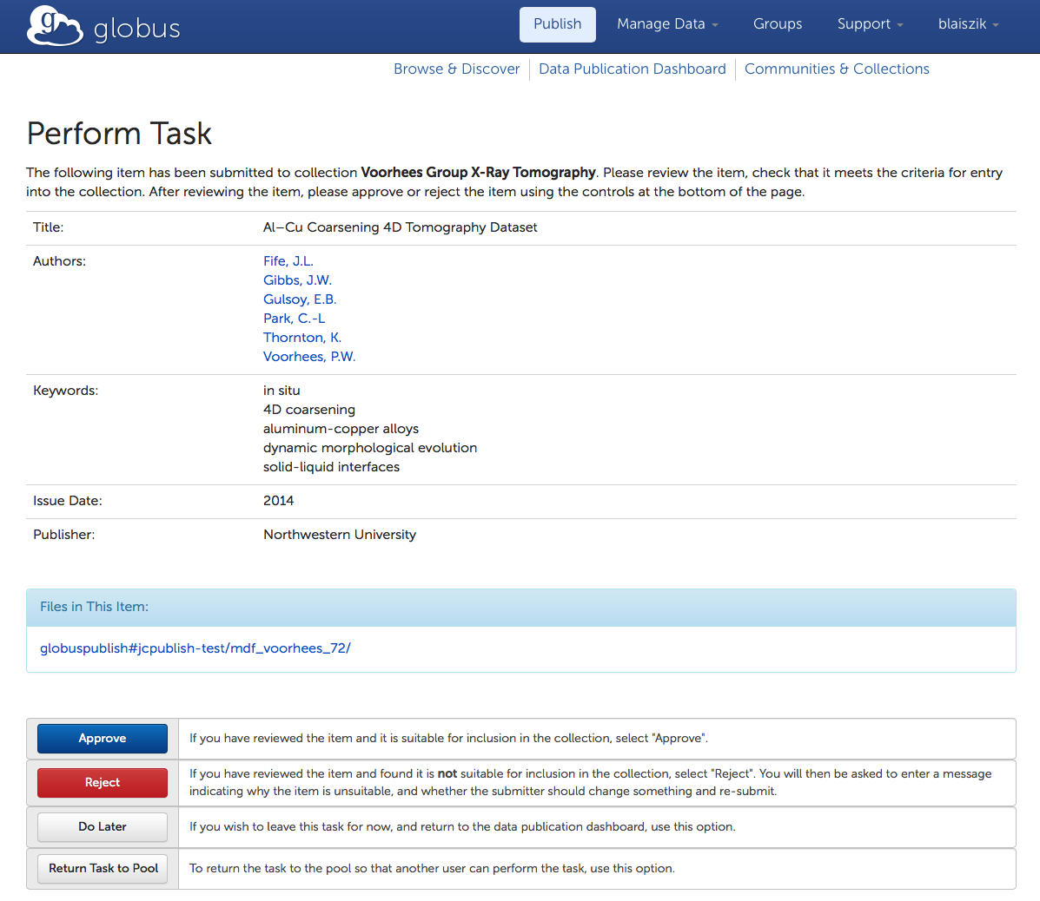
Dataset Curation
Optionally specified in collection configuration
Can be approved or rejected (i.e. sent back to the submitter)

Slide 31
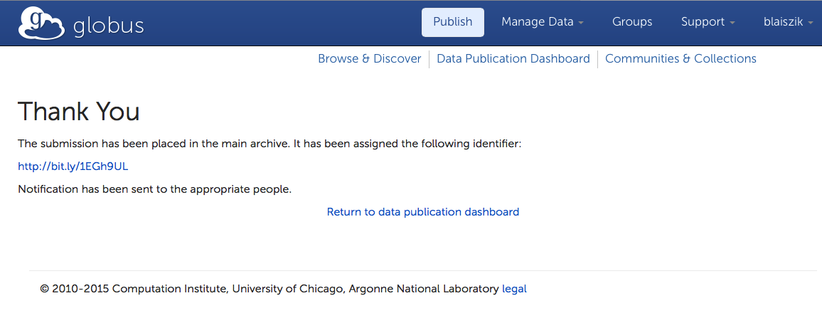
Mint a Permanent Identifier
Can optionally be DOI or Handle

Slide 32
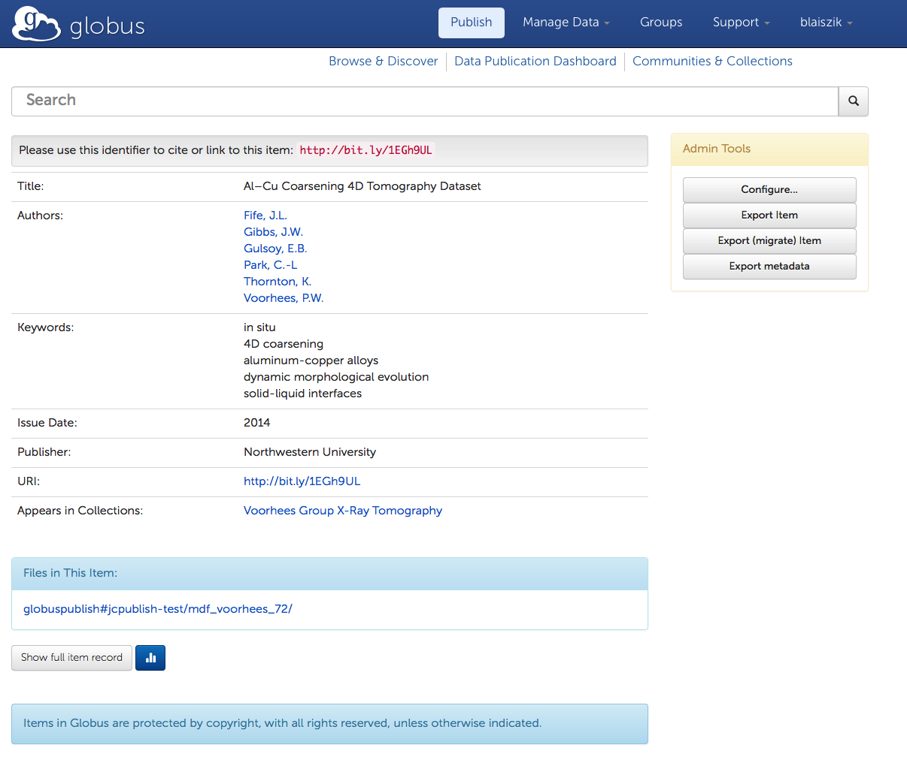
Dataset Record

Slide 33
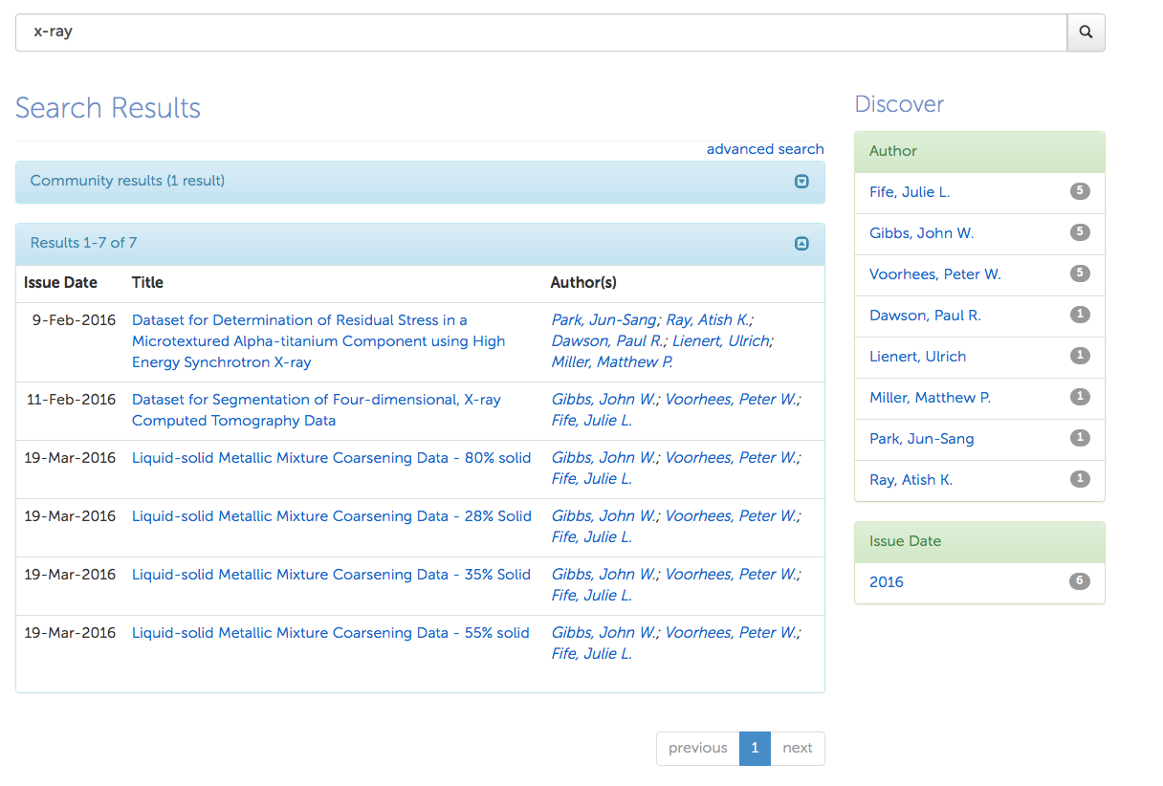
Dataset Discovery

Slide 34
Registering Materials Resources
[w/ NIST – Youssef, Dima]

Slide 35
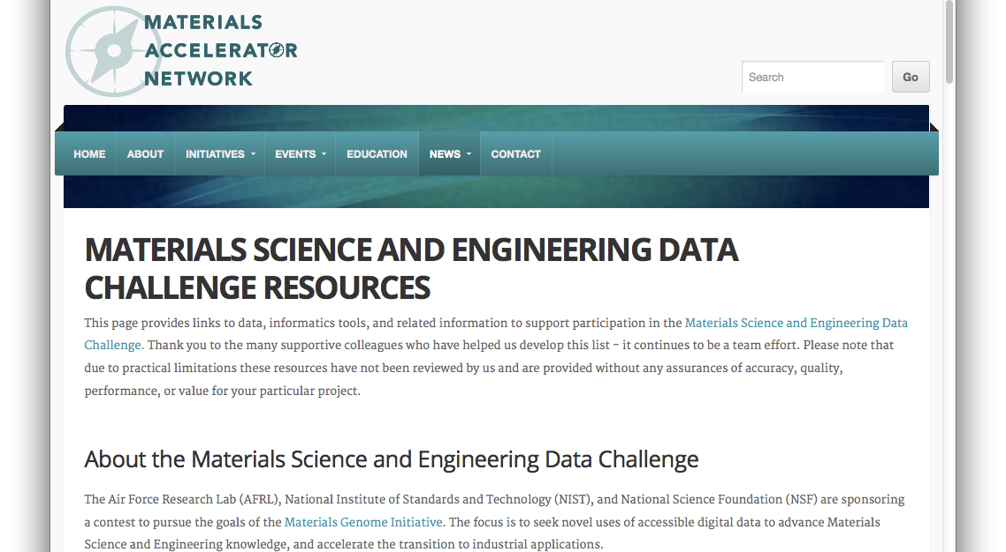
Materials Resource Registry
Materials Science Data Challenge
http://acceleratornetwork.org/mse-challenge/

Slide 36
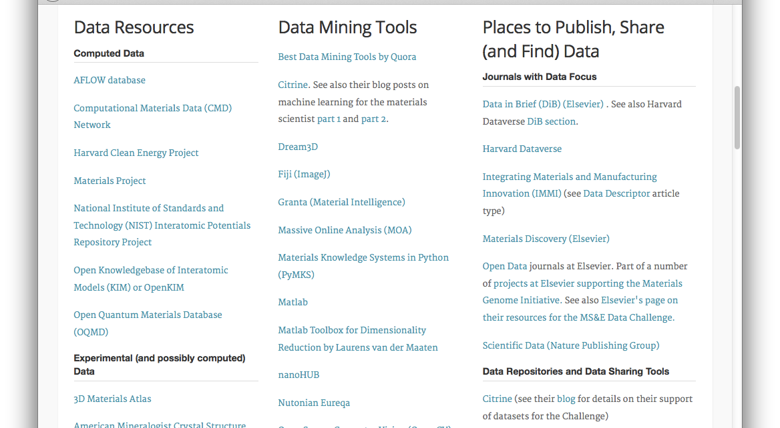
Materials Resource Registry
Materials
Accelerator Network

Slide 37
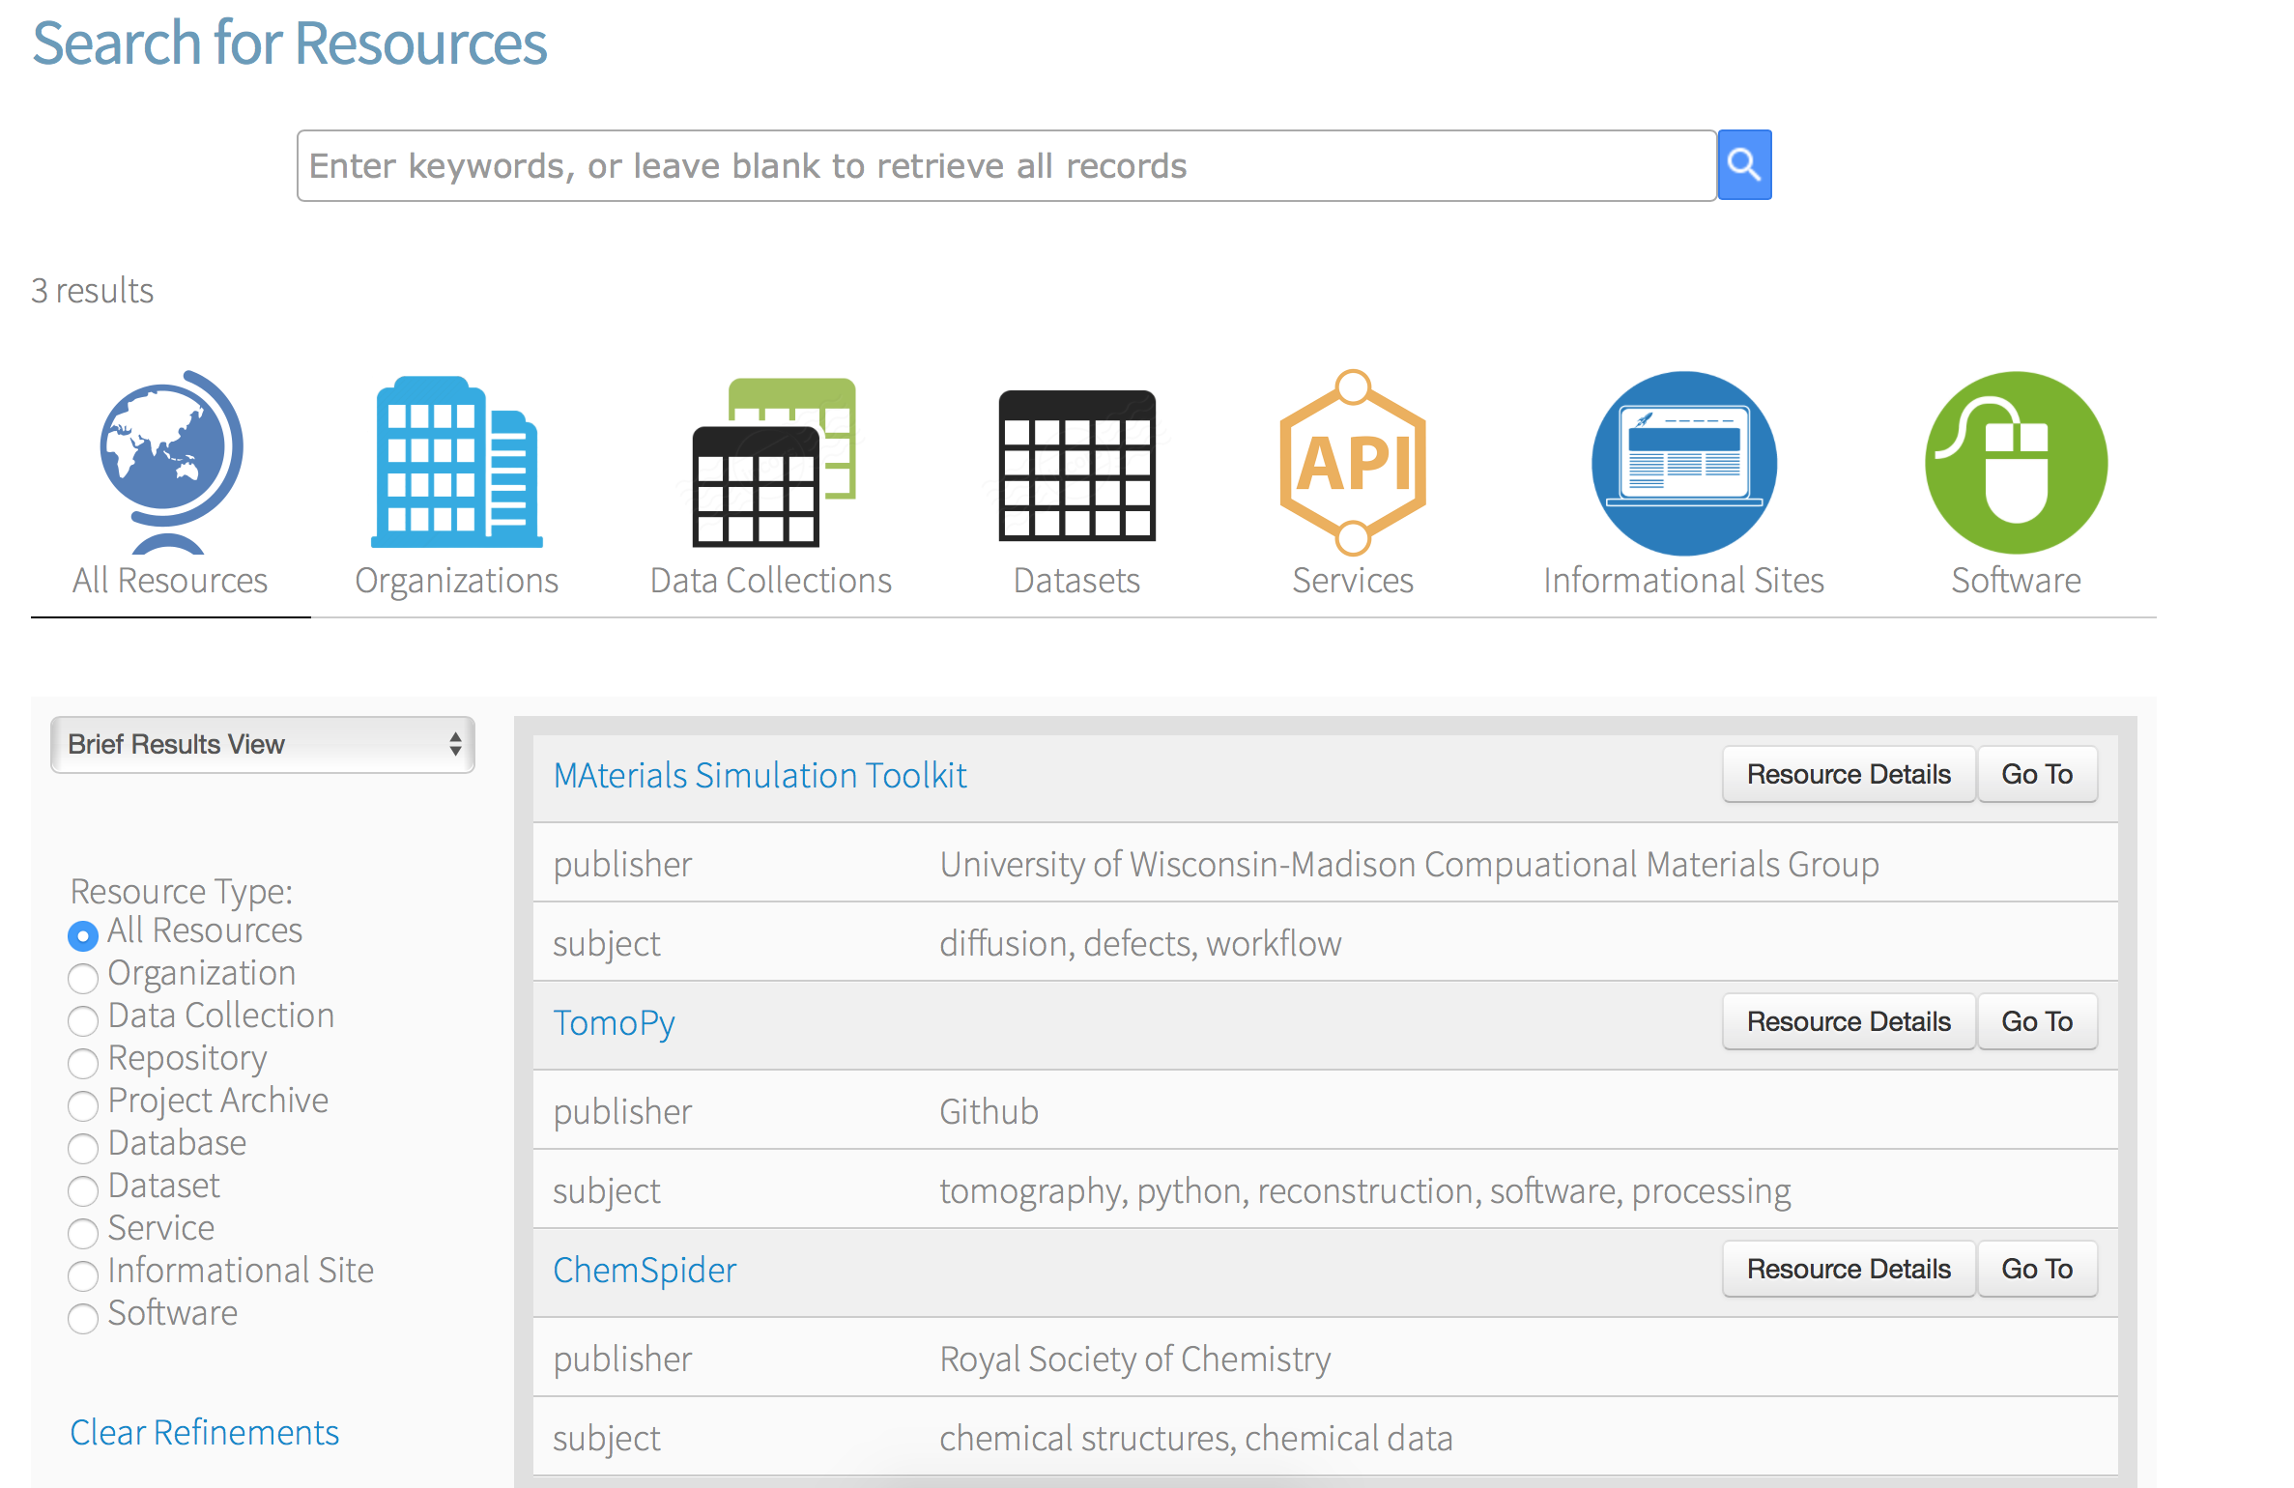
Materials Resource Registry
Browse Results
[w/ NIST - Youssef, Dima]

Slide 38
What’s Currently Available?
Web interface to support data publication via Globus platform (identify management, user groups, optimized big data transfer)
100s of TB of storage at NCSA (scalable to many PB) more at Argonne (1.7 PB on Petrel)
Help with developing metadata schemas to describe your research datasets
Materials resource registry. Email me to get your resource added! (blaiszik@uchicago.edu)

Slide 39
What are we looking for?
Early adopters, willing to get their hands dirty with the service and give honest feedback
Key datasets and resources of all sizes, shapes, raw or derived, that might help us understand the process better

Slide 40
Next Steps
now
Identify datasets to pilot publication pipelines and build schema repository
Engage with researches working with materials data to understand use cases and learn friction points
Please talk to us if you have data you want to share, publish, discover, …

Slide 41
Presentations
B. Blaiszik, K. Chard, R. Ananthakrishnan, J. Pruyne, J. Wozniak, M. Wilde, R. Osborn, S. Tuecke, I. Foster. “Globus Research Data Management Services and the Materials Data Facility”, Sept. 2015, Center for PRedictive Integrated Structural Materials Science (PRISMS) Annual Meeting,
B. Blaiszik, K. Chard, J. Pruyne, J. Towns, S. Tuecke, I. Foster. “The Materials Data Facility (MDF) – Data Services to Advance Materials Research”, Oct. 2015, Materials Science and Technology Conference , Columbus, OH, USA.
Ian Foster, B. Blaiszik, K. Chard. “The Materials Data Facility”, Oct. 2015, 4th National Data Service Consortium Workshop, San Diego, CA, USA.
B. Blaiszik, K. Chard, I. Foster. “The Materials Data Facility (MDF) – Data Services to Advance Materials Research”, Dec. 2015, National Center for Supercomputing Applications Joint Materials Science Seminar, University of Illinois at Urbana-Champaign, Urbana, IL, USA.
B. Blaiszik, K. Chard, I. Foster. “The Materials Data Facility (MDF) – Data Services to Advance Materials Research”, Dec. 2015, Integrated Imaging Initiative Seminar, Argonne National Laboratory, Lemont, IL, USA.
M. Ondrejcek, B. Blaiszik, K. Chard, J. Pruyne, R. Ananthakrishnan, J. Towns, K. McHenry, S. Tuecke, I. Foster. “Materials Data Facility - Data Services to Advance Materials Science Research”, Feb. 2016, T2C2 DIBBS Meeting, University of Illinois at Urbana-Champaign, Urbana, IL, USA.
B. Blaiszik, K. Chard, J. Pruyne, R. Ananthakrishnan, J. Towns, S. Tuecke, I. Foster. “Materials Data Facility - Data Services to Advance Materials Science Research”, Feb. 2016, (invited) TMS 2016, Nashville, TN, USA.

Slide 42
Publications
Kyle Chard, Jim Pruyne, Ben Blaiszik, Rachana Ananthakrishnan, Steven Tuecke, and Ian Foster. "Globus Data Publication as a Service: Lowering Barriers to Reproducible Science." In e-Science (e-Science), 2015 IEEE 11th International Conference on, pp. 401-410. IEEE, 2015.
Ben Blaiszik, Kyle Chard, Jim Pruyne, Rachana Ananthakrishnan, John Towns, Steven Tuecke, and Ian Foster. “Building a Materials Data Facility- Data Services to Advance Materials Science Research”, Materials Science and Technology 2015, 2015.
Manuscript in prep for special issue of JOM on materials data services

Slide 43





Thanks to Our Sponsors!
U.S. DEPARTMENT OF
ENERGY

Slide 44
Lessons Learned

Slide 45
Lessons Learned
The demand is there from researchers and institutions
Lots of cross-over with centers and projects
  (NIST) CHiMaD
  (DOE) MICCoM, JCESR, PRISMS, Argonne, I³
  (NSF) T2C2 [DIBBS], AMI-CFP (PIRE), HV/TMS (I/UCRC), IMaD BD Spoke*
Data Heterogeneity is a challenge
Friction points
  Data model (v 1.0)
    Need data objects e.g. {“temperature”:100, “unit”:“K”}
    Likely need finer grained metadata capabilities (i.e. file-dir level)
  More data flavors (immutable alone is not enough)
  Data gathering in retrospect
  Schema generation and interoperability
    Working with NIST, RDA, Citrine et al.
  Differing approval processes
  Lack of programmatic interface (planned). e.g. Integration with other institutional publication platforms
Support for data interactivity and visualization
Versioning
Notes:
PIRE: Integrated Computational Materials Engineering for Active Materials and Interfaces in Chemical Fuel Production
Center for Novel High Voltage/Temperature Materials and Structures
PRedictive Integrated Structural Materials Science

Slide 46
Data Interaction
And Viz
Data-driven experiments using HPC resources and workflow technologies
Real-time interaction with data regardless of data location (pending appropriate data access) and data size
(future) Machine learning across datasets and storage locations
(future) Automated discovery support
APIs
Cloud DB
data, metadata, pointers
data, metadata, pointers
Experiment
Analytics
Simulation

Slide 47
Data Publication Pipeline Analysis
Enter Proceed Pending x
23 15 7 1
Initiate Engagement
14 6 8 0
Gather Data
6 3 3 0
Describe Data
3 2 1 0
Publish Data
Numbers for late Nov. – early Feb.
  A bit misleading since some of these are groups or centers rather than individuals
No lossy stages detected yet
Rate limiting step is data gathering+ data description
  Building metadata schema
  Populating schema with dataset values

Slide 48

Discover Research Datasets
Search on file metadata, custom metadata, and indexed file-level data
Goal: Intuitive search (e.g. Google-style) with support for more complex range queries and faceting (e.g. Amazon-style)

Slide 49
Globus Background
Endpoint
E.g. laptop or server running a Globus client (e.g. Dropbox client)
Enables advanced file transfer and sharing
Currently GridFTP, future GridFTP + HTTP
Some Key Features
REST API for automation and interoperability
Web UI for convenience
Optimizes and verifies transfers
Handles auto-restarts
Battle tested with big data

