Slide 1





Progress and Challenges in Polymer OPV Solar Cells.
CHiMAD Use-Case Group on Organic Photovoltaics
Research Team: Luping Yu, Tobin Marks, Juan De Pablo, Giulia Galli, Lee J. Richter (NIST).
Collaborators: Ryan Nieuwendaal, Dean DeLongchamp, (NIST), Wei Chen and Lin Chen (ANL, NWU), Monica Olvera (CHIMAD, NWU).

Slide 2
Design Goals of Use Group
Develop innovative OPV materials and processes for improved performance and stability at a reduced cost.
Transition from conventional platforms based on fullerene acceptor to all organic acceptors
Apply MGI principles to critical issues in structure/function and processing/structure relationships to accelerate OSC device development.
Approaches
Molecular Structure/Function
Synthesis of new structures to test structure/function relationships
Development of new theoretical methods for electronic processes
Computer aided identification of new synthetic motifs
Process/Device Structure
Exploration of novel process/structure paradigms
Development of new large-scale modeling approaches to simulate aggregation, crystallization, phase de-mixing, additive effects, and charge transport Quantitative models for morphology evolution during solution casting

Slide 3
Significance of the Use-Case Group
Bulk heterojunction organic solar cells (OSCs) - an alternative solar energy harvesting system.
New materials exhibiting superior photovoltaic properties are being developed, and their synergy is being studied.
Ternary OSCs developed with PCE>10.5%.
Our theoretical understanding in structure/property relationships deepened.
Synergy with effort by NIST scientists is evolving.
Molecules developed can find applications in organic electronics.

Slide 4
Paper published acknowledging CHiMAD support:
1. Luyao Lu, Mary Allison Kelly, Wei You, LP Yu, Status and prospects for ternary organic photovoltaics, Nature Photonics 9 (8), 491-500, 2015
2. L Lu, T Zheng, Q Wu, AM Schneider, D Zhao, L Yu, Recent Advances in Bulk Heterojunction Polymer Solar Cells Chemical Reviews, 2015, DOI: 10.1021/acs.chemrev.5b00098
3. Luyao Lu, Wei Chen, Tao Xu, Luping Yu, High performance ternary blend polymer solar cells involving both energy transfer and hole relay processes, Nature Commun., 6, 7327, 2015.
4. Schneider, Alexander; Lu, Luyao; Manley, Eric; Zheng, Tianyue; Xu, Tao; Marks, Tobin; Chen, Lin; Yu, Luping, Wide Bandgap OPV Polymers Based on Pyridinonedithiophene and Their Use as an Efficient Energy Relay in Ternary Organic Solar Cells, Chemical Science, 6 (8), 4860-4866, 2015. DOI: 10.1039/C5SC01427A,
Patents – Donglin Zhao, Qinghe Wu, Luping Yu, Electron acceptors based on alpha-position substituted PDI for OPV solar cells. In progress.

Slide 5
Review committee recommendations
Relevance of OPV research to renewable energy
Concerns about OPV Lifetimes
Collaborative Effort with NIST Scientists

Slide 6
Uniqueness of This USE Case
Why us?
Unique materials-Best donor and non-fullerene materials
Best simulation capabilities-both electronic and molecular dynamic
Theory guided design and synthesis of new materials
Best characterization capability in team with NSIT.
Close collaborations among team groups

Slide 7


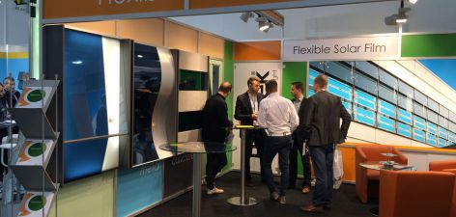

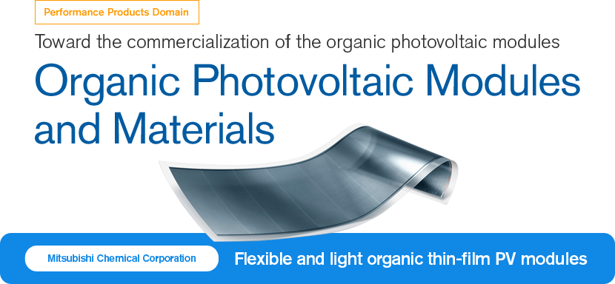

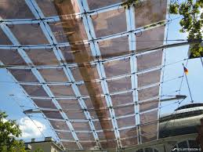

Relevance to Industry and Industrial connection
OPV Industrial Commercialization Activity
Heliatek (Ger):
13.2% - claimed OPV world record efficiency
US + Taiwan, (Polyera JV)
Japan
NEXT Energy Technologies (US)
Germany

Slide 8
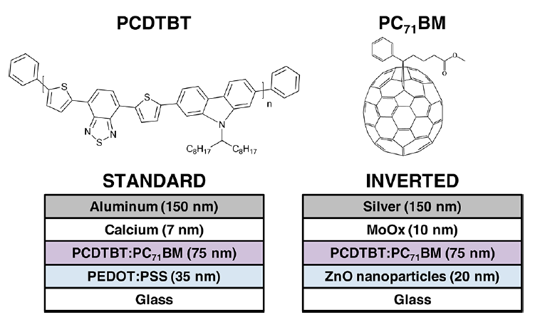
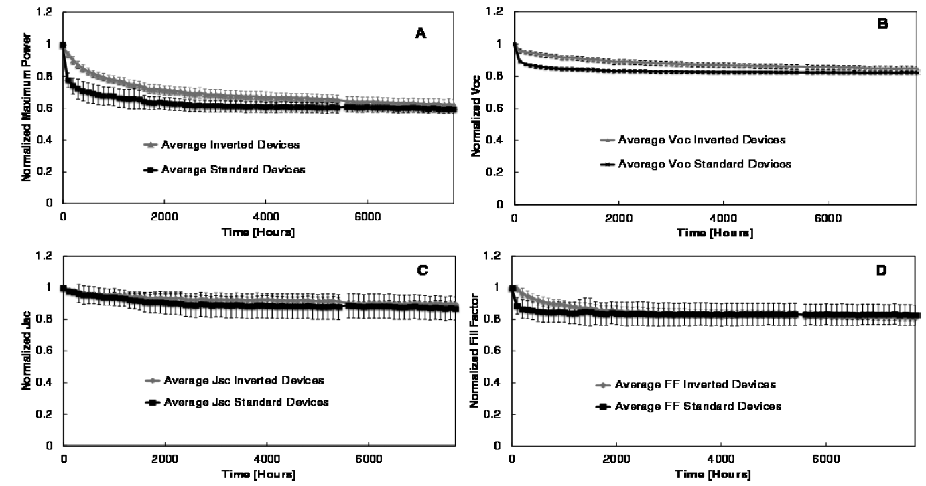


Concerns on OPV Solar Cell Stability
Table 1. Average Extrapolated Solar Cell Lifetimes
architecture lifetime lifetime (years)
(hours simulated
sunlight)
standard 41 000 20
inverted 16 000 8

Slide 9
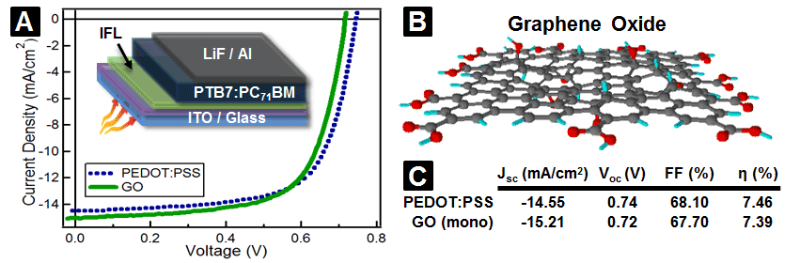
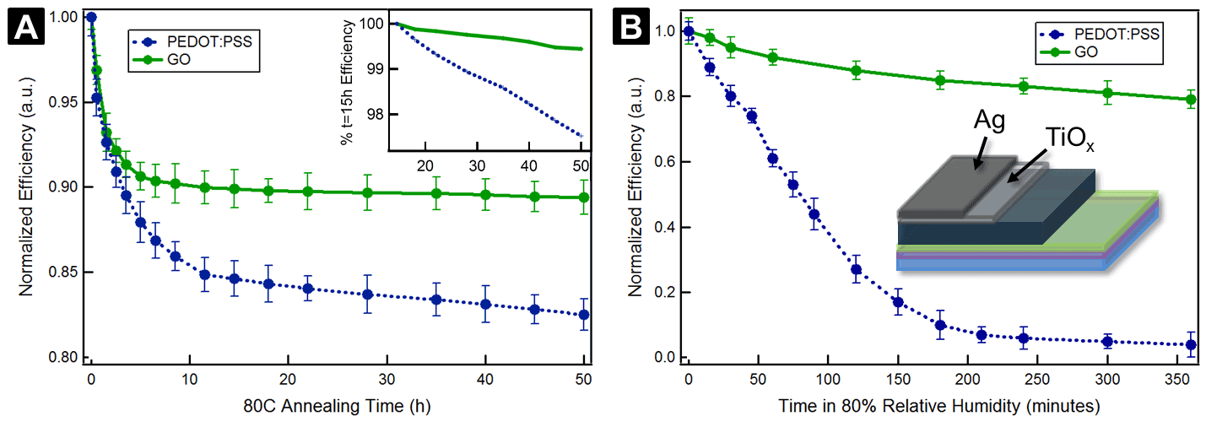
Hersam, Yu, Marks, et al, The Journal of Physical Chemistry Letters 2 (24), 3006-3012, (2011).

Slide 10
Collaborative Effort with NIST Scientists
Student training and research at NIST.
Measurements on HOMO/LUMO and glass transition temperature.
Synthesis of deuterated PTB1 for NMR studies and validation of theoretical models.
Monthly group meeting.

Slide 11
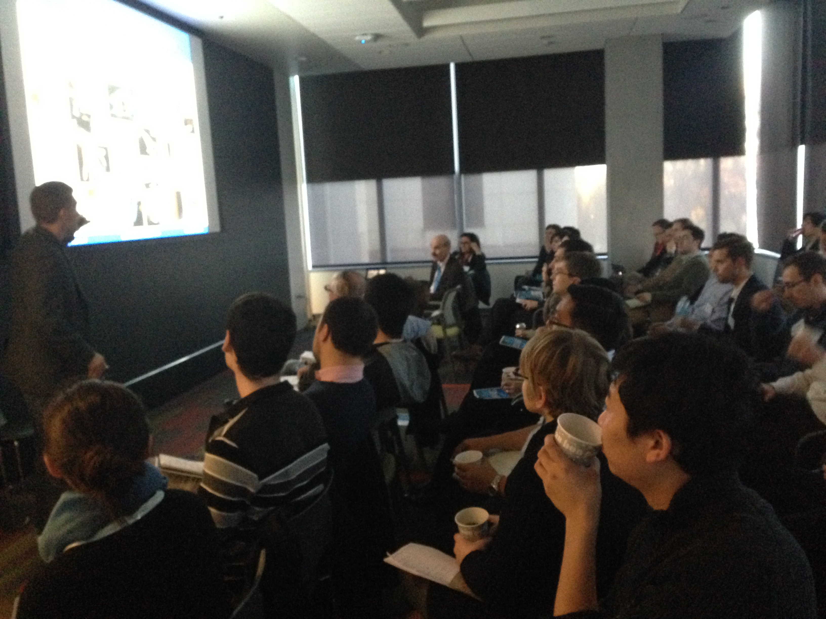
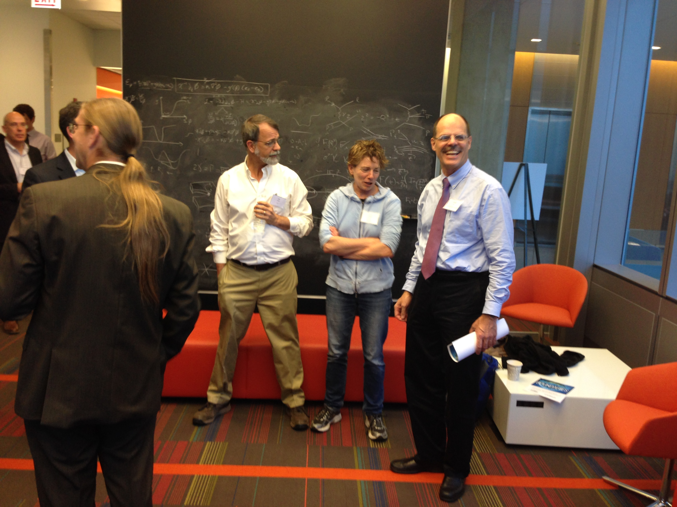
Symposium on
Advances and Challenges in Soft Matter Photovoltaic Research
Sponsored by CHiMAD and NIST, 11/13-14/2015
Organizer: Luping Yu, Tobin Marks and Lee Richter Jr.
Attended by: > 50 people. 11 speakers.
Major theme of the symposium:
To discuss recent advances, and to identify the grand challenges for development of organic solar cells.
To examine emerging tools, particularly predictive computational methods and data-base related strategies, and their role in advancing OPV science and related areas (e.g., organic electronics).
Place this Use Case in global context and identify strategic design opportunities.

Slide 12




NIST/CHiMaD Joint Symposium:
Advances and Challenges in Soft Matter Photovoltaic Research
Eckhardt Research Center 5640 South Ellis Avenue Chicago, IL
Speakers:
Mark Ratner (NWU), Chad Risko (UK)
Lin Chen (NWU/ANL), Ross Larsen (NREL),
Jenny Nelson (Imperial, UK). Monica Olvera (NWU) Chad Snyder (NIST), David Gundlach (NIST),
Harald Ade (NCSU) Juan de Pablo (UC),
Giulia Galli (UC)
Speakers:
Open Discussion Sessions:
8:30-10:00 Materials Design
10:15-12:00 Blend Morphology
1:15-2:45 Device Fabrication
3:00-4:30 Theory and Database
Sponsoring Organizations:

Slide 13
Significant Achievements at Year 2
Developed efficient ternary blend OSC with a PCE of 10.5% and showed that the third component can reduce surface trap densities in the ternary blend.
New organic electron acceptors were developed that can rival to fullerene in OPV devices.
Marks developed a new building block, bithiphenesulfoamide, as a new photovoltaic materials component. It was designed and developed to offer a strongly electron-withdrawing and strongly dipolar sulfonamide group.
Galli and Goldey examined the electronic structures and properties of the donor (PTB7) and the acceptor material (PC71BM). Energy levels match experimental cyclic voltammetry data well, with errors of 0.1 eV. Hole transfer rate was calculated, which explain the experimental results.
De Pablo carried out molecular simulation of OPV-relevant materials and investigated the ring stacking behavior of single PTB7 molecules with and without its sidechains, and that of PTB7 in the bulk. The potential energy map between donor and acceptor interaction was calculated.

Slide 14
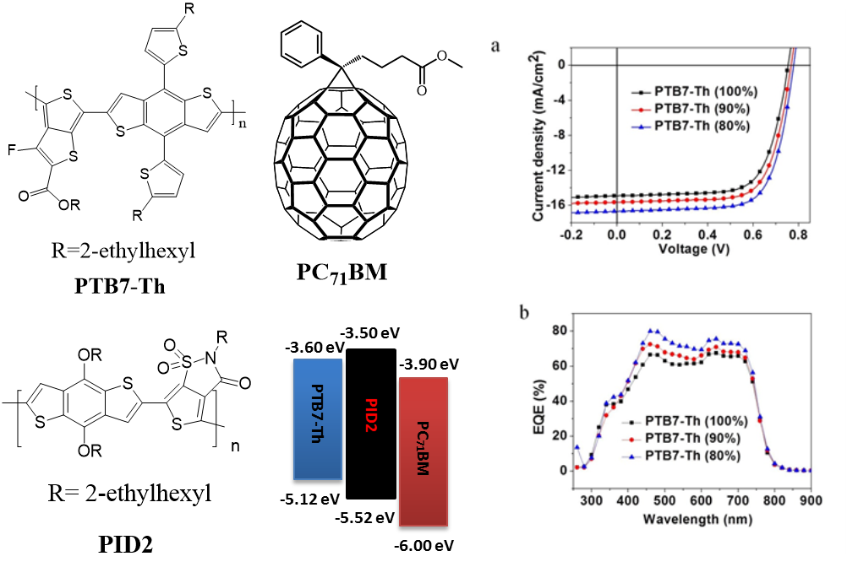
Ternary Blend Polymer Solar Cells with High Power Conversion Efficiency (Yu, Lu, Shaparov)
DESIGN GOALS
Develop OPV solar cells with high efficiency , low cost and long term stability.
Establish structure/property relationship via synthesis, physical characterization, theoretical investigation and device engineering to guide further explorations of new and more efficient materials.
Use theory as guidance in development of new materials.
PTB7-Th:PID2:PCBM Ternary OPV System
Insert
New polymers with varied band gaps were synthesized either as electron donor or acceptors.
Ternary OPV solar cells were developed that exhibit high efficiency and large enhancement.
New methods are being developed to modify the generic molecular dynamics force field method to fully describe the aromatic semiconducting polymers.
Electronic properties of these polymers are modelled based on sophisticated quantum mechanical calculation.
L. Lu, et al., Nature Commun., 2015, 6, 7327.

Slide 15
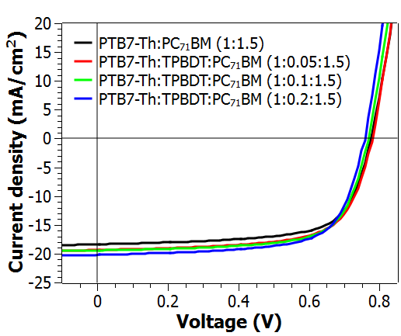
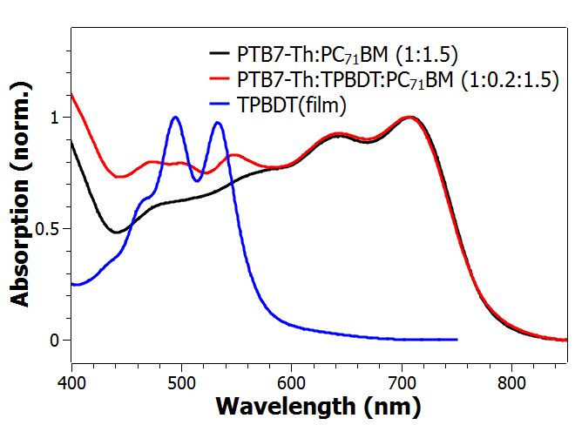
Ternary OSC with PTB7-Th and Two acceptors
Inverted device architecture: ITO/ZnO/PTB7-Th:TPBDT:PC₇₁BM/MoO₃/Ag
Active layer | V_{oc}, (V) | J_{sc}, (mA/cm²) | FF, (%) | PCE, (%) | Highest PCE, (%)
PTB7-Th:PC7₁BM (1:1.5) | 0.77±0.01 | 18.1±0.1 | 67.9±0.7 | 9.5±0.1 | 9.8
PTB7-Th:TPBDT:PC7₁BM (1:0.05:1.5) | 0.77±0.01 | 18.7±0.2 | 67.2±0.2 | 9.8±0.1 | 10.2
PTB7-Th:TPBDT:PC7₁BM (1:0.1:1.5) | 0.76±0.01 | 19.4±0.2 | 68.3±0.8 | 10.1±0.1 | 10.3
PTB7-Th:TPBDT:PC7₁BM (1:0.2:1.5) | 0.77±0.01 | 19.6±0.4 | 67.7±0.2 | 10.1±0.2 | 10.5
-3.6
-3.9
-3.9
Energy, eV
PTB7-Th
TPBDT
PC₇₁BM
-5.2
-5.7
-6.0

Slide 16


Theoretical Studies on Ternary System
(de Pablo, Yu and Galli)
Question:
What causes increased efficiency for ternary system?
Theoretical studies:
Electronic structures and photophysical processes
Force-field molecular dynamic simulation
Results:
Our calculations show hole-transfer kinetics between PID2 and PC71BM are much faster than between PTB7 and PC71BM
Properties of solvents control chain conformation.
16
Notes:
16

Slide 17
Electronic structure properties as signatures of morphological motifs in organic photovoltaics
Matthew Goldey and Giulia Galli
Extended chain configurations
Ground state
energy levels
Charge transport
at interfaces
Disorder at finite temperature

Slide 18


Methods
Exchange-correlation functional Perdew-Burke-Ernzerhof (PBE/PBE0), Becke 3-parameter Lee-Yang-Parr (B3LYP), and revised Vydrov and Van Voorhis vdW-functional (rVV10)
Norm-conserving Troullier-Martins pseudopotentials, with a kinetic energy cutoff of 85 Ry
Maximally localized Wannier functions
First principles molecular dynamics
http://quantum-espresso.org/
Gianozzi, et al. J. Phys. Condens. Matter 21, 395502 (2009).
https://orcaforum.cec.mpg.de/
Neese. WIREs Comput Mol Sci 2, 73–78 (2012).
http://qboxcode.org/
Gygi, Phys. Rev. Lett. 102, 166406 (2009).
Perdew, Burke, and Ernzerhof. Phys. Rev. Lett. 77, 3865 (1996).
Becke. J. Chem. Phys. 98 (7), 5648–5652 (1993).
Perdew, Ernzerhof, and Burke. J. Chem. Phys.105, 9982 (1996).
Sabatini, Gorni, and de Gironcoli. Phys. Rev. B 87, 041108 (2013).
18
Notes:
18

Slide 19
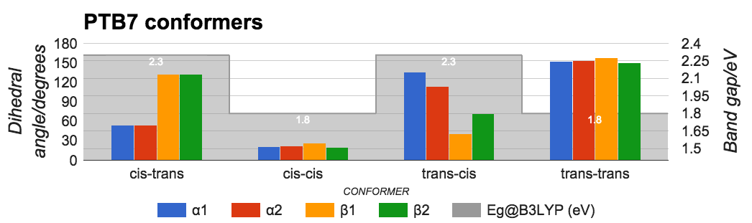
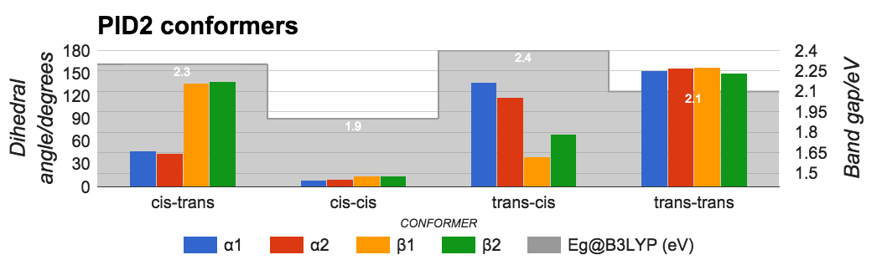
Extended polymer configurations
The band gap of extended polymers depends heavily on twisting of dihedrals
19
Notes:
Slide 1 shows dihedrals and band gaps for different dihedral conformers of extended chains of PTB7 and PID2. There are four structural motifs shown here, which are characterized by whether the dihedrals are aligned (cis) or not (trans). The conformers where the dihedrals are either all aligned or all anti-aligned are more likely energetically, and they also have significantly lower band gaps than the other conformers (by up to 0.5 eV). This shows that the band gap of extended polymers depends upon local dihedral conformation.
19

Slide 20
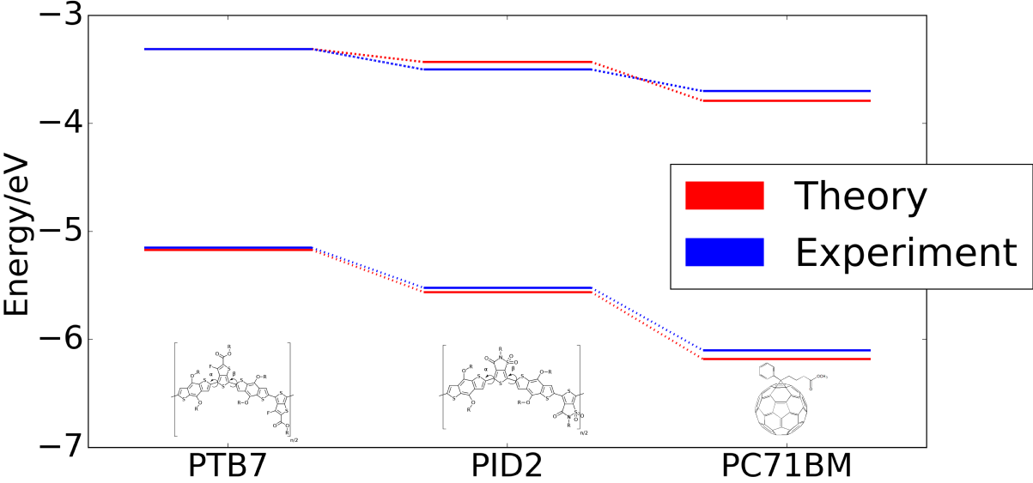
Alignment of electronic bands
Agreement within 0.1 eV of experimental values using B3LYP on isolated systems
Polymer calculations use 5x1x1 k point mesh
Lu, et. al. Nat. Photon., 8(9), 716 (2014).
20
Notes:
20

Slide 21
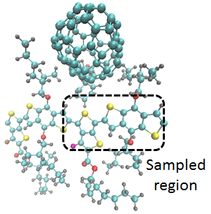
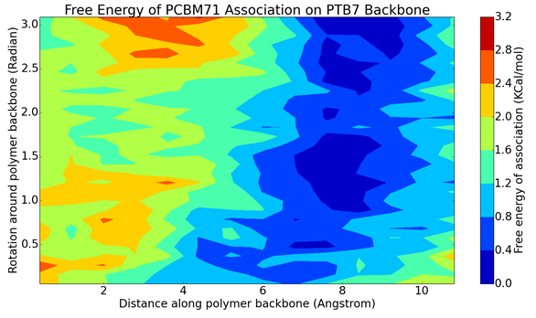
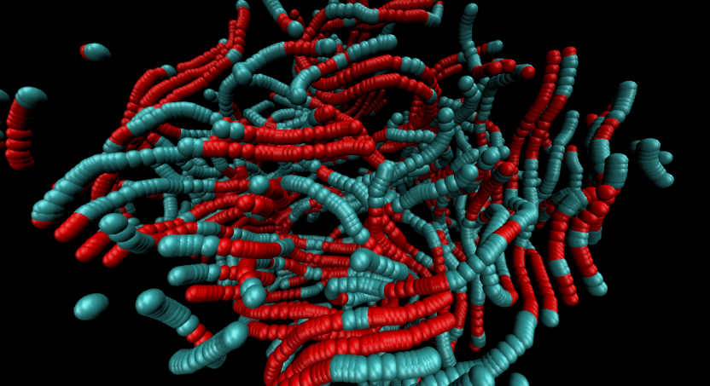
PCBM-71 Association with PTB7 (Daniel Reid, Yu, de Pablo)
Mapping free energy of PCBM-71 association with PTB7
System solvated in chlorobenzene
Modeled using infinite polymer chain
Initiated NMR experiments with Yu and NIST groups to validate the theory.

Slide 22
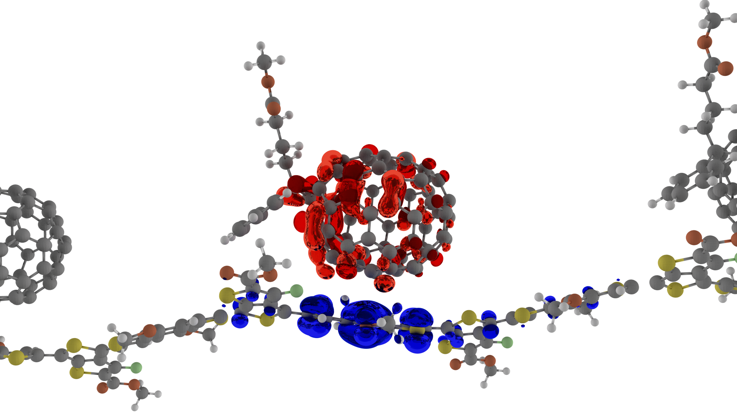
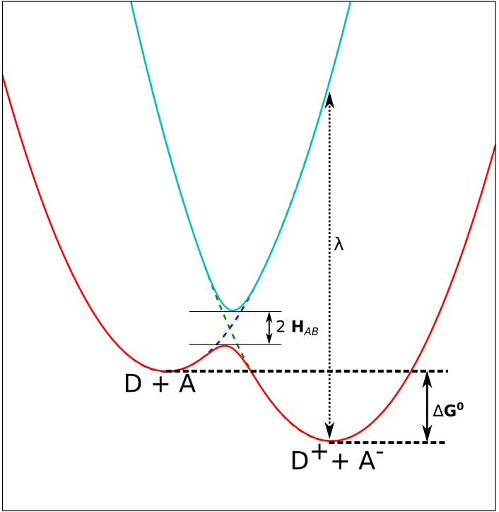
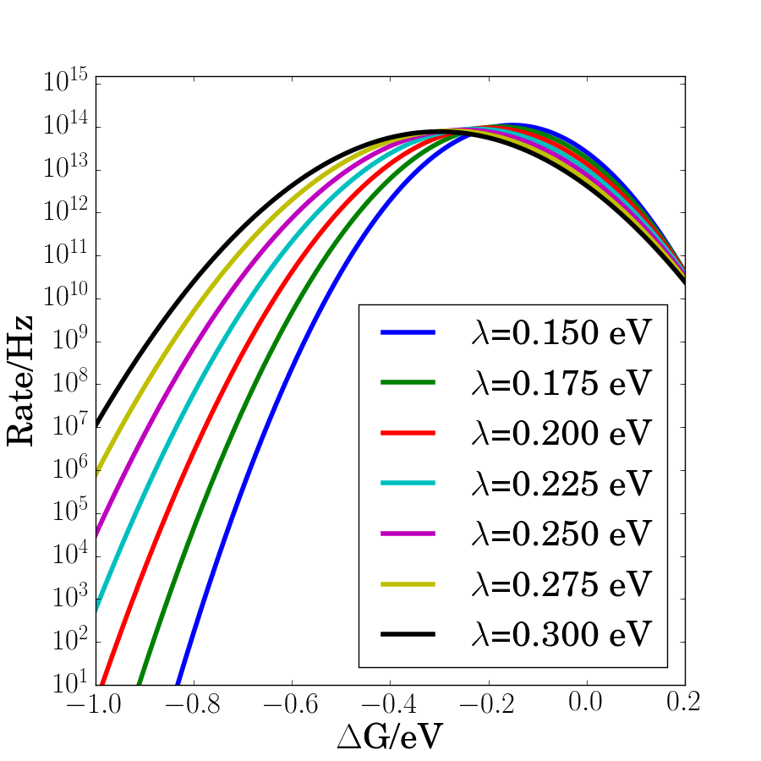
Charge transport at interfaces
Matthew Goldey and Giulia Galli
Marcus theory calculation of charge transport rates
Reorganization energy
Diabatic coupling
Driving force
deep in inverted Marcus region
PTB7:PC71BM 𝚫G₀= -0.9 eV |H_{AB}|=50 meV
PID2:PC71BM 𝚫G₀~ -0.6 eV
Smaller |𝚫G₀| increases rate of transfer by orders of magnitude
22
Notes:
ƛ=0.2 eV?
22

Slide 23
Results from Calculations
Electronic energy levels
Calculations within 0.1 eV of experimental bands
Thermal broadening of 0.2 eV for PTB7 bands
PTB7 bands blue-shift 0.2 eV upon 𝜋-stacking
Kinetics
PC71BM to PTB7 hole transfers much slower than PC71BM to PID2 hole transfers
PTB7:PID2 hole transfer rates larger than the HOMO energy difference
25% decrease in along-chain couplings for stacked chains
23
Notes:
EQE enhancement of ternary system comes through PID2:PC71BM interface
PID2 enables extraction, but we only need a little of this
PTB7:PID2 may have minimal driving force due to disorder – entropy must play a significant role in hole transport
23

Slide 24
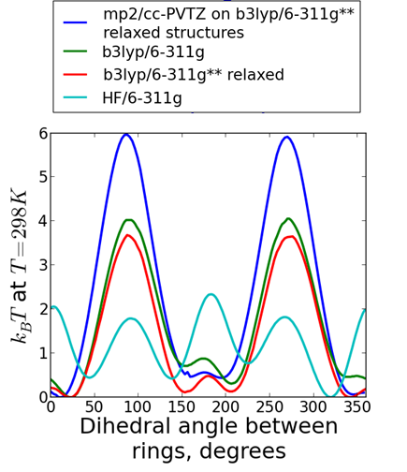
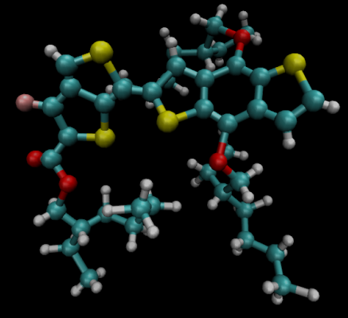
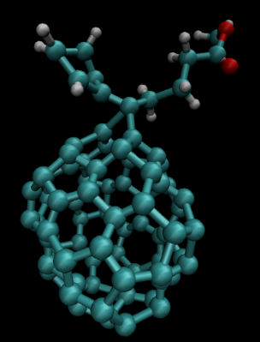
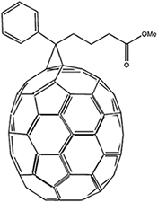
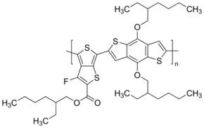
OPV Model on Ternary System
(Daniel Reid, Yu, de Pablo)
Force field developed using
  OPLS Lennard-Jones parameters
  Dihedral potentials from electronic structure
  Atomic charges from electrostatic potential fitting
Model reproduces experimental densities, glass transition

Slide 25
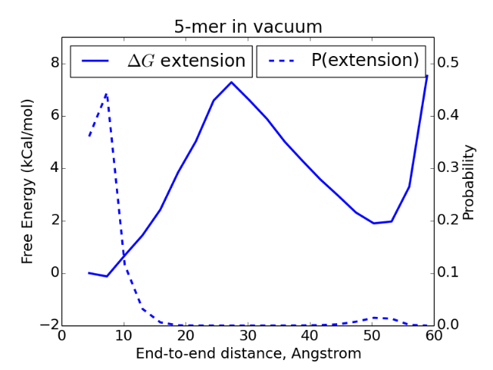
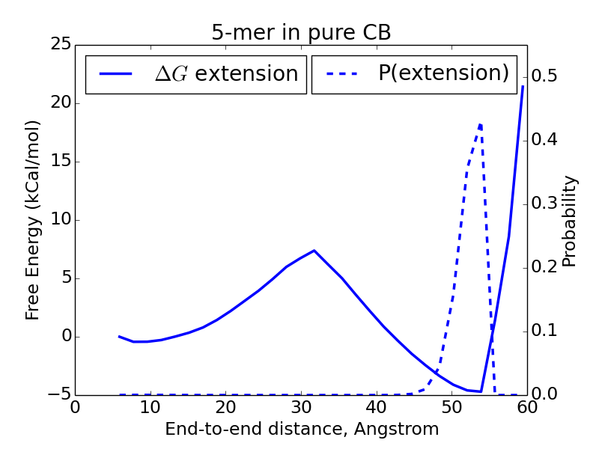
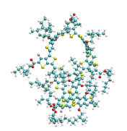
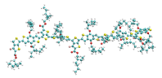
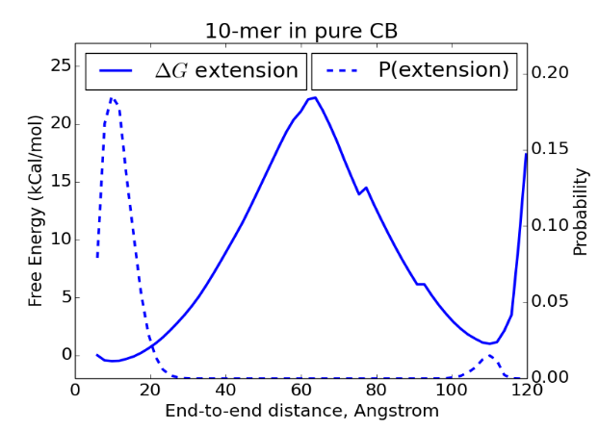
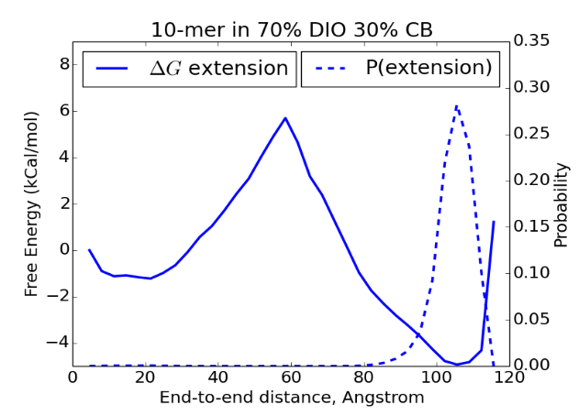
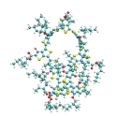
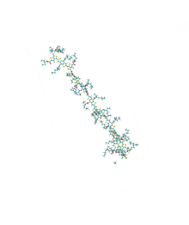
Free energy sampling of PTB7
Performing umbrella sampling to determine free energy of PTB7 extension in solution
  Using explicit solvent (CB and DIO)
  Umbrellas spaced by 3.0 Å
Key findings from new force field computation
New force field allows for atomistic simulations of PTB7; a significant amount of intra-chain folding and inter-ring stacking, which was used in Galli’s quantum calculations.
Simulations in the presence of DIO indicate that this additive reduces considerably the amount of intrachain folding – this could relate to Lee Richter’s observations.
Simulations of position of fullerene with respect to monomer backbone show what are the preferred positions and orientations – this could relate to Lee’s NMR measurements.

Slide 26
Transition to new non-fullerene acceptors
Designed based on theoretical understanding
TP-BDT
TP-BDT-b
Add | D/A Ratio | J_{sc}/mAcm⁻² | V_{oc}/V | FF | Eff/%
TP-BDT | 1:1.5 | 17.90 | 0.79 | 0.60 | 8.47
TP-BDT-b | 1:1.5 | 16.50 | 0.91 | 0.48 | 7.25

Slide 27
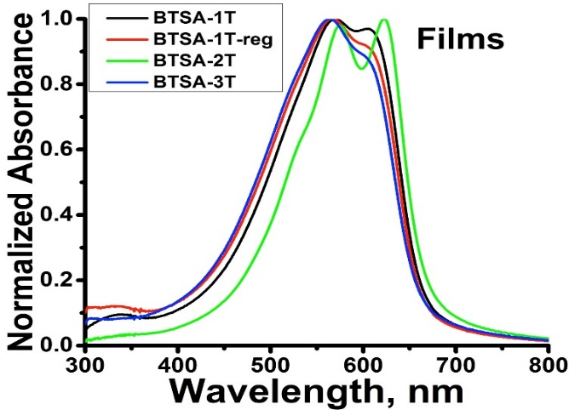
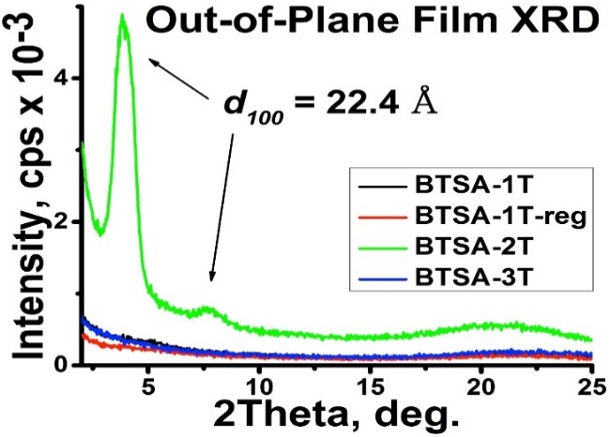
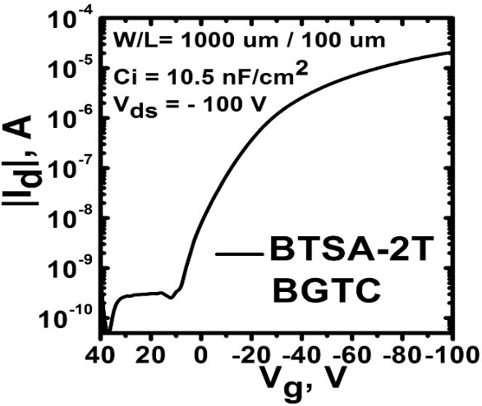
Second generation of New Building Block for OPV Polymers (Marks,Melkonyan)
 | Mn, kDa | PDI | Eg (Sol), eV | Eg (Film), eV | E_{HOMO,} eV | E_{LUMO,} eV | µ_{h}, cm²/(V*s)
BTSA-1T | 11.4 | 4.6 | 1.90 | 1.85 | -5.40 | -3.55 | 2.2 E-3
BTSA-1T-reg | 14.1 | 3.4 | 1.88 | 1.87 | -5.49 | -3.62 | 1.6E-3
BTSA-2T | 14.4 | 4.6 | 1.89 | 1.84 | -5.39 | -3.55 | 0.056
BTSA-3T | 53.1 | 10 | 1.93 | 1.86 | -5.36 | -3.50 | 1.2E-2

Slide 28
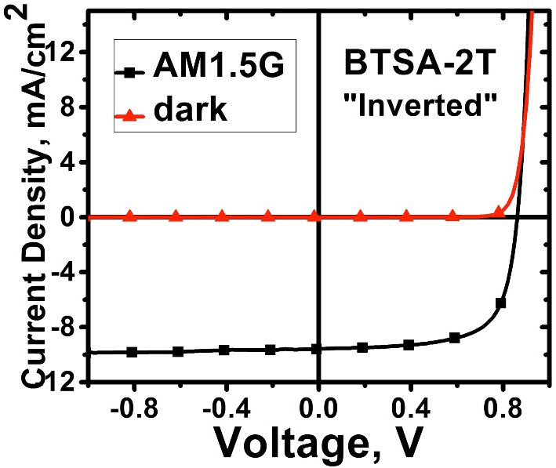
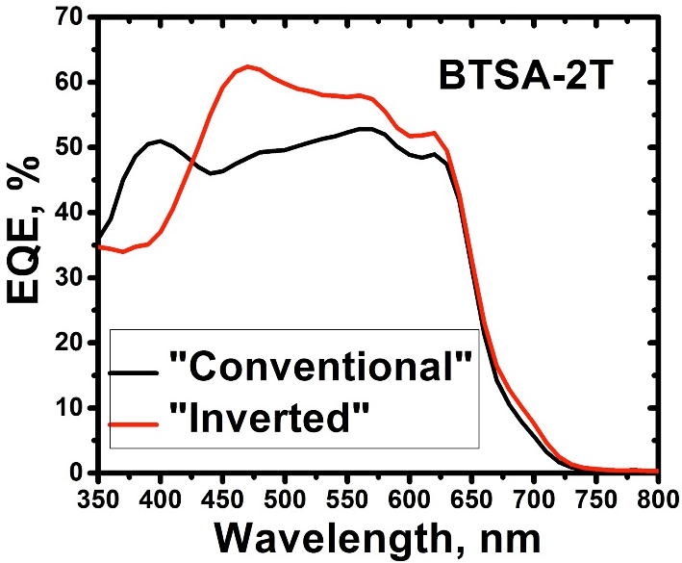
BTSA-XT Solar Cells
Polymer:PC71BM ratio 1:2
Processing Solvent Mixture CHCl₃:DCB(9:1) + 2% DIO.
The results for BTSA-1T, BTSA-1T-reg, BTSA-2T seems optimized, however BTSA-3T required optimization in synthesis (broad PDI issue) and processing conditions
 | V_{oc} [V] | J_{sc} [mA/cm²] | FF [%] | PCE [%]
BTSA-1T | 0.96 | 9.1 | 46.2 | 4.0
BTSA-1T-reg | 0.94 | 8.3 | 45.5 | 3.8
BTSA-2T | 0.85 | 9.5 | 68.2 | 5.5
BTSA-3T | 0.82 | 9.5 | 64.0 | 5.0

Slide 29
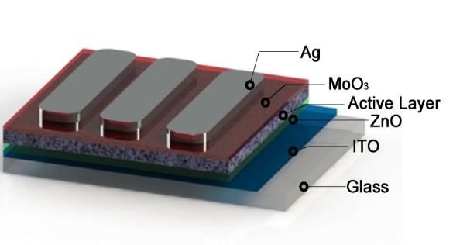
PTPD3T : Fullerene Solar Cells
device thickness ~100 nm for all
PTPD3T
donor
Inverted architecture:
ITO/ZnO/PTPD3T:PC₇₁BM/MoO_{x}/Ag
PC₇₁BM
acceptor
Batch # | M_{n} (kg/mol) | V_{OC} (V) | J_{SC} (mA/cm²) | FF (%) | PCE (%)
64P | 64 | 0.77 | 11.9 | 79 | 7.2
39P | 39 | 0.77 | 11.7 | 79 | 7.1
19P | 19 | 0.77 | 9.8 | 78 | 5.9
15P | 15 | 0.75 | 9.7 | 75 | 5.5
11P | 11 | 0.78 | 8.9 | 78 | 5.4
8P | 8 | 0.78 | 8.2 | 78 | 5.0
Higher M_{n} →
Higher PCE
PCE gains due to J_{SC}
Nanjia Zhou
J.Am.Chem. Soc. 2016, 138, 1240–1251.
Notes:
1. First we decided to test fullerene based devices and see Mn effects. Following the majority of the lit studies on polymer Mn effects, we also observe that the highest PCEs are obtained for highest polymer Mns. These gains are due to Jscs improvements.

Slide 30
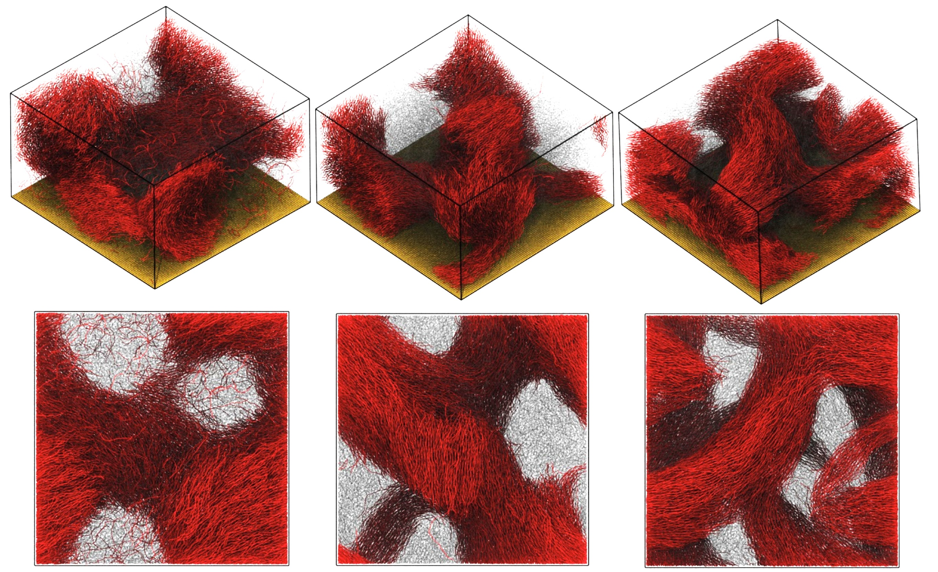
Coarse-Grained Morphology Modeling
Smaller domain sizes & finer bundle network
Exciton dissociation vs. recombination
Medium M_{n} ideal for both carrier generation and transport
Increasing polymer M_{n}
Simulation size:
120 x 120 x 70 nm
20P : 20N
40P : 40N
60P : 60N
Low–Low
Medium–Medium
High–High
with Zhou, N.; Aldrich T.
Olvera de la Cruz, Ting Li J.Am.Chem. Soc. 2016, 138, 1240–1251

Slide 31
Future Plans
Theory guided Design and Synthesis
Design and Synthesize new donor polymers based on theoretical calculations.
BTSA-T3 series: Optimization of solubilizing chains based on molecular dynamic calculations
Explore new non-fullerene molecules and polymers
Devices optimization directed by MD simulation
Aided with MD simulation, further Optimization of Device Fabrication by Processing Additives, and Annealing
Explore and understanding new ternary systems.
Study Blend Film Morphology with GIWAXS, TEM, AFM (NIST Collaboration)
Study Bulk Charge Transport by SCLC and time resolved photoconductivity measurements.
Study New Donors with new non-fullenerene Acceptors.
More Collaboration with CHiMaD Team and NIST Scientists
  Use BTSA-based small molecules single crystal XRD data for
  charge transport modeling and explore polymer-polymer cell morphology
  evolution.
  More simulations on bulk assembly and electronic dynamics of ternary system. To simulate results of small molecules to polymers.
  Take advantage of NIST expertise and facilities; students exchange, training.

Slide 32
Thank you for your attention
NIST
and CHiMAD for Support

