Slide 1
Polymer Matrix Materials
Use Case Group
CHiMaD Annual Review Meeting
March 23, 2016

Slide 2










Polymer Matrix Materials
Catherine Brinson
(NU)
Sinan Keten
(NU)
Erik Luijten
(NU)
Juan de Pablo
(UC)
Wei Chen
(NU)
Jack Douglas
(NIST)
Douglas Fox
(NIST/American U)
Jeffery Gilman
(NIST)
Jan Obrzut
(NIST)
Fred Phelan
(NIST)
Notes:
Look at annual report – Just PI’s at this case

Slide 3
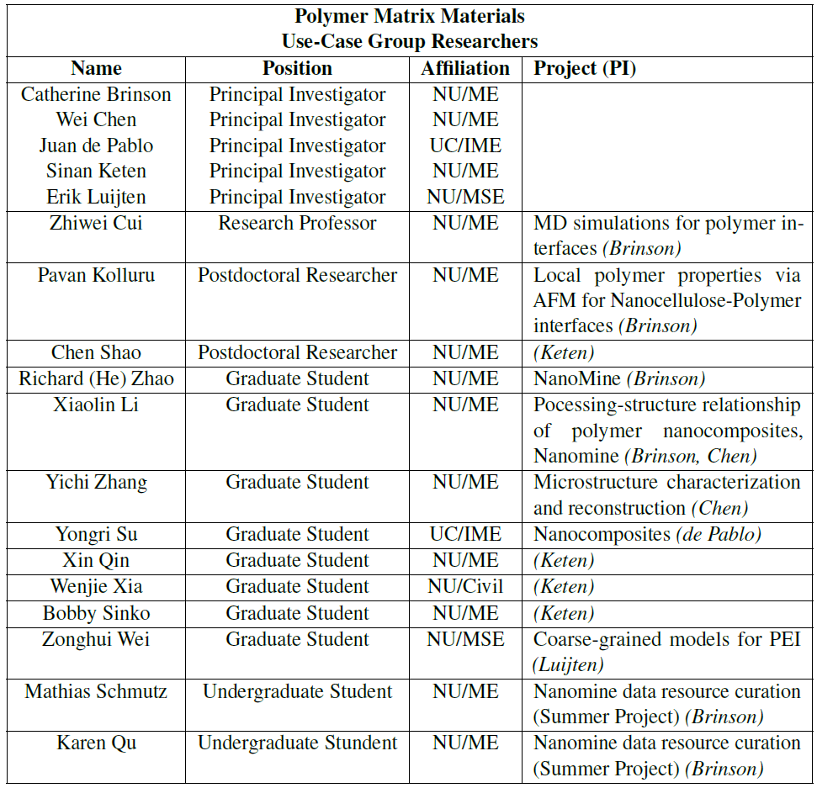

CHiMaD Team
NIST Associates
Chelsea Davis
Caglar Emiroglu
Ketan Khare
Beatriz Pazmino
Thomas Rosch
Muzhou “Mitchell” Wang
Jeremiah Woodcock
Northwestern U. and U. Chicago Researchers
Industrial Partner
Richard Sheridan (NU/NIST)

Slide 4
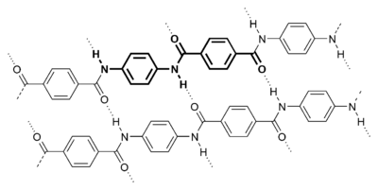
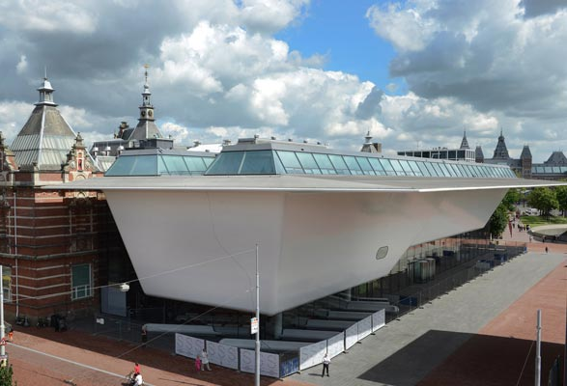
Motivation
Polymer matrix composites are lighter and stronger than conventional structural materials
Interfacial strength and durability is difficult to predict and control
Understanding and controlling properties of interface/interphase are important
quote – “50% of failures can be traced to interface….”
· NIST roadmap – composite related, plastics assoc, 6sigma quality goal, 50% reduction cost, 1-2x faster manuf speed,
· why interested in interphase
· barath thesis – connection VE prediction, without including wrong answer, without measuring interphase just guessing,
· infrastructure composites, automotive, overriding reasons revolution process-structure-properties. Without interphase ,cannot predict properties. Thus modeling and expts we are doing is critical.
· Show Tg can go up or down with changes in interface
· Goal enhance modulus, decrease impact of water;
· Modeling guide us and tool to help understand mechanisms
Stedelijk Museum
(Amsterdam, Netherlands)
Notes:
Lots of examples… Big bathtub building. Windmill blades
Consistently overdesigned and prematurely decommissioned. (take references from research proposal)
Roadmapping to indicate need
From Stedelijk Museum website (Modern art museum in Amsterdam, Netherlands
The smooth white surface of the facade is made up of 271 panels of a pioneering new composite material with Twaron® fiber as its key ingredient. The panels are attached to the steel structure by 1,100 aluminum brackets. Twaron, a synthetic fiber, is extremely lightweight (27 kilograms per square meter, or less than half the weight of a normal curtain wall), is five times as strong as steel, maintains its shape and strength in varying weather conditions and does not melt in fire. Because the composite with carbon fiber and Twaron can be molded, it permits the creation of a smooth, seamless surface of virtually any area. Twaron is ordinarily used for the hulls of motorboats and racing yachts, sailcloth, aerospace and industrial components. - See more at: http://www.stedelijk.nl/en/visit-us/building/new-annex#sthash.zTlwINm6.dpuf

Slide 5
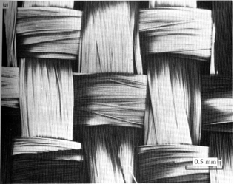
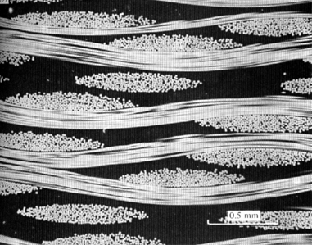
Why Composite Materials?
“Current composites are overdesigned by 300% due to lack of reliable models and data”
-NIST AMTech Roadmaps
Fiber
E_{f}
Composite
0.5 mm
Stress
Nanocomposite
Matrix
E_{m}
D. Hull and T.W. Clyne, Introduction to Composite Materials, 2nd ed., 1996.
Strain

Slide 6
Nanocomposite Concepts
Potential Failure Modes
Particle
Interface
Moisture uptake
Fatigue damage
Thermal expansion
UV degradation
Interphase
Polymer Matrix
Key Properties:
  Filler properties;
  Bulk matrix properties;
  Interfacial bond strength;
  Interphase matrix properties;
  Particle dispersion
Notes:
Simple talking points
#1 There are five key properties of interest in polymer nanocomposites: 1) filler properties; 2) bulk matrix properties; 3) interface bond strength; 4) interphase properties; 5) particle dispersion
#2 With nanocomposites we get three materials; particle, bulk, and interphase
#3 Controlling, optimizing, measuring and computing interphase properties is the key to PNC design
#4 Need to control and measure negative factors such as damage and moisture

Slide 7
Role of Surface Energy
Poor Dispersion
Good Dispersion
Surface Energy Control
  Interphase size & properties (raises or lowers T_{g})
  Dispersion: uniform vs. aggregated
  Interfacial bond strength
  Moisture uptake: rate and equilibrium
Notes:
Simple talking points
#1 Surface energies control at least four major PNC properties
#2 Therefore, we are working on chemistry of that control surface energies
#2 Interphase properties are strongly controlled by the nature of the interaction between the filler and the polymer which my either raise or lower Tg
#3

Slide 8
Design Goal and Approach
updated design goals from annual report:
In short term this use-case aims to;
• Develop the fundamental understanding of interphase properties in cellulose-polymer
nanocomposites
• Develop databases, models, and tools to manipulate and design interphase properties
in cellulose-polymer nanocomposites and thus control their bulk physical properties
(e.g. diffusion, modulus, Tg)
• Develop design rules to tune properties and control service life (e.g., double inter-
phase modulus and double freeze-thaw cycles)
Develop design rules to tune and control properties and predict service life of polymer matrix composites
  (e.g., double interphase modulus and double freeze-thaw cycles)
Manipulate and tune the interphase of nanocellulose-polymer composites utilizing databases, models, and experimental tools
Notes:
Design goal – service life in fatigue, cycling, envt, big goals, then ; be able to manipulate and tune interphase and the resultant properties – bulk thermomechanical properties. including Stiffness and Tg of composite, and environmental durability. etc.
Ability to design and control props for a broad range of comp applications
Bulk thermomechanical properties
Stiffness/modulus
Glass transition temperature, T_{g}
Strength/toughness
Performance capabilities
Environmental resistance
Fatigue performance
Add

Slide 9
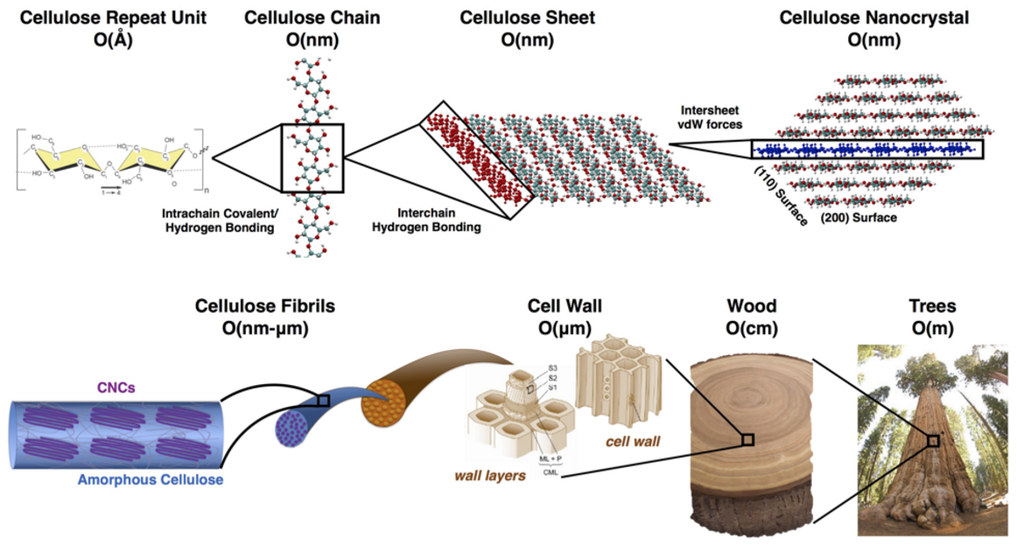
“Model” Material System: Cellulose Nanocrystals in Polymer

Slide 10
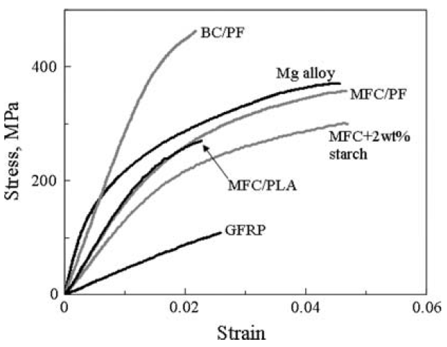
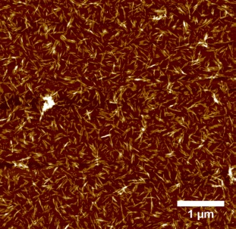
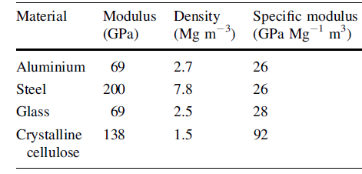
“Model” Material System: Cellulose Nanocrystals in Polymer
CNC
Sacui et al, ACS App. Mat. & Interfaces, 2014.
Eichhorn et al, J. Mater. Sci., 2010.
Notes:
Add key for all of the diff celluloses

Slide 11
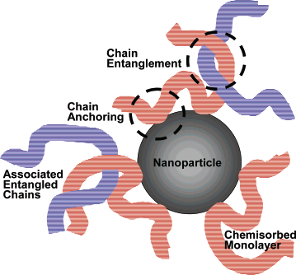
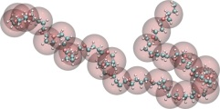
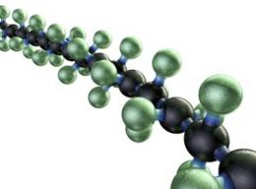
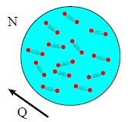
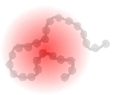
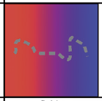
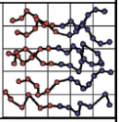
Hierarchical Approach
Molecular
Nano
Macro/micro
Flory-Huggins Database
WebFF
NanoMine
Data Resources
Notes:
Include representative modeling/experimental parts
Put gradient kinda bars to show the overlap of the databases
Reverse the order so that size increases from left to right

Slide 12
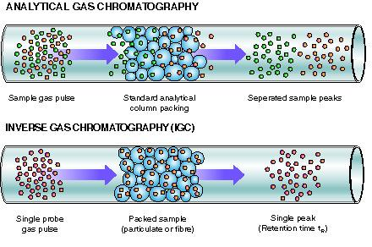
CNC Surface Energy
Sacui, et al., ACS Appl Mat Inter, 2014.
Qin, et al., NanoLetters, 2015.
Gilman, Woodcock, Fox, Keten, Sinko, Qin

Slide 13
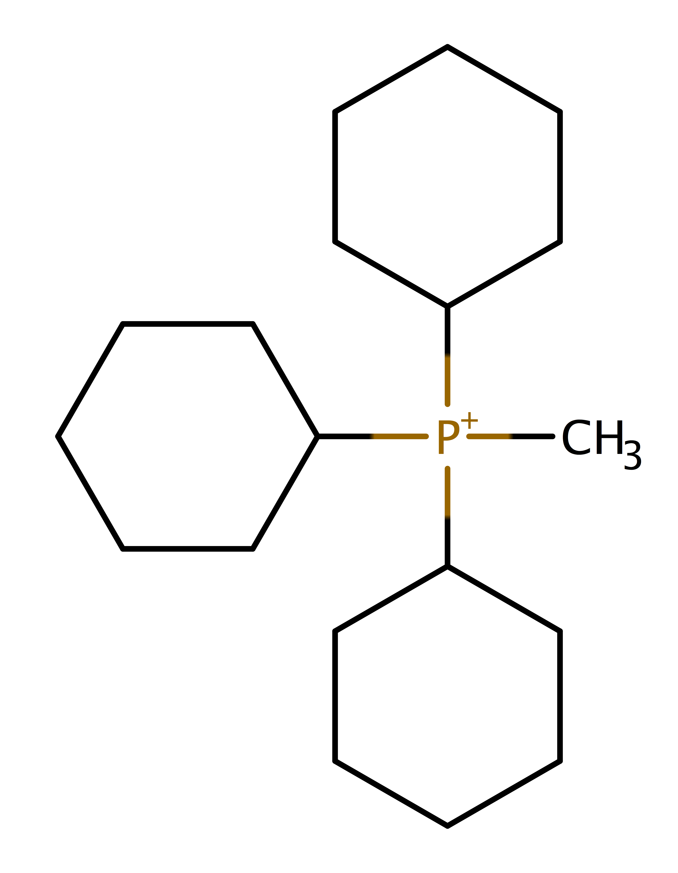
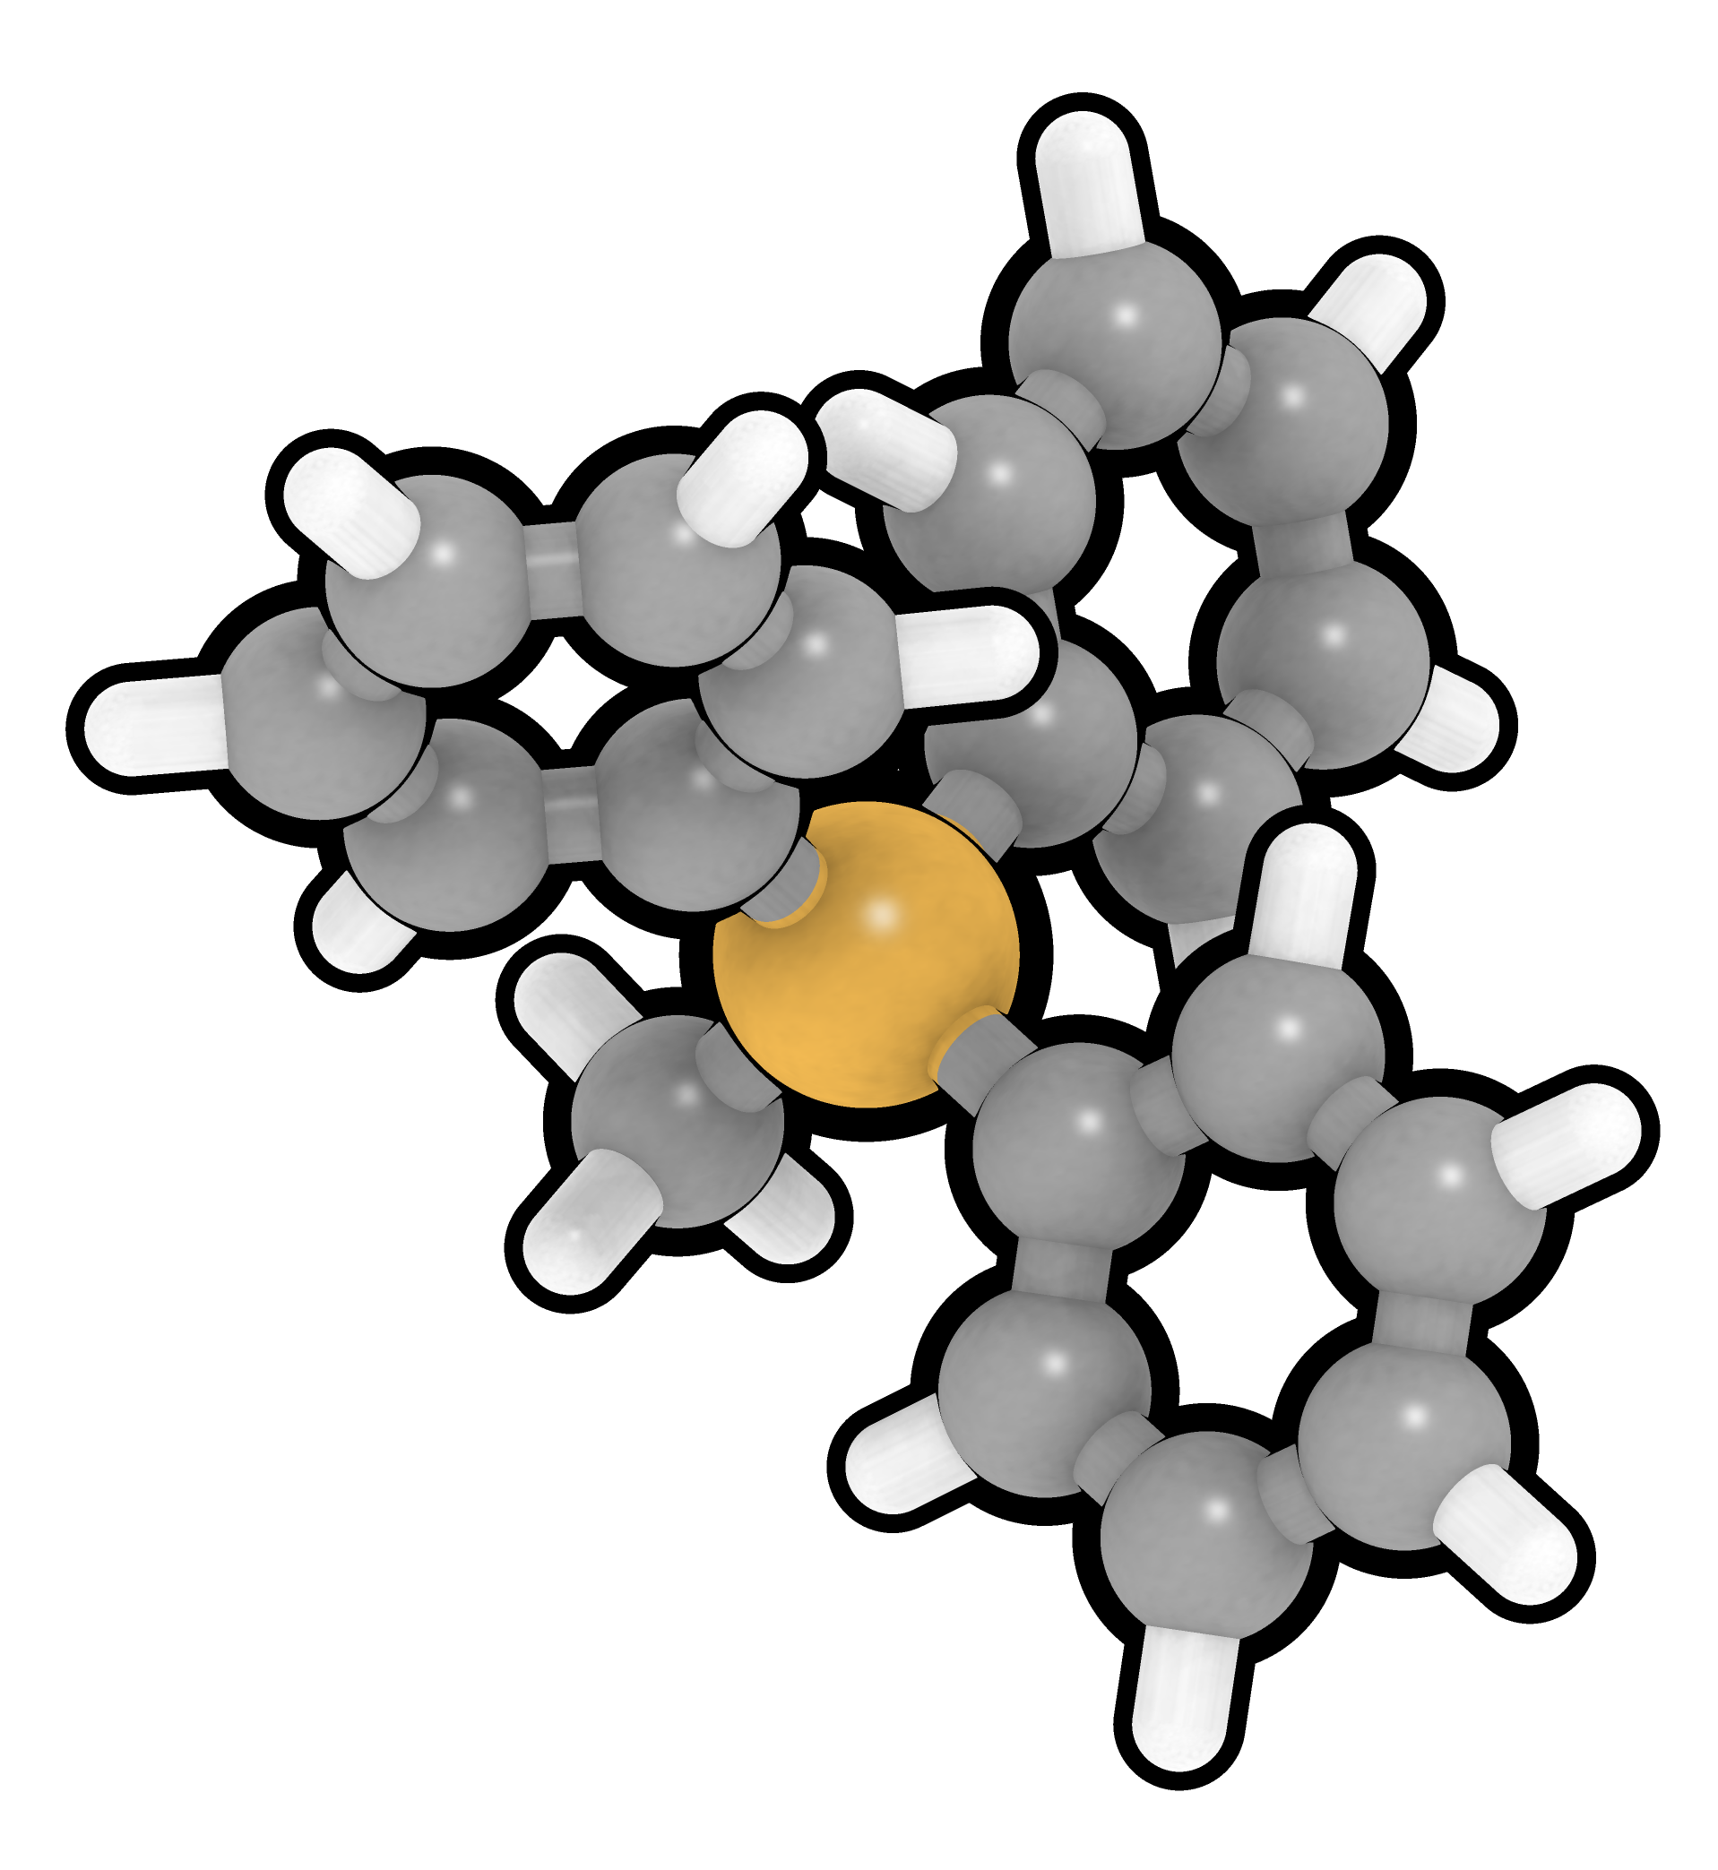
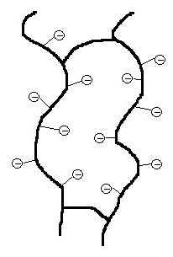
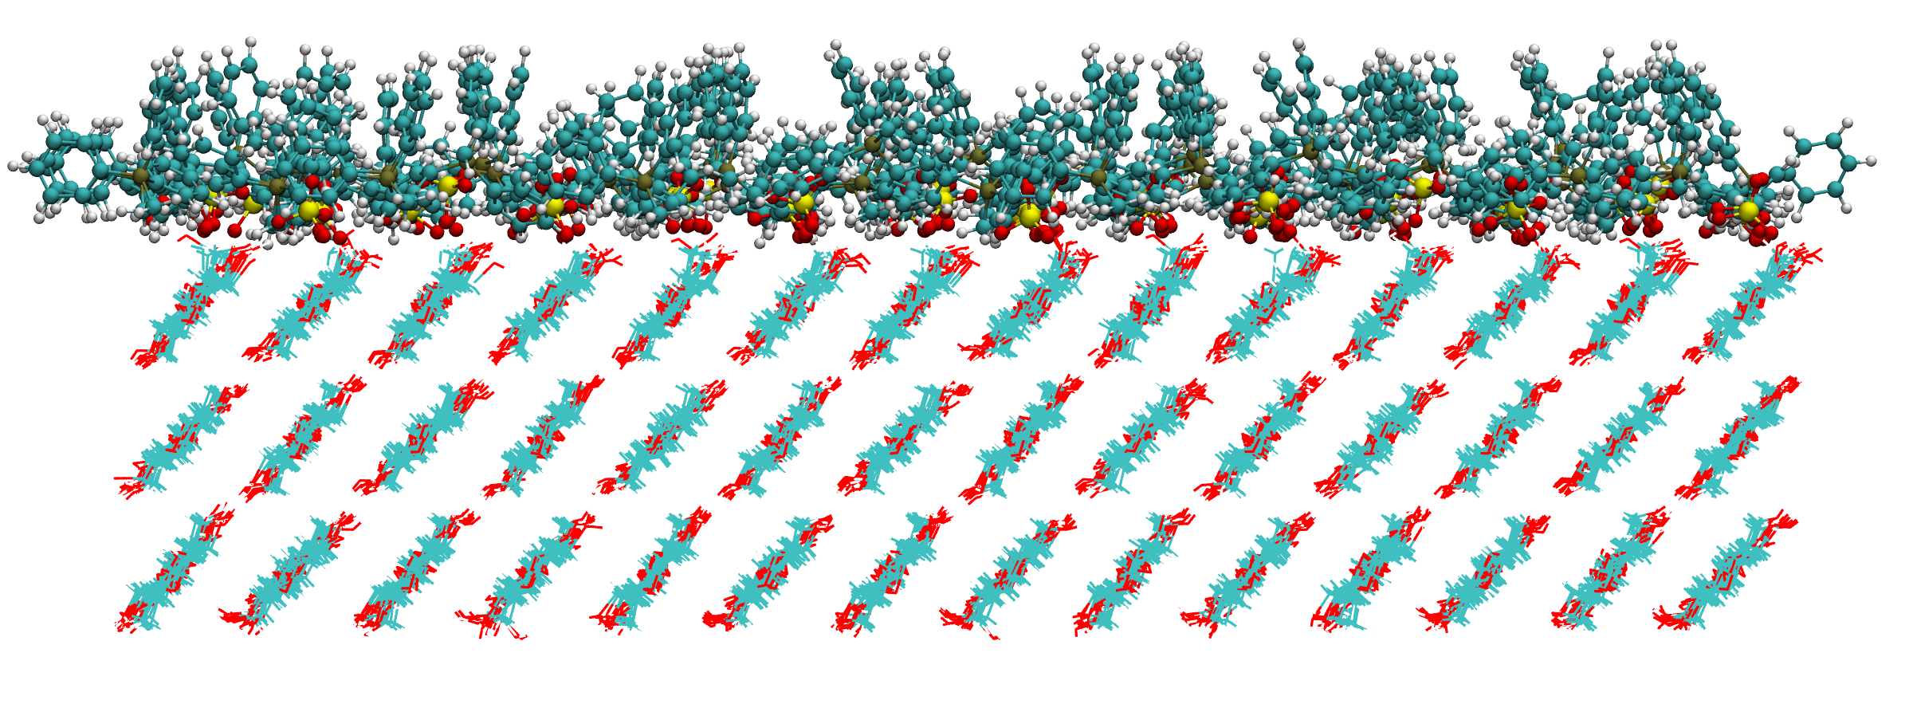
CNC Surface Modification
Ion Exchange
Cation:
Methyl triphenyl phosphonium (MePh3P)
Na-CNC
Na⁺
IL-CNC
CNC surface modified with sulfate anions and hydrophobic cations
IL cation
Fox, Keten, Qin, Xia, Gilman, Woodcock
Notes:
Remove water data (50%)
Using Force Field Toolkit in VMD (quantum mechanics based calculations) to parameterize the ions Doug Fox is using to modify CNC surfaces.
Now looking at repeating interfacial surface energy calculations of modified CNCs with PS and PMMA under dry and wet conditions.
Here we have images of three of the ions that Doug has successfully modified CNCs with. One of the major hurdles we had to overcome was correctly parameterizing these ions with the force field we used for simulating CNCs. We have used the force field toolkit in VMD to parameterize these ions and have succesfully simulated these with CNCs (as shown in image on slide).
Now that we are able to simulate CNCs with these modifications, we are repeating the surface energy calculations with PMMA and PS thin films in order to understand how these different ions change the interactions between the materials. In addition, we will be looking at how the presence of water changes these interactions. Further, Erik Luijten’s group will be looking at how these different modificatons change the water absorption properties of CNCs.

Slide 14
Hierarchical Approach
Molecular
Nano
Macro/micro
Flory-Huggins Database
WebFF
Nanomine
Data Resources
Notes:
Include representative modeling/experimental parts
Put gradient kinda bars to show the overlap of the databases
Reverse the order so that size increases from left to right

Slide 15
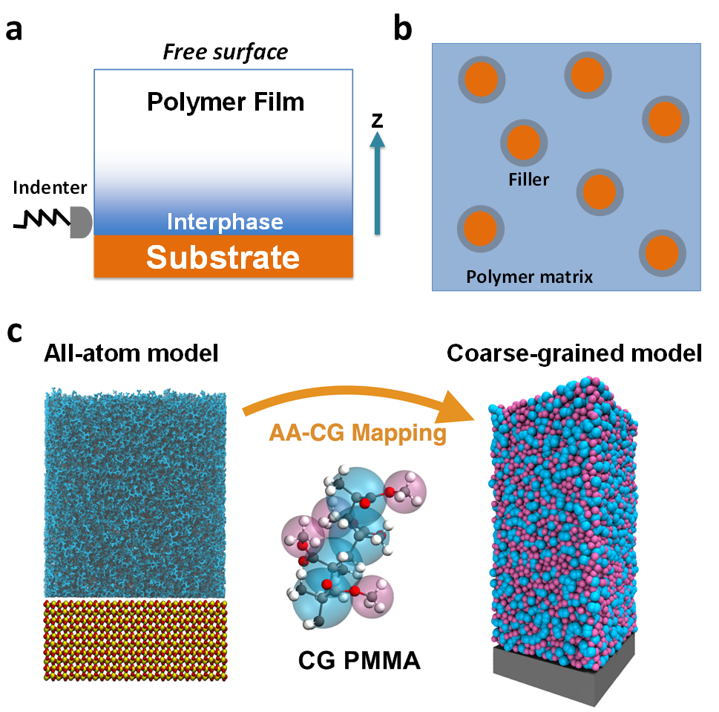
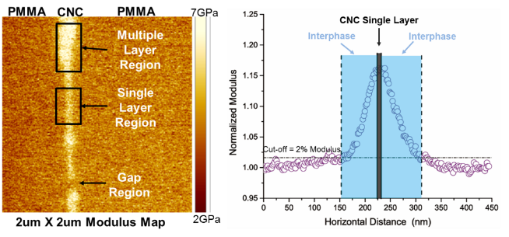
Characterizing PMMA-CNC Interphase with AFM Experiments
AFM modulus measurement of composite interphase
Coarse-grained molecular dynamics modeling approach
Brinson, Keten, Kolluru, Cui
Notes:
Drop casting process is used to create a thin layer of CNC suspensions on a PMMA film and a sandwich structure is created by hot-pressing another PMMA film on top. A cross-section of this sandwich structure is then characterized using the AFM as shown in the second row. Regions of Single and Multple CNCs layers can be seen along with a gap region (which acts as the control). The corresponding line scans shown that the single and multiple layered regions have the sample interphase length scale. Current experiments are focusing on developing similar in-situ composites with surface modified CNCs whose surface energies are well-characterized. The results of the corresponding AFM based experiments will be compared with on-going MD simulations aimed at identifying the interphase characteristics for similar PMMA-surface modified CNC material systems.

Slide 16
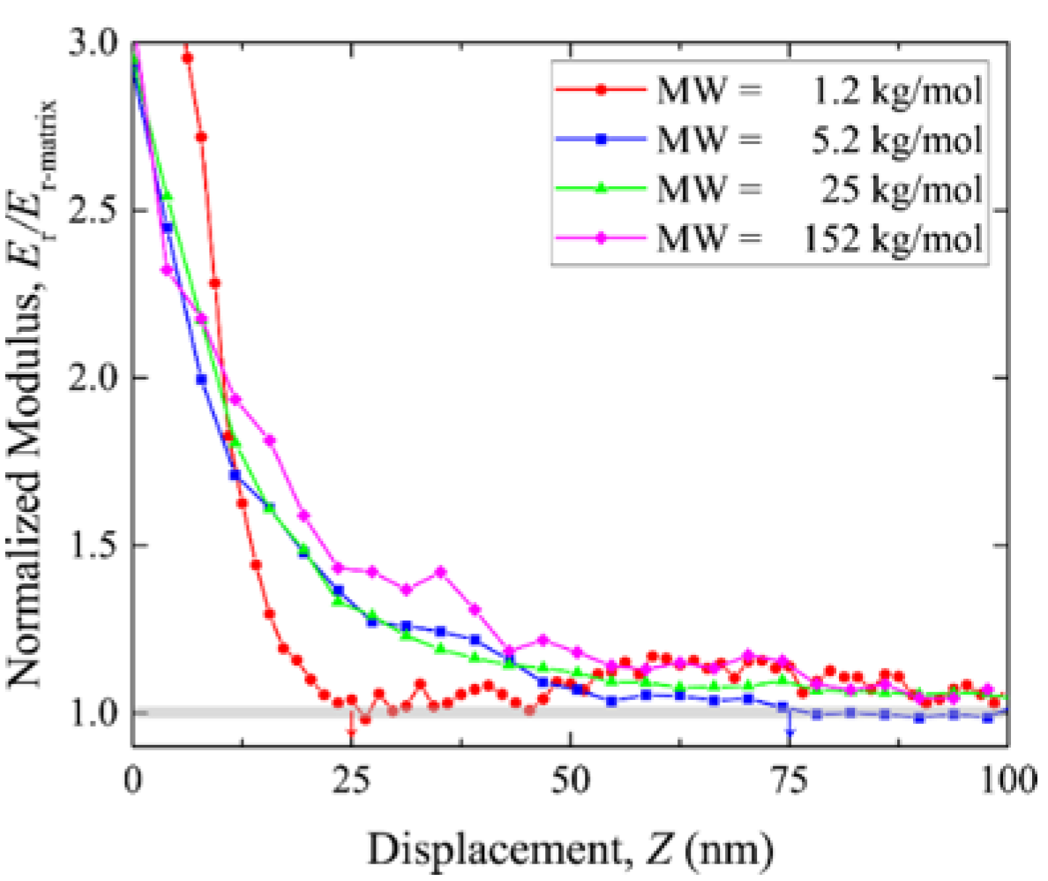
Factors Affecting Interphase
AFM Experiments
Width of interphase is dependent on molecular weight of polymer
Contact geometry can strongly influence results
Notes:
The role of material and geometrical parameters affecting interphase characteristics are currently being studied using direct AFM-based indentation experiments on model nanocomposites.
The role of the matrix molecular weight is being studied for two reasons: (a) to understand the role of molecular length scale on the length scale of the interphase (another tunable material parameter)
(b) correlate experimental results with MD simulations (which are typically limited to low molecular weights).
The results of these experiments (using PS-silica model nanocomposite system) indicates that the increasing molecular weight leads to an increase in the interphase size, esp. from 1200 g/mol to 25,000 g/mol. A saturation of interphase size however appears to have taken place, as a further increase in the molecular weight leads to no change in the interphase length scale. At the lowest molecular weight a significant increase in the ‘strength’ of the interphase is also apparent; the normalized modulus indicating the extent of interphase stiffening relative to the normal polymer matrix stiffness, is higher at the lower molecular weight. Experiments are underway to fully explore the role of MW on the interphase characteristics.
Another factor that is currently being pursued is the effect of multiple inteprhases on an small volume of polymer, akin to the real particulate nanocomposite systems. For instance, the figures on the right depict a V-notch in Silicon filled with polystyrene and the corresponding modulus line scans from AFM-based experiments. The black line scan at the very bottom shows that the polymer at the center (of this line scan) reaches a normal matrix modulus of ~ 5 GPa. The interphase length scale is ~75 nm. As we move higher in 50 nm increments (green, red and blue line scans respectively), it can be noted that the polymer near the center of the line scans is influenced by the two interphase regions, which are moving closer, this leading to a higher modulus in the center of ~7.5 GPa (on the blue line scan). Simultaneously, this interaction between the two interphase regions also reduces the interphase length scale.

Slide 17
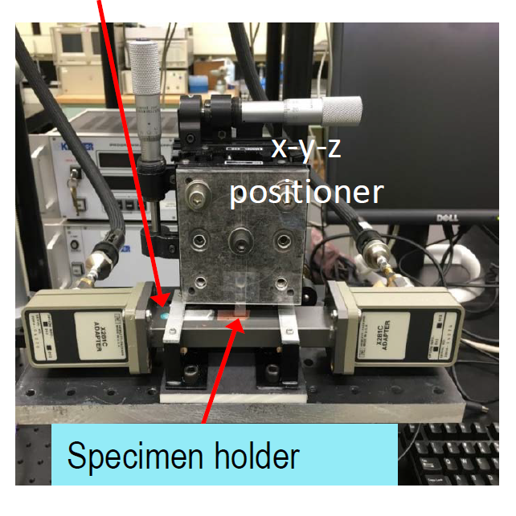
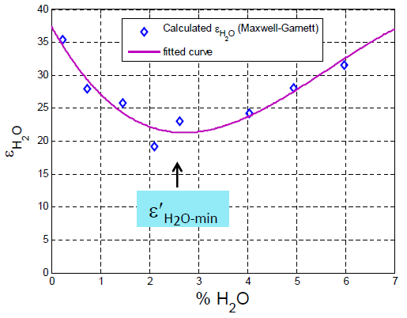
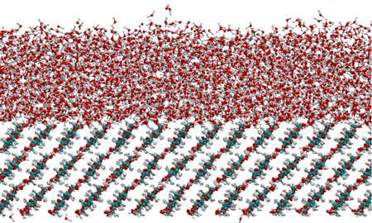
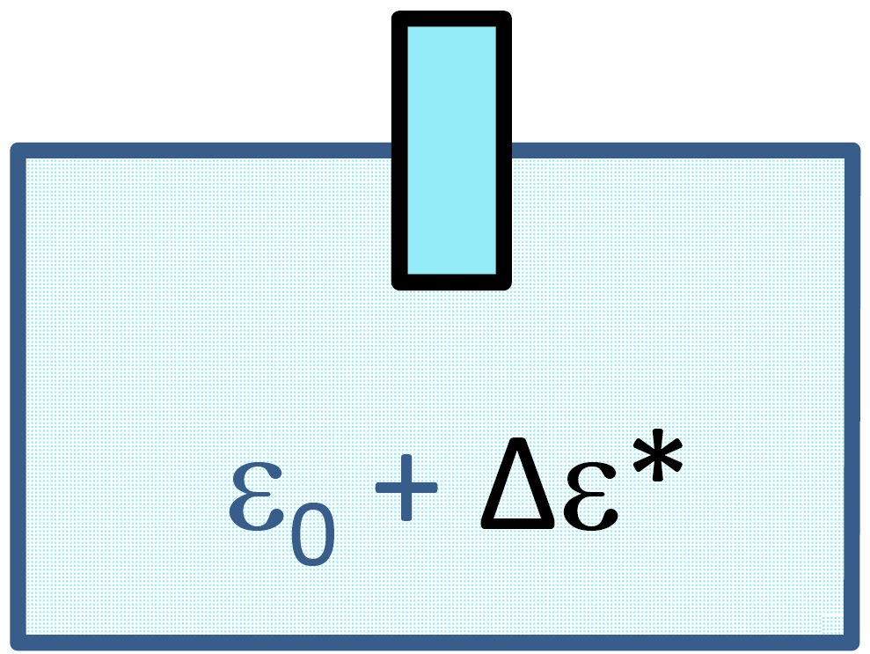
Interaction of Surface Modified CNCs with Water
Modeling interactions of water with modified CNC surface
Introducing different surface modifications effectively increases the interaction between CNCs and water due to increased hydrogen bonding.
Microwave spectroscopy experiments characterize dielectric constant (ε’) of water in CNC film
Keten, Sinko, Shao, Obrzut, Emiroglu, Pazmino, Douglas

Slide 18
Hierarchical Approach
Molecular
Nano
Macro/micro
Flory-Huggins Database
WebFF
Nanomine
Data Resources
Notes:
Include representative modeling/experimental parts
Put gradient kinda bars to show the overlap of the databases
Reverse the order so that size increases from left to right

Slide 19
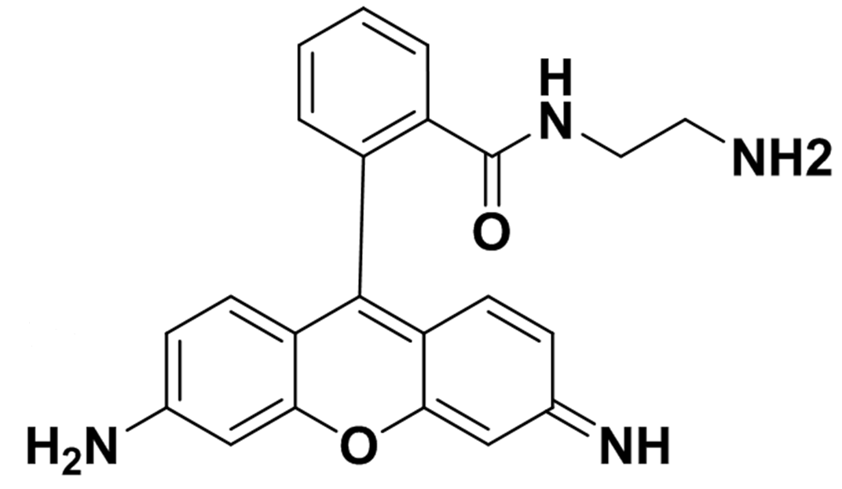
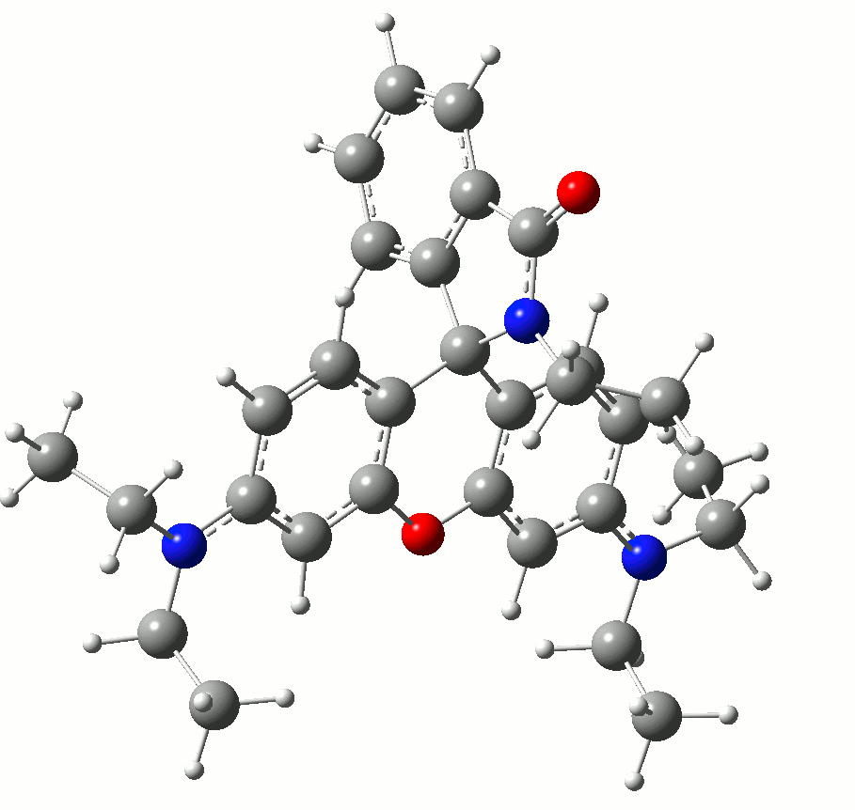
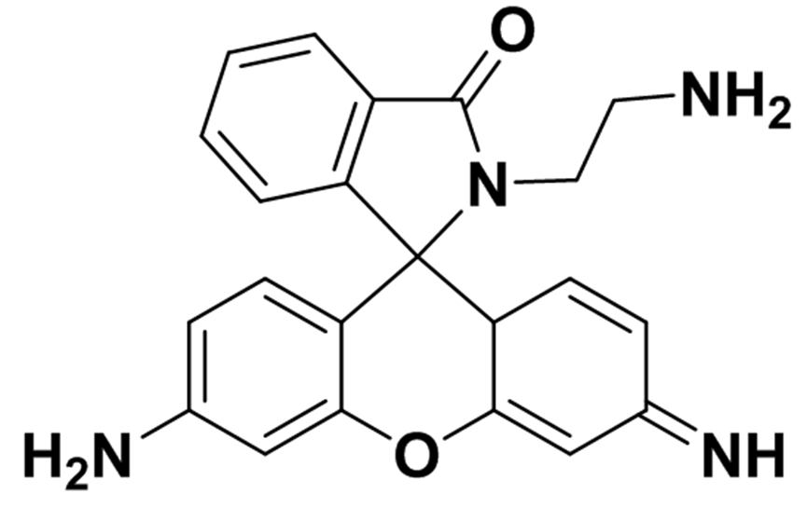
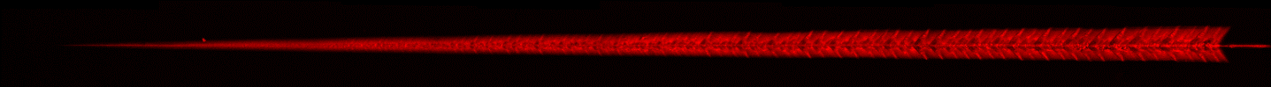

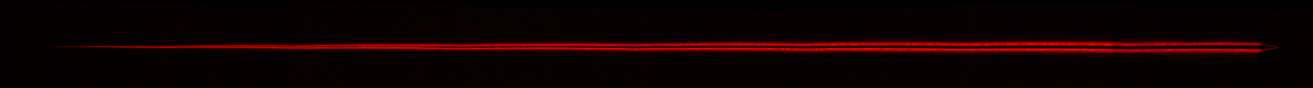
Mechanoresponsive
Damage Sensing
Non-fluorescent
Fluorescent
ε
Δ
Nanoindenter
`
MP
MP
MP
MP
MP
Epoxy
Constrained Geometries for Simulating External Force (COGEF)
0°
0mN
50mN
50µm
180°
Gilman, Phelan, Woodcock, Wang, Davis, Khare
Notes:
Density functional theory (DFT) is a computational quantum mechanical modelling method used in physics, chemistry and materials science to investigate the electronic structure (principally the ground state) of many-body systems, in particular atoms, molecules, and the condensed phases. Using this theory, the properties of a many-electron system can be determined by using functionals, i.e. functions of anotherfunction, which in this case is the spatially dependent electron density. Hence the name density functional theory comes from the use of functionals of the electron density. DFT is among the most popular and versatile methods available in condensed-matter physics,computational physics, and computational chemistry.

Slide 20
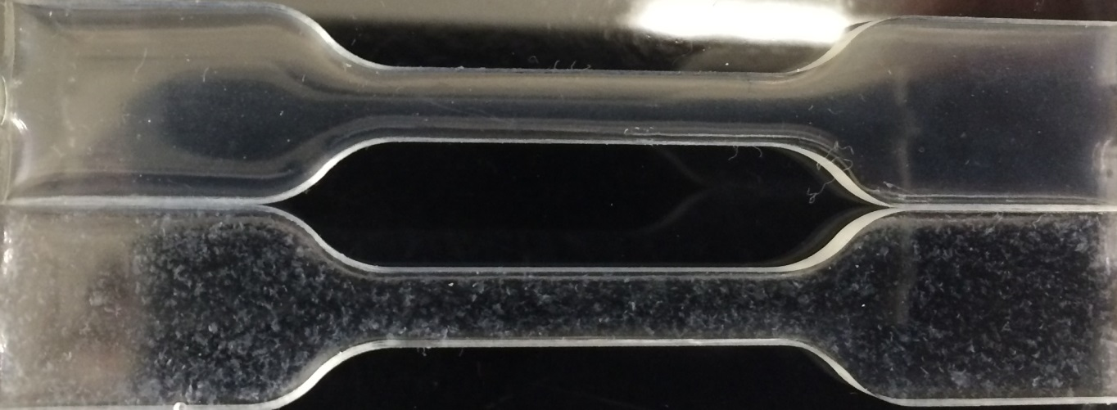
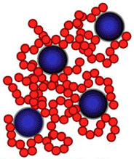
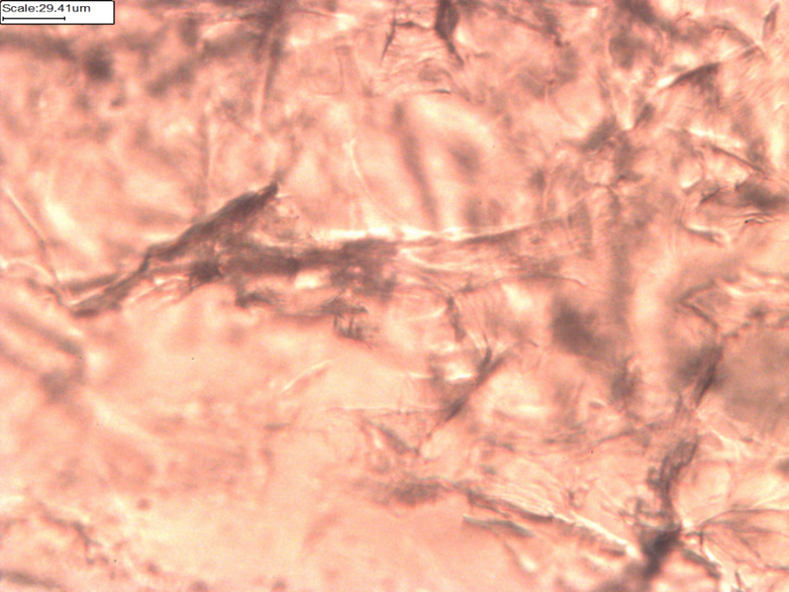
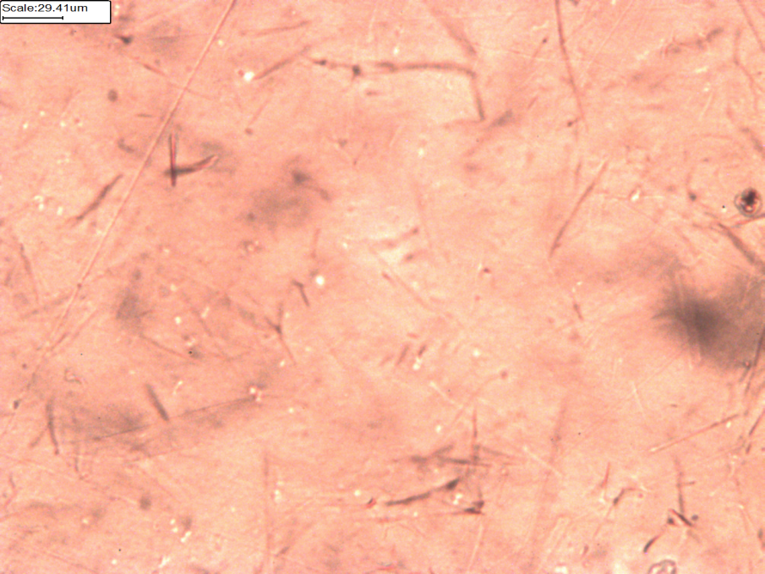
CNC Dispersion in PMMA
2mm
NP-NP
Interaction
NP-poly
Interaction
50µm
Na-CNC
MePh3P-CNC
Quality of nanocomposite dispersion is dependent on interactions between particles and polymer matrix.
Virial coefficient is efficiently calculated from RDF
Fox, Woodcock, Phelan, Rosch

Slide 21
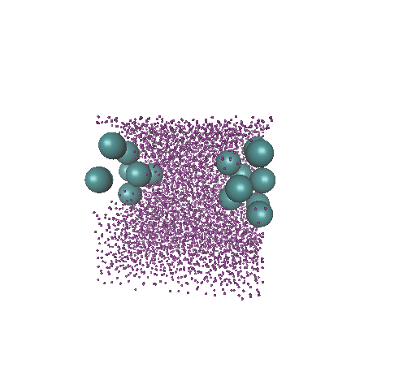
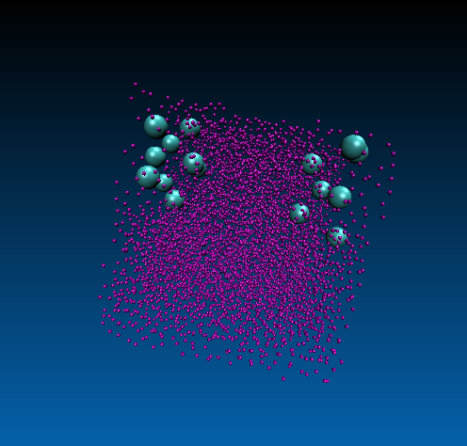
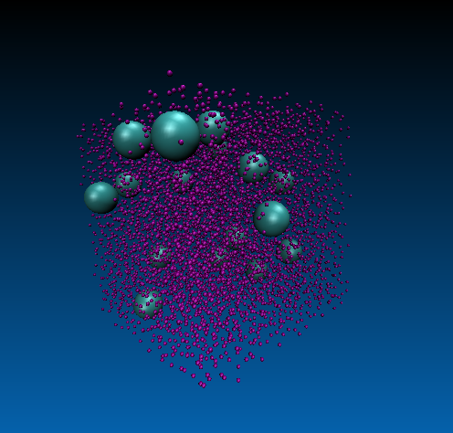
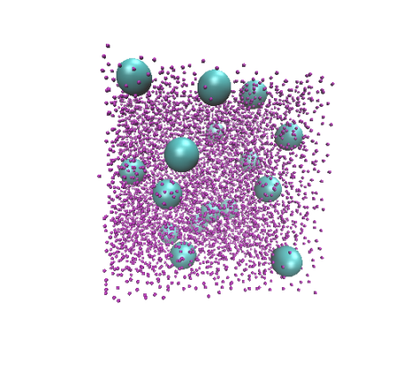
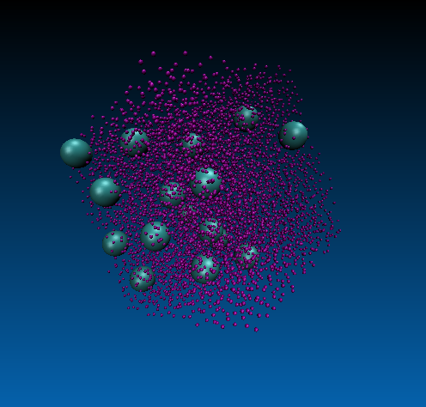
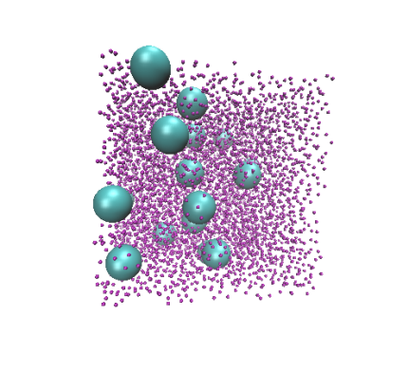
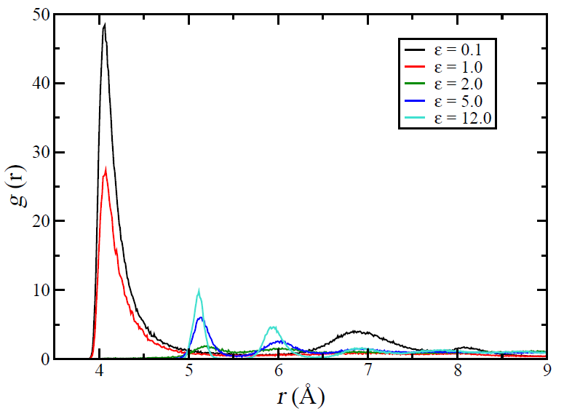
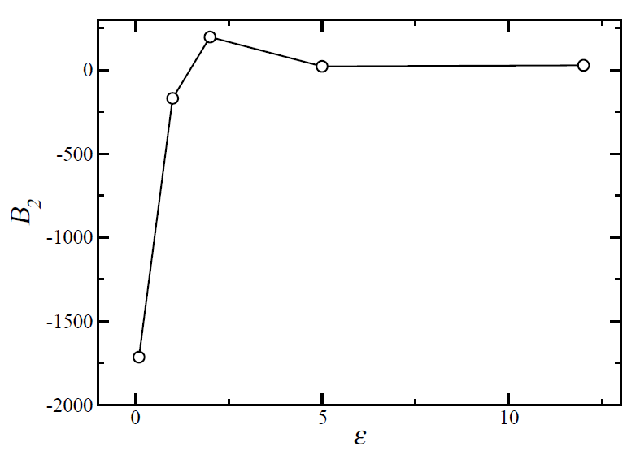
Nanoparticle Dispersion Prediction
Aggregated
Increasing NP-polymer surface energy
Dispersed
A
B
C
C
B
A
Wade, Rosch, Phelan
Notes:
Calculation is for coarse-grained nanocomposite system similar to Liu et al., Langmuir, 27, p. 7926, (2011) , N.B., Rg_polymer > R_NP
The dispersion state of the particle is observed to greatly change as the interaction energy between polymer and matrix is varied
The 2nd Virial coefficient is a measure of the propensity of the particles to either aggregate or disperse
When B2 is highly negative, the particles are attractive, and it would be almost impossible to disperse such particles, however processed, into a good nanocomposite
When B2 is positive, the matrix is relatively attractive enough to disperse the particles, provided Rg_polymer > R_NP
Our next goal is calculation of the B2 values for various functionalized CNC (relative to PMMA)

Slide 22
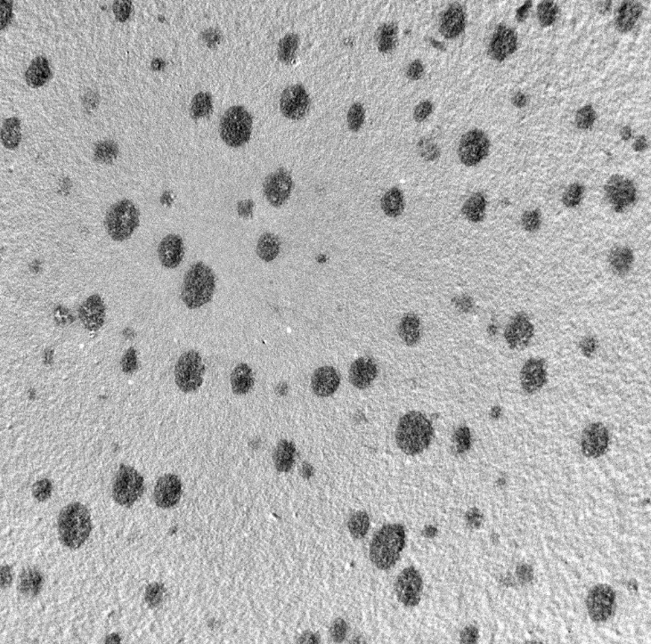
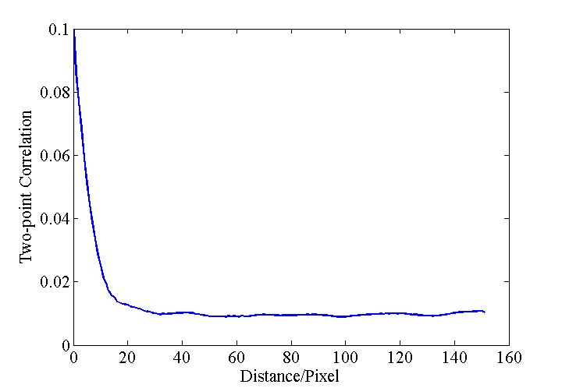



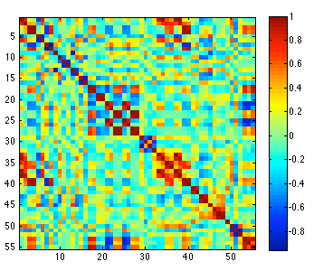
Nanoparticle Dispersion Characterization & Reconstruction
Pre-processing
Characterization
Reconstruction
Experimental image
Statistical features
2D
Binary image
Dimensionality Reduction
3D
Chen, Li, Zhang

Slide 23
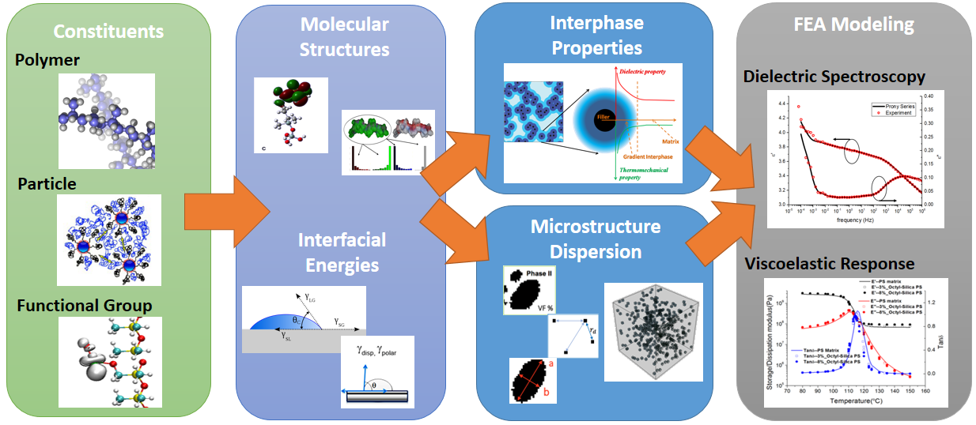
Polymer Matrix Composites – Material Data Infrastructure
Databases, data structure and curation
Open source and sharing, API libraries, and web interfaces
Analytics, prediction, and assistance in understanding of underlying physics
Flory-Huggins Parameter Tool
Semi-automatic extraction of 𝛘 parameter from literature
NanoMine
Database, design & analysis tools,
and simulations
for polymer nanocomposites
WebFF & COMSOFT
data resource, simulation & analysis for force fields and coarse-grained models
NanoMine Components
Property Prediction
Material Design
Brinson, Chen, de Pablo, Zhao, Li, Zhang, Su
Notes:
Three components in data efforts within polymer matrix materials group:
Flory Huggins (Juan) –FH parameter extraction from literature, web-bases predictive system for chi-parameter generation for polymers.
Nanomine - (Cate) – polymer nanocomposite data resource, analysis, and modeling. Curate literature and lab data on nanocomposites, constructed data schema to house relevant parameters, link processing-structure-property, and generate statistical model to find underlying physics that govern interphase behavior
WebFF COMSOFT (Fred) – force field and coarse grain parameter database and modeling system for soft materials
Common components: bullet points upper right
Example: nanomine components.
What it can do: property prediction based on selected constituents – interfacial energies based on constituents - interphase property from interfacial energies – microstructure from interfacial energies – bulk composite property based on finite element.
What we are targeting to do: design material based on uncovered correlation from composite property to microstructure to interphase properties to feasible material constituents.

Slide 24
Use Case Group Interactions
Monthly WebEx
Quarterly face-to-face visits
Student visits to NIST
Joint students (cross projects)
  Keten/Brinson
  Luijten/Keten
  Brinson/Chen
Owens Corning Collaboration
  Gilman, Brinson, Gale Holmes
Glass Fiber
ε = 0
20µm
ε = ε_{c}
0-4000 ps

Slide 25
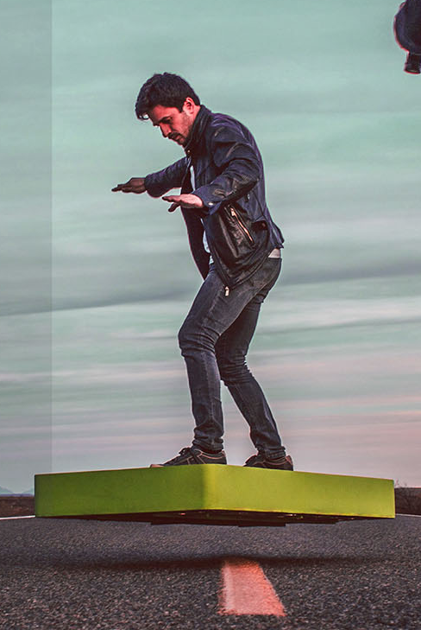

Ongoing and Future Work
Hoverboard by Arcaspace
Unit housing is fabricated from aerospace composite to shield rider from massive heat output of board without adding too much weight to the device
http://arcaspace.com/en/ArcaBoard/specs.htm
Notes:
top image is 600 counts/px , bottom is 200/px – Otherwise wouldn’t see anything (top) or would saturate (bottom)

Slide 26


Ongoing and Future Work
Role of surface energy on materials properties of interphase
  AFM modulus mapping experiments
  Interfacial mechanophore experiments
  Flory-Huggins Parameter Database
Role of interfacial water
  Microwave spectroscopy on CNC composites
  Modeling of interfacial water
Incorporation of data, both experimental and modeling, into data resources (NanoMine database and WebFF prediction tools)
CNC

Slide 27
Polymer Matrix Materials
Catherine Brinson
(NU)
Sinan Keten
(NU)
Erik Luijten
(NU)
Juan de Pablo
(UC)
Wei Chen
(NU)
Jack Douglas
(NIST)
Douglas Fox
(NIST/American U)
Jeffery Gilman
(NIST)
Jan Obrzut
(NIST)
Fred Phelan
(NIST)
Notes:
Look at annual report – Just PI’s at this case

