Slide 1

CHiMaD Data Mining
Ankit Agrawal and Alok Choudhary
Dept. of Electrical Engineering and Computer Science
Northwestern University
Team Members:
Greg Olson, Chris Wolverton, Wei Chen, Cate Brinson
Wei Xiong, Logan Ward, Vinay Hegde, Kareem Youssef, Yichi Zhang, He Zhao
Amar Krishna, Ruoqian Liu, Arindam Paul, Alona Furmanchuk
CHiMaD Annual Meeting
March 23, 2016

Slide 2
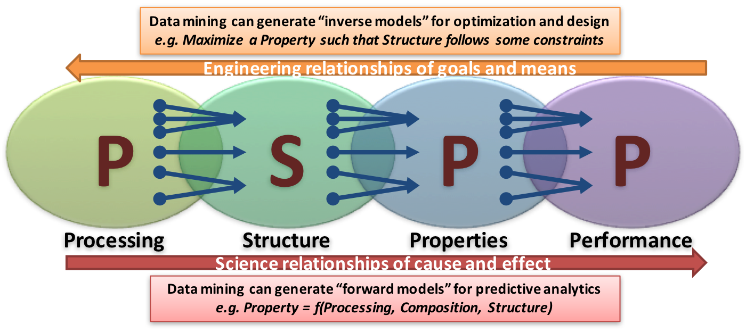
USE-CASE GROUP
A. CHOUDHARY, A. AGRAWAL, NU
DATA MINING
GOALS
Developing data-driven informatics to accelerate materials discovery and design
Extracting actionable insights at unprecedented latency via bottom-up and hypothesis-driven discoveries
Data mining on various heterogeneous and big databases that are complex, high dimensional, structured and semi-structured
Research Accomplishments and Ongoing Efforts
Integrating CALPHAD and Data Mining for Advanced Steel Design
Composition-based Machine Learning Framework for Predicting Inorganic Material Properties
Supervised Learning-based Microstructure Characterization and Reconstruction
Fast Models for Properties of Crystalline Compounds Using Voronoi Tessellations and Machine Learning
Classification of Scientific Journal Articles to Support NIST Data Curation Efforts
Towards Designing OPV devices using Data Mining

Slide 3
Ongoing Projects
Integrating CALPHAD and Data Mining for Advanced Steel Design
Composition-based Machine Learning Framework for Predicting Inorganic Material Properties
Fast Models for Properties of Crystalline Compounds Using Voronoi Tessellations and Machine Learning
Supervised Learning-based Microstructure Characterization and Reconstruction
Classification of Scientific Journal Articles to Support NIST Data Curation Efforts
Towards Designing OPV devices using Data Mining

Slide 4
Ongoing Projects
Integrating CALPHAD and Data Mining for Advanced Steel Design
Composition-based Machine Learning Framework for Predicting Inorganic Material Properties
Fast Models for Properties of Crystalline Compounds Using Voronoi Tessellations and Machine Learning
Supervised Learning-based Microstructure Characterization and Reconstruction
Classification of Scientific Journal Articles to Support NIST Data Curation Efforts
Towards Designing OPV devices using Data Mining

Slide 5
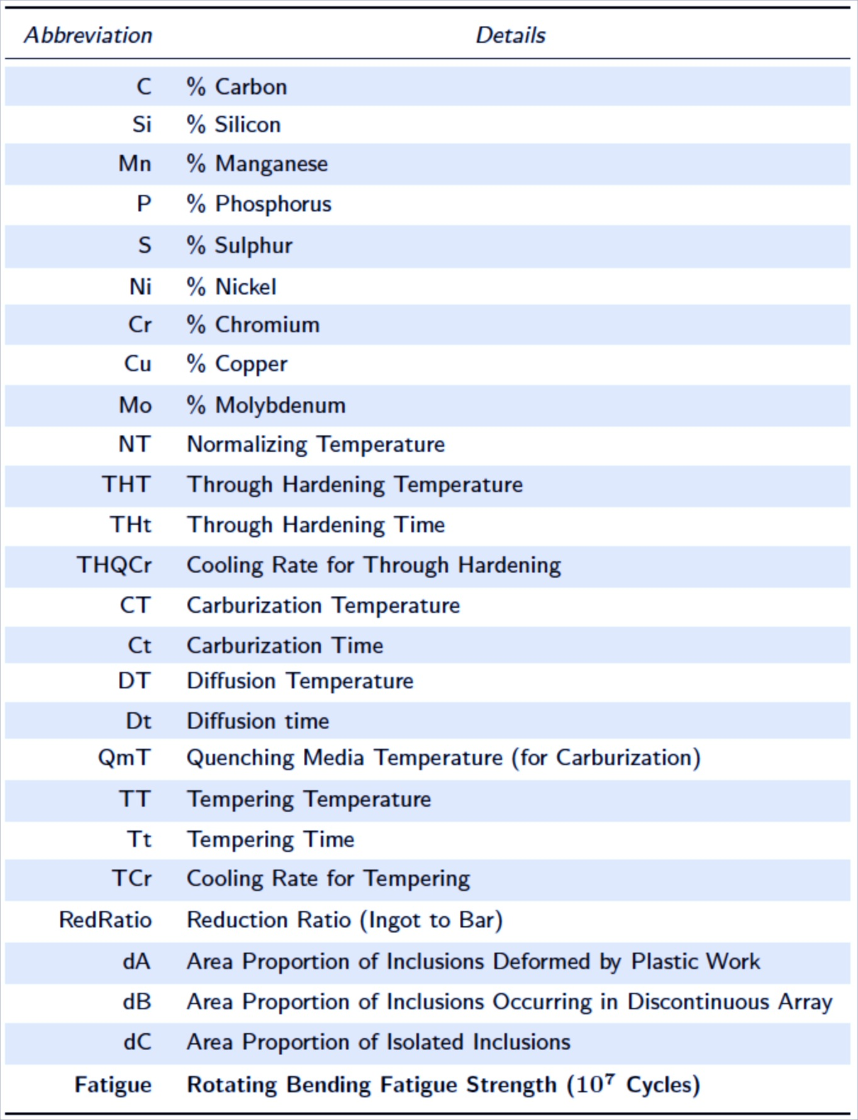
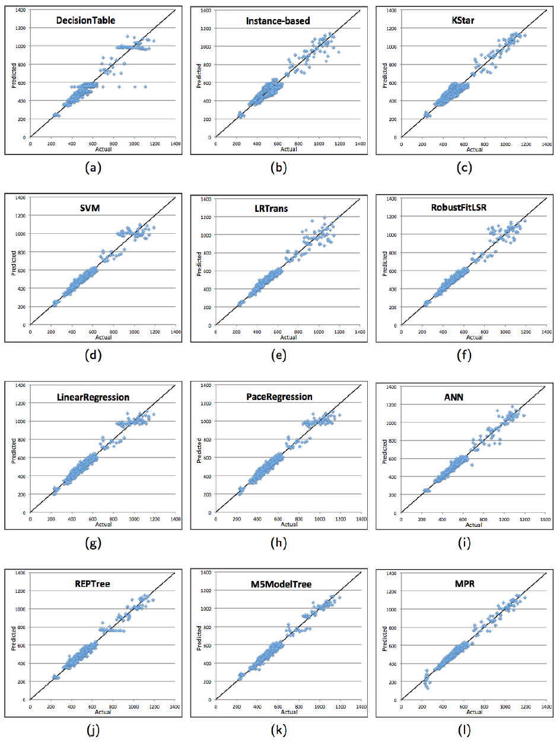
Prior Work: Steel Fatigue Strength Prediction
COMPOSITION
MANUFACTURING PROCESSES
CORRELATES TO
CORRELATES TO
PROPERTIES
(FATIGUE STRENGTH)
NIMS experimental
database
A. Agrawal, P. D. Deshpande, A. Cecen, G. P. Basavarsu, A. N. Choudhary, and S. R. Kalidindi, “Exploration of data science techniques to predict fatigue strength of steel from composition and processing parameters,” Integrating Materials and Manufacturing Innovation, 3 (8): 1–19, 2014.

Slide 6
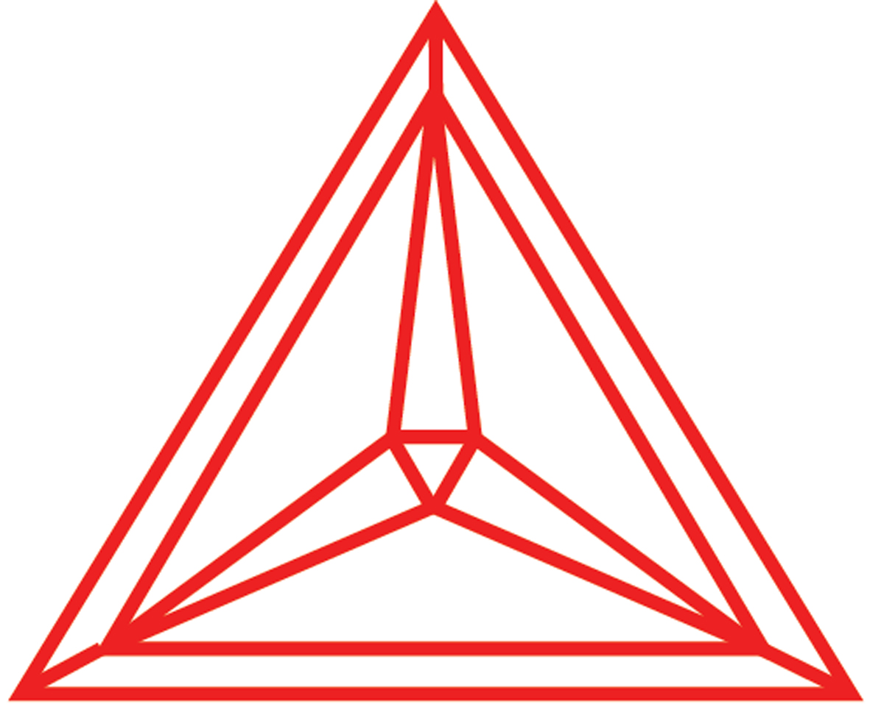
Envisioned Integration of CALPHAD and Data Mining
Contributors: Ankit Agrawal, Wei Xiong, Greg Olson, Alok Choudhary
NIMS steel database
DATA MINING
TQ interface / Thermo-Calc
Structure-Property Linkages
(More applicable than prior models)
Martensitic theory
CALPHAD model
Thermodynamic info
Volume fraction of Carbide
Volume fraction of Oxide
Martensitic temperature
Residual austenite fraction
Austenite stability

Slide 7
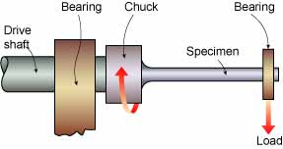
Experimental database on Fatigue Strength of carbon steels from NIMS, Japan
NIMS experimental database
for 10 component system
0.17~0.63
0.16~2.05
0.37~1.60
Normalizing temp / time
Quenching temp / time
Hardening temp / time
Carburization temp / time
Diffusion temp / time
Composition (9 element)
Inclusion, vol.%
0.00~0.03
0.00~0.03
0.01~2.78
0.01~1.17
0.01~0.26
0.00~0.24
Rotating bending fatigue strength (10⁷ Cycles)
High cycle fatigue testing

Slide 8
Advantage of coupling
CALPHAD with data-mining
Fe, C, Cr, Al, Ni
Experimental information
Fatigue
Model
CALPHAD
Attributes
of Phases
Data-mining
Fe, C, Cr, Al, Ni,
Co, Mo, Mn, etc.
Experimental information
Attributes of Phases:
Ms temperature
Inclusion volume fraction
Gibbs free energy
Austenite stability
Diffusivity
… …

Slide 9
Coupling between CALPHAD and data-mining
Data-mining
Method 2
Fatigue strength
Martensitic transformation theoretical models
Phase diagram theoretical models
Level 2 (model)
Method 1
Carbide, vol.%
Ms temperature
Retained Austensite Fraction
Inclusion, vol.% (same as experiment)
Austenite stability parameter
Level 1 (Input/Experiment)
Method 2
Normalizing temp / time
Quenching temp / time
Hardening temp / time
Carburization temp / time
Diffusion temp / time
Composition (9 element)
Inclusion, vol.%
Using Thermo-Calc/TQ toolbox, an interface has been built to convert level 1 raw data into thermodynamic key parameters (Level 2)

Slide 10


Level 2 / Model / Thermo-Calc TQ interface
Five parameters for primary consideration:
Oxide vol.% (experiment: 0.008~0.15%)
Carbide content (Thermo-Calc database)
Ms temperature
Retained Austenite Concentration
Austenite stability parameter
Ref: D.P. Koistinen and R.F. Marburger, Acta Metall. 7 (1959) 59-60.
Ref: G. Ghosh and G.B. Olson, Acta Metall. Mater., 42 (1994) 3361-3370.

Slide 11
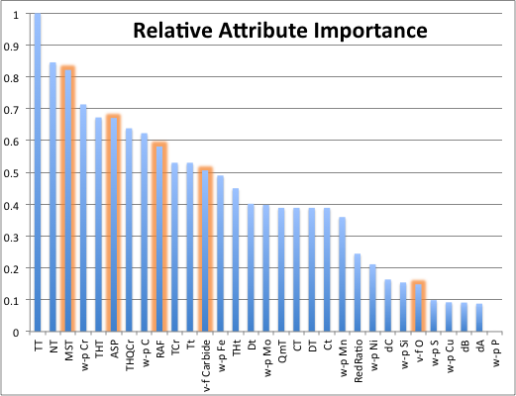
Preliminary Results: Attribute Ranking
Ms temperature is the most important parameter in data-mining

Slide 12

Existing Models for Ms Temperature
Model B:
Ref: Capdevila, et al., ISIJ International 42 (2002) 894
Ms, Model A
Model A:
Ref: Stormvinter et al., MMTA 43 (2012) 3870
Ms, Model B
Model B is generated using model based on 748 experimental data points for Ms temperature, It should be more accurate than Model A.
Notes:
http://link.springer.com/article/10.
Model C, kMart-SRG:
Ref: Ghosh and Olson, JPED 22 (2001) 199.
1007%2Fs11661-012-1171-z#/page-1

Slide 13
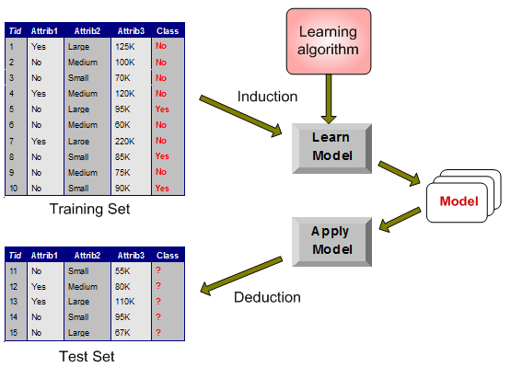
Data Mining Modeling
Classification/Regression
  Learning a predictive model based on supervised (labeled) training data, which can then be used to classify unseen data
  E.g. Decision trees, Neural Networks, Support Vector Machines, etc.
Model evaluation
  Test-train split
    Split the labeled data into training and testing sets
  Cross-validation
    Test every instance in the dataset using a model that has not seen that instance
    Types
      k-fold cross validation
      Leave-one-out cross-validation (LOOCV) with k=n

Slide 14
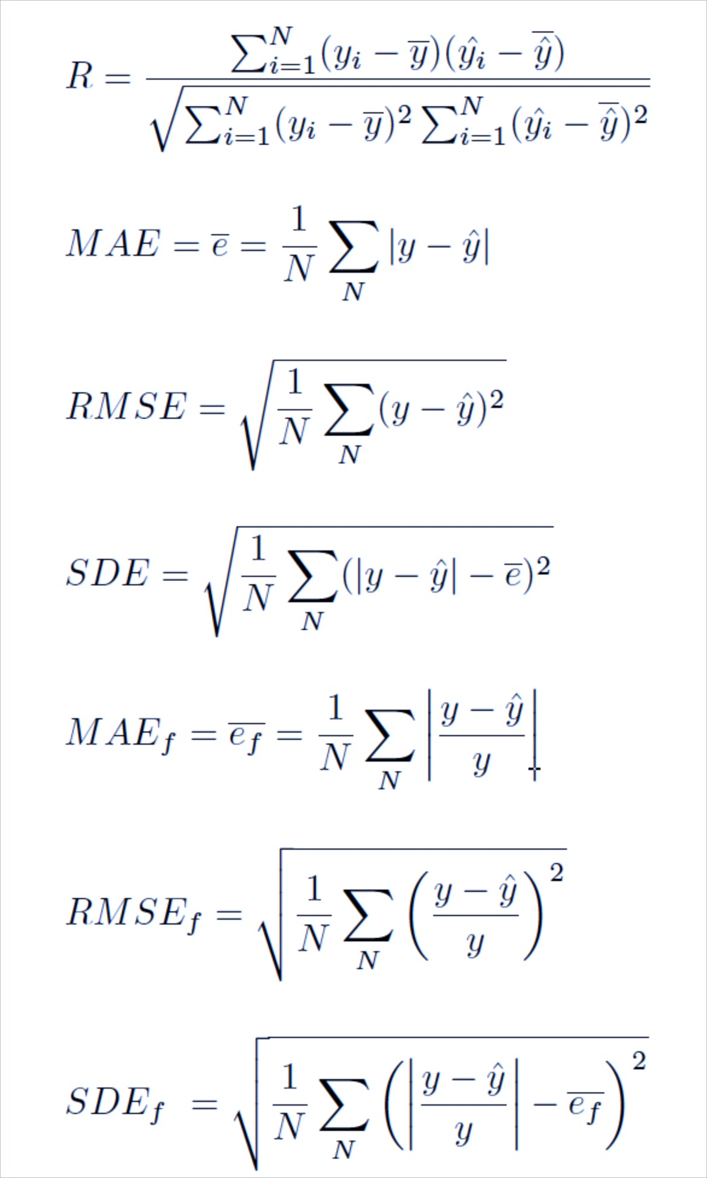
Evaluation Metrics
Compare vectors of actual and predicted values
    Coefficient of correlation (R)
    Coefficient of determination (R²)
    Mean Absolute Error (MAE)
    Root Mean Squared Error (RMSE)
    Standard Deviation of Error (SDE)
    Mean Absolute Error Fraction (MAE)
    Root Mean Squared Error Fraction (RMSE)
    Standard Deviation of Error Fraction (SDE)
Notes:
13

Slide 15
Existing Models for Ms Temperature
R²=0.5749
R²=0.6847

Slide 16
Predictive Modeling for Ms Temperature
Preprocessing
Evaluation
Predictive modeling
Testing
split
Ms Temperature Prediction Database
Experimental Data on Martensitic temperature
Training split
Leave One Out Cross Validation (LOOCV)

Slide 17
Data Mining Models for Ms Temperature
R²=0.7812
R²=0.8437
R²=0.7853
R²=0.8634
R²=0.9166
R²=0.9087

Slide 18
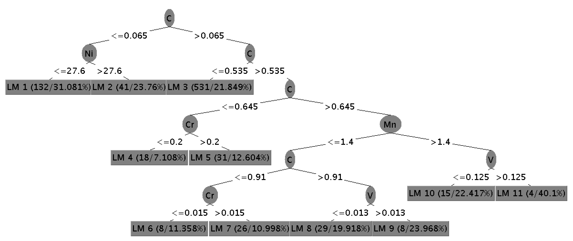
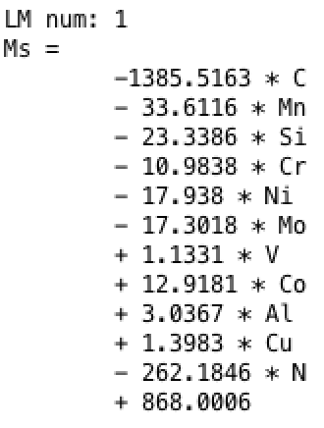
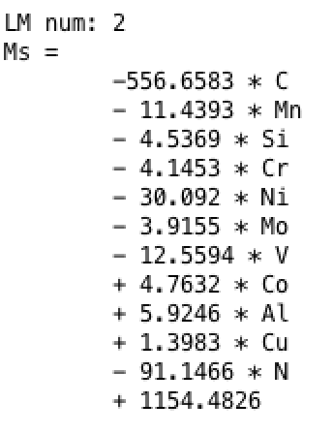
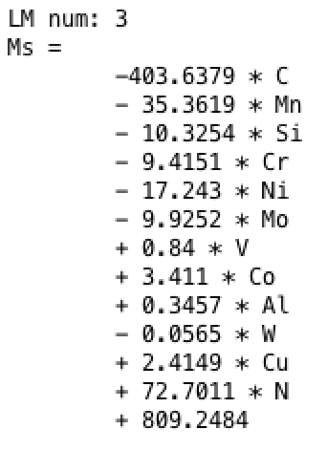
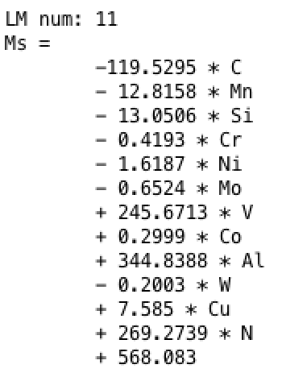
M5P Decision Tree Model for Ms Temperature
…

Slide 19
Predictive Models for Ms Temperature
 | R | R² | MAE | RMSE | MAE_{f}
Model A | 0.7582 | 0.5749 | 51.62 | 94.83 | 0.1060
Model B | 0.8275 | 0.6847 | 37.24 | 69.83 | 0.0816
Linear Regression | 0.8839 | 0.7812 | 33.85 | 55.97 | 0.0749
Neural Networks | 0.9185 | 0.8437 | 23.78 | 47.77 | 0.0474
Support Vector Machines | 0.8862 | 0.7853 | 30.43 | 55.93 | 0.0709
Nearest Neighbor | 0.9292 | 0.8634 | 27.73 | 44.55 | 0.0553
Decision Tree (M5P) | 0.9574 | 0.9166 | 20.83 | 34.45 | 0.0430
Random Forest | 0.9533 | 0.9087 | 22.92 | 36.65 | 0.0474

Slide 20
Predictive Modeling for Fatigue Strength
CALPHAD
MsT predictor
Evaluation
Predictive modeling
Testing
split
Structure-Enriched Data
Fatigue Strength Prediction Database
Experimental Data from NIMS
Training split
Leave One Out Cross Validation (LOOCV)

Slide 21
Predictive Models for Fatigue Strength
R²=0.5462
R²=0.8688
R²=0.5176
R²=0.9251
R²=0.8823
R²=0.9308

Slide 22
Predictive Models for Fatigue Strength
 | R | R² | MAE | RMSE | MAE_{f}
Linear Regression | 0.7391 | 0.5462 | 85.06 | 125.70 | 0.1606
Neural Networks | 0.9321 | 0.8688 | 51.13 | 67.55 | 0.0973
Support Vector Machines | 0.7194 | 0.5176 | 79.68 | 131.49 | 0.1392
Nearest Neighbor | 0.9618 | 0.9251 | 45.17 | 51.09 | 0.0857
Decision Table | 0.9420 | 0.8874 | 47.03 | 62.60 | 0.0857
Decision Tree (M5P) | 0.9393 | 0.8823 | 49.32 | 66.66 | 0.0952
Decision Tree (Random Tree) | 0.9566 | 0.9151 | 45.64 | 54.58 | 0.0861
Decision Tree (REPTree) | 0.9453 | 0.8936 | 42.16 | 61.13 | 0.0844
Random Forest | 0.9648 | 0.9308 | 40.92 | 49.17 | 0.0808

Slide 23
Future Directions
Improving Processing-Structure linkage
  Use better martensitic theory models
  More accurate oxide fraction, austenite stability parameter
Improving Structure-Property linkage
  Use ensemble data mining models
  Explore hierarchical predictive mining
Get access to more experimental data?
Inverse models (property-structure-processing) for steel design
Long-term vision: Verification with experiments

Slide 24
Ongoing Projects
Integrating CALPHAD and Data Mining for Advanced Steel Design
Composition-based Machine Learning Framework for Predicting Inorganic Material Properties
Fast Models for Properties of Crystalline Compounds Using Voronoi Tessellations and Machine Learning
Supervised Learning-based Microstructure Characterization and Reconstruction
Classification of Scientific Journal Articles to Support NIST Data Curation Efforts
Towards Designing OPV devices using Data Mining

Slide 25
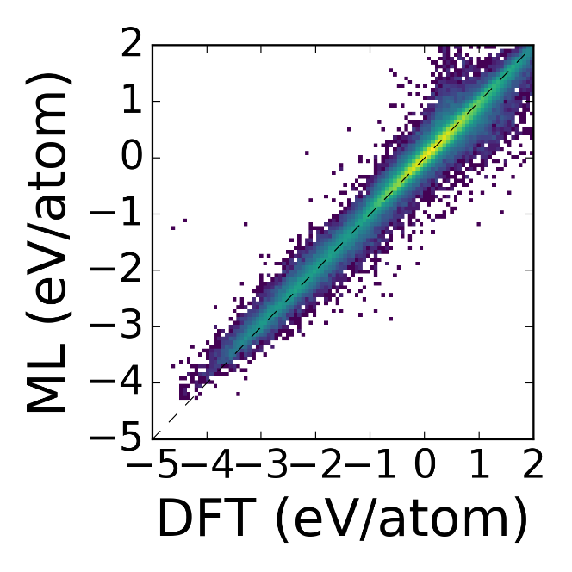
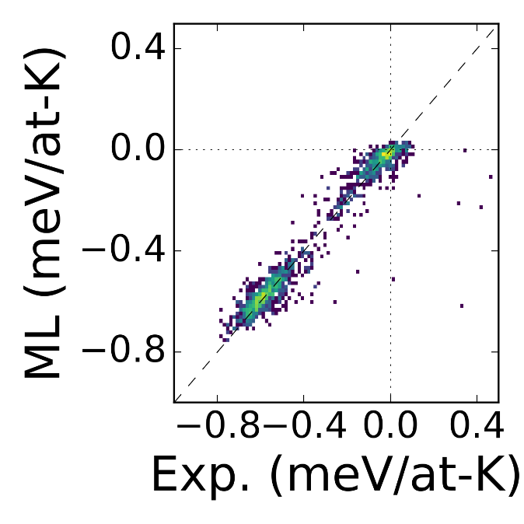
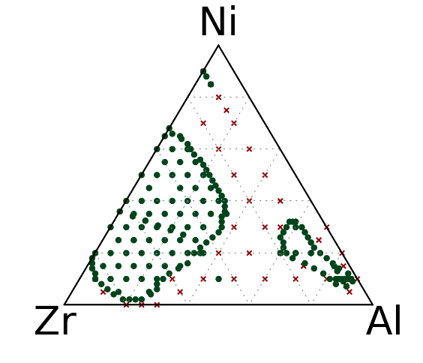
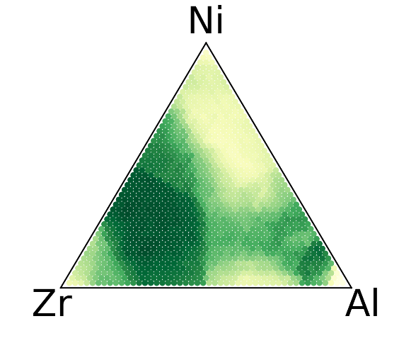


A General-Purpose Machine Learning Framework for Linking Composition and Properties
Contributors: Logan Ward, Rosanne Liu, Kareem Youssef
Ankit Agrawal, Alok Choudhary, Chris Wolverton
$ΔH_{f}$ using DFT Data
Goal: Simplify the creation of
machine learning models
Strategy:
General purpose representations
User-friendly software
GFA Using Experimental Data
$ΔS_{f}$ using Experimental Data
Measured
Predicted
Notes:
How I would present this:
Talk about the goal of our work is to streamline the process of creating new machine learning models
Discuss how we did it:
Creating 145 novel attributes to describe each compound. These attributes are designed to reflect chemical effects, and include descriptions such as the variance in electronegativity, the average melting temperature, and whether it is possible to form a neutral ionic compound.
By having a rich library of different descriptions, we can then use machine learning to create new models without having to first “re-invent” a representation.
This allows us to quickly create models for properties such as:
The formation enthalpy of crystalline compounds, using data taken from the Open Quantum Materials Database
DFT calculations require hours of CPU time to complete. Our machine learning model can make thousands of evaluations per second
The formation entropy of crystalline compounds, using experimental data taken from resources including the JANAF Tables [Side note: I use this example because NIST made the JANAF tables]
Predicting glass-forming ability of metal alloys. In cross validation, our method can predict glass forming compositions with 93% accuracy.
Metallic glasses are only possible to form at special compositions, which are hard to locate a priori
This model was trained on around 6000 experimental measurements of glass forming ability, as reported in the Landolt-Bornstein Handbook.
In a test where we excluded all data from the Al-Ni-Zr ternary from our training set, our model could reproduce the existence of two regions where it is possible

Slide 26
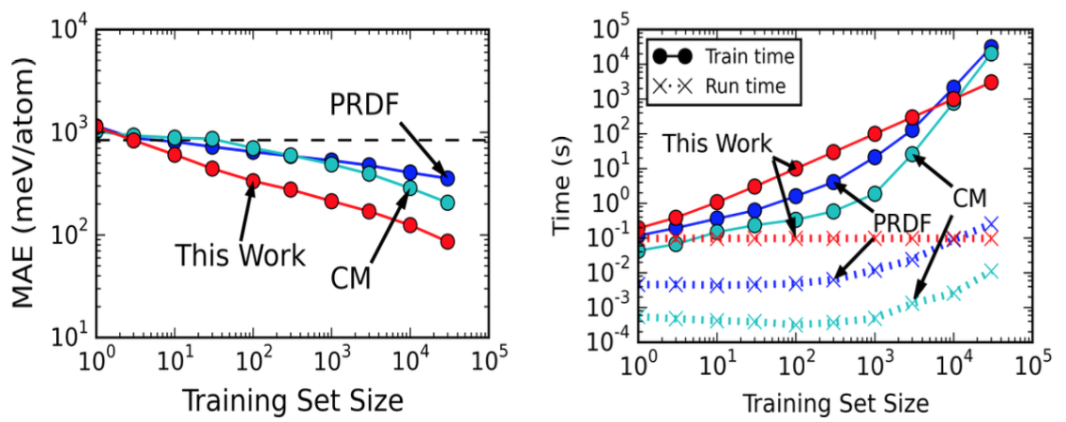
Fast Models for Properties of Crystalline Compounds Using Voronoi Tessellations and Machine Learning
Contributors: Rosanne Liu, Logan Ward, Amar Krishna, Vinay Hedge, Chris Wolverton, Ankit Agrawal, Alok Choudhary
Goal: Incorporate crystal structure
information into models
Method: Use local environment determined using Voronoi tessellation
Application: Replace / reduce DFT calculations
Example: Predicting formation energy
Notes:
When using high-throughput density functional theory to discover new materials, we start by creating a new hypothetical compound based on a novel combination of elements on a known structure. Then, we find the equilibrium positions of each atom using DFT and compute its properties – a process which takes hours per compound
We could dramatically expand the number of materials it is possible to screen using high-throughput DFT by first identifying promising candidates with machine learning
To do we’ve developed technique that uses machine learning to create a model based description of an arbitrary crystal structure based on its Voronoi tessellation
Attributes describe the local environment around an atom, and network of bonding between atoms
All without introducing any dependence on knowing the exact atomic positions. Our attributes are even length-scale-independent and are not sensitive to the choice of the unit cell
Our method fairs well compared to existing methods (i.e., Coulomb Matrix and Pair Radial Distribution Function (PRDF) Matrix approaches)
In a test of trying to predict the DFT-predicted formation energies, we beat them in accuracy
Our models also train about 10x faster and require about a third of the memory
They also run about as fast as existing methods
And, unlike the competition, they *should be* [we’re still testing this] less dependent on knowing the actual atomic coordinates

Slide 27



Structural Equation Model for Key Descriptor Identification
Contributors: Yichi Zhang, He Zhao, Cate Brinson, Wei Chen
Reduce dimension by discovering latent microstructure features
Feature extraction (Create latent factors)
Feature Selection (Choose important descriptors by weights)
Input:
Descriptor
Responses:
Property
Input data: Microstructure Descriptors
Exploratory Factor Analysis (EFA)
Grouping
& reduction
of descriptors
Latent Features
X₁
Y₁
F₁
F’₁
X₂
F₂
Y₂
Response data:
Correlation functions
/Properties
X₃
SEM Parameter Estimation
F’₂
Y₃
X₄
F₃
Y₄
X₅
$$X=λ_{x}F+e_{x}$$
$F^{′}=$ $βF+$ $ζ$
$$Y=λ_{y}F^{′}+e_{y}$$
Data
SEM based analysis
Output
Zhang, Y., Zhao, H., et al., 2015, TMS IMMI
Notes:
Structural Equation Modeling approach to identify significant microstructure descriptors with the least dependency, based on the microstructure correlation functions (CF) derived from images

Slide 28
Classification of Scientific Journal Articles to Support
NIST Data Curation Efforts
Contributors: Amar Krishna, Sarala Padi, Adele Peskin,
Ankit Agrawal, Alden Dima, Ken Kroenlein, Alok Choudhary
Goal: Automating the TRC’s document classification and curation process.
Methodology: Topic Modeling followed by Classification
Dataset: 2357 articles dataset with 1000 topics (for each article).
Results: 10-fold cross-validation classification accuracy of 0.95 (Area under the ROC curve)
Web Tool: http://info.eecs.northwestern.edu/TRCArticleClassifier/

Slide 29
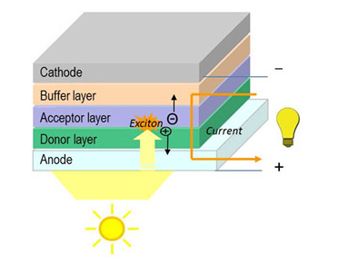
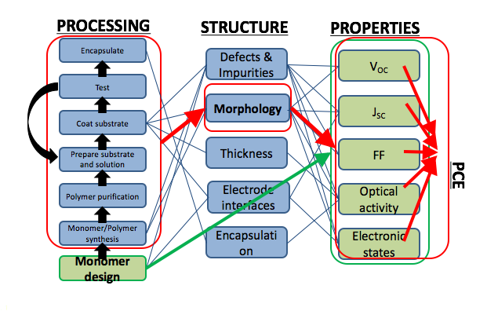
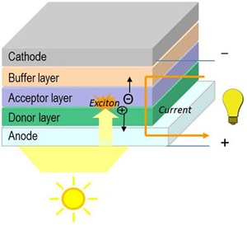
Designing optimal OPV devices by modeling Processing-Structure-Property Linkages using Machine Learning
Contributors: Arindam Paul, Alona Furmanchuk, Logan Ward, Chris Wolverton, Ankit Agrawal, Alok Choudhary
Goal: Develop a system using ML to predict devices with optimal PCE (power conversion efficiency)
Strategy:
Fingerprints
Schema based on literature to describe OPV devices
Processing TEM images of active layer to derive descriptors
Chemical Formula, Fingerprints
Build models using algorithms
Iterate for best prediction
Predict Real Data
Notes:
1. OPVs
a. Organic Photovoltaic devices are made up of polymers where monomeric units (donor, acceptor) are blended together to form the OPV. The donor receives the sunlight (absorbs photon), gets excited and donates an electron which moves towards the acceptor. This charge difference creates the electricity. OPVs have the advantage over semiconductor PVs (photovoltaics) that it is cheap, light weight and customizable (because the monomers , in particular the donor monomers can have a variety of options to choose from)
b. But, the efficiency (power conversion efficiency) is very low in OPVs. Even something as high as 10-15% is considered good for OPVs. Because the final property of the OPV device is ascertained by the processing and thereafter, structure of the device, we need to improve it.
2. We try to remedy this by 2 ways:
a. By linking the properties of the monomeric units (HOMO of the donor, LUMO of the acceptor) to the final efficiency using the Scherber model.
highest occupied molecular orbital
lowest unoccupied molecular orbital
$$V_{oc}=\left({(1}/e)\left(\left|E^{Donor}HOMO\right|−\left|E^{Aceptor}LUMO\right|\right)−0.3V\right) \\ PCE =\frac{J_{SC}V_{OC}FF}{P_{IN}}$$
This is a theoretic model which gives the maximum possible performance of the OPV device. So basically:
HOMO,LUMO->Voc->PCE
So we learn the PCE of experimental datasets of compounds, and then try to predict PCE for a new compound. This is the approach we have taken as of now, so in red.
b. The second way is to get information about the processing techniques used to make the OPV from basic monomeric units and information of the structure. By doing that, we can get an accurate prediction of the actual device performance of the device.
3. Molecular Fingerprints give an unique identifier to describe each monomer, which helps us to to link to HOMO, LUMO etc. We use a python library rdkit to get the fingerprints of a compound. We use Harvard OPV database made public to get the SMILES (which give information about the structure of a compound) and then get fingerprints from them using rdkit. As of now, we use Circular and MACCS fingerprint techniques.
4. We have used 11 regression models using scikit and then found the best performance (least MSE, highest R2) for RandomForest and Ridge classifiers.

Slide 30




Online predictive tools for thermoelectric non-stoichiometric materials
Contributors: Al’ona Furmanchuk, Ankit Agrawal, James Saal, Jeff W. Doak, Gregory B. Olson, Alok Choudhary
http://info.eecs.northwestern.edu/ThermoEl
http://info.eecs.northwestern.edu/ThermoEl
Electrical conductivity
Seebeck coefficient
Thermoelectric figure-of-merit
Temperature
Thermal conductivity

Slide 31

Thank You !
Ankit Agrawal
Research Associate Professor
Dept. of Electrical Engineering and Computer Science
Northwestern University
ankitag@eecs.northwestern.edu
www.eecs.northwestern.edu/~ankitag/

