Slide 1
OUTREACH
Emine Begum Gulsoy
CHiMaD Annual Meeting | March 23, 2016

Slide 2
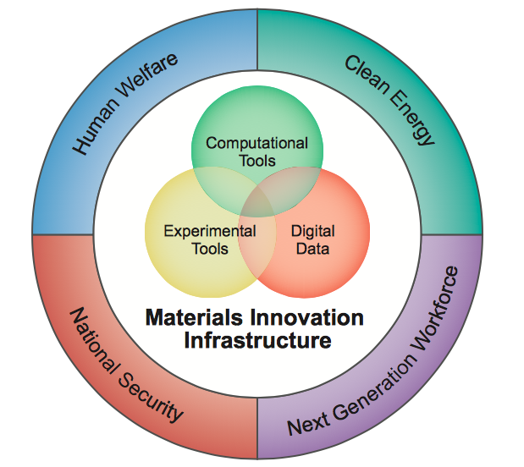
Materials Genome Initiative for Global Competitiveness – June 2011
Fundamental databases and tools enabling reduction of the
10-20 year materials creation and deployment cycle by 50% or more
Developing a Materials Innovation Infrastructure
Integrated experimental, computational, and data informatics tools
Span entire materials continuum
Open-access/Open-source
Achieving National Goals with Advanced Materials
Develop the infrastructure to design new materials
Equipping Next Generation Materials Workforce
Engaging all stakeholders
Government, academia, and industry
High-school, undergraduate, graduate and professional levels
www.whitehouse.gov/sites/default/files/microsites/ostp/materials_genome_initiative-final.pdf

Slide 3
Created at wordle.net using
outreach chapter of 2015 annual report

Slide 4
OUTREACH 2015
ASM Materials Genome Toolkit (undergraduate level)
MGI Seminar Series (graduate and professional level)
Community Standard Building (graduate and professional level)
Materials Design
Phase Field Methods
Data & Databases
SRG Materials Design Consortium
Use-case led symposia
Outreach to Underrepresented Groups (high-school, undergraduate level)
Fayetteville State University (FSU) Interactions
Chicago Area initiatives

Slide 5
Materials Genome Toolkit
ASM Materials Education Foundation & Thermo-Calc Software
12 (3-year, multi-user) state-of-art licenses worth $1.6M
For U.S. Engineering programs to build these tools into their undergraduate curriculum
In 2015 : 6+1 Licenses were awarded
In 2016 : 3 Licenses will be awarded (deadline to apply April 30)
SOFTWARE
DATABASES
Thermo-Calc
DICTRA
TC-PRISMA
TQ –Interface
TC Toolbox for MATLAB
TC-API
TCFE + MOBFE
TCAL + MOBAL
TCNI+MOBNI
TCMG

Slide 6
Materials Genome Toolkit
Schools are required to take part in ASM Undergraduate Design Competition
California State Polytechnic University in Pomona
Carnegie Mellon University
Michigan Technological Institute
Alfred University
University of Maryland
Virginia Polytechnic Institute and State University
Colorado School of Mines (LIFT)
Fayetteville State University (CHiMaD)
1st Place
2nd Place
3rd Place
Thermo-Calc Software Introductory and Advanced Training & Introduction to Materials Design
July 6-8, CMU, Pittsburgh
Notes:
LIFT (lightweight innovations for tomorrow)

Slide 7
MGI Seminar Series
15 colleagues, mostly international, gave seminars
(majority from US, Japan)
Broadcast, using Go-to-Meeting, connecting researchers from NIST, NU, UC, ANL
chimad.northwestern.edu/news-events/upcoming-events.html
chimad.northwestern.edu/news-events/SeminarBroadcast.html
CHiMaD Listserv –
To join please email me (e-gulsoy@northwestern.edu)
chimad.northwestern.edu/people/staff.html

Slide 8
Community Standard Building:
Phase Field Methods
SRG Materials Design Consortium & NU-NIMS for Materials Innovation: Joint Workshop
Data, Database & Discovery
Innovation in Sheet Metal Forming
NIST Diffusion/CALPHAD Data Informatics and Tools Workshop
Advanced Co-based Superalloys (NIST)
1st US-Japan Materials Genome Workshop
CHiMaD Materials Design
Use-case led symposia
Semi-automated Data Base Creation Course

Slide 9
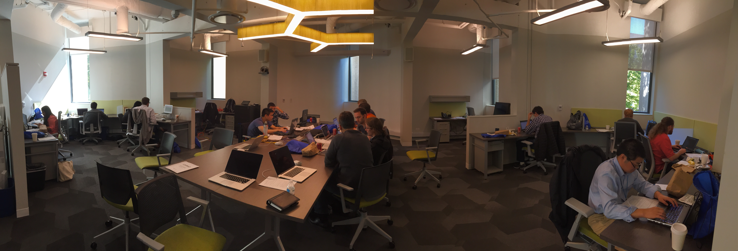
Community Standard Building: Phase Field Methods Workshop I –II & Hackathon
Jan 9 | Oct 14-16
Heinonen / Voorhees

Slide 10
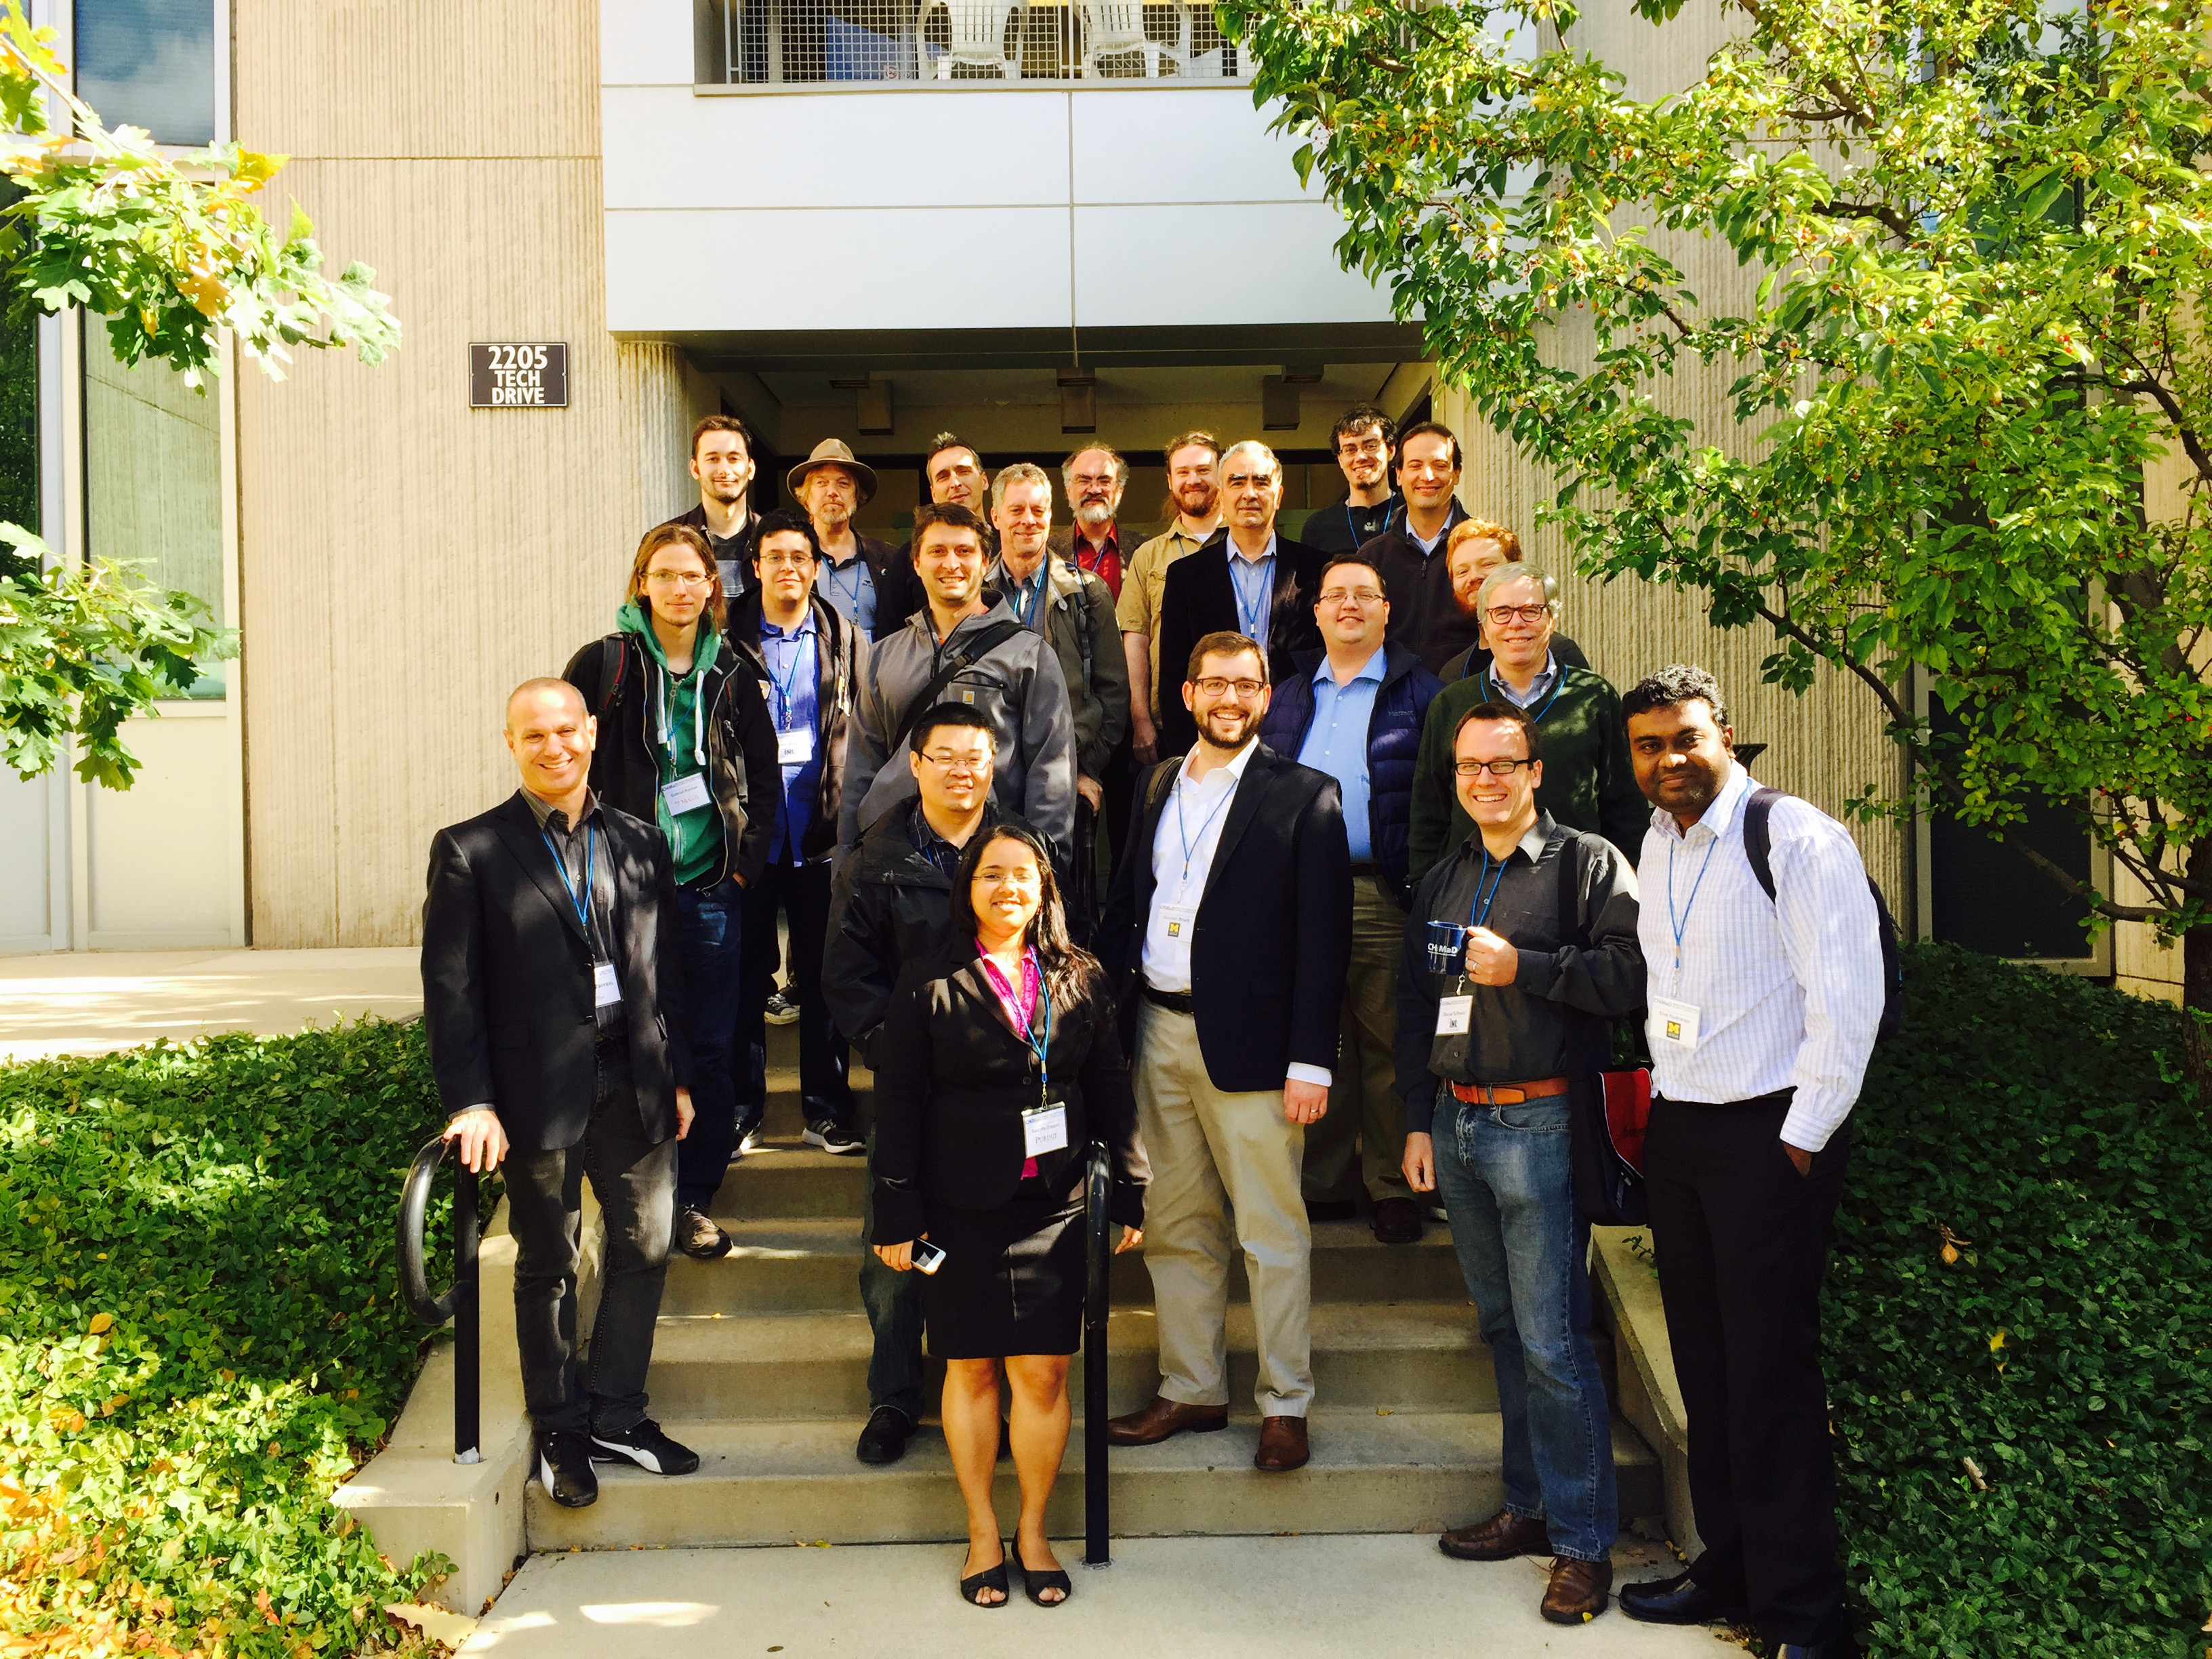
Community Standard Building: Phase Field Methods Workshop I –II & Hackathon
Jan 9 | Oct 14-16
Heinonen / Voorhees
Workshop I
High-level introduction of methods by major code developers
Discussion on standard building
Benchmark problem team nominated
(Heinonen, Voorhees, Warren, Guyer)
Hackathon
6 Teams (12 Participants)
24 hours
Solved the 2 proposed benchmark problems
Workshop II
27 Attendees
Discussed and revised the proposed benchmark problems
Will be made available, along with solutions, on the PF website by NIST
Workshop III & Hackathon May 3-5, 2016

Slide 11
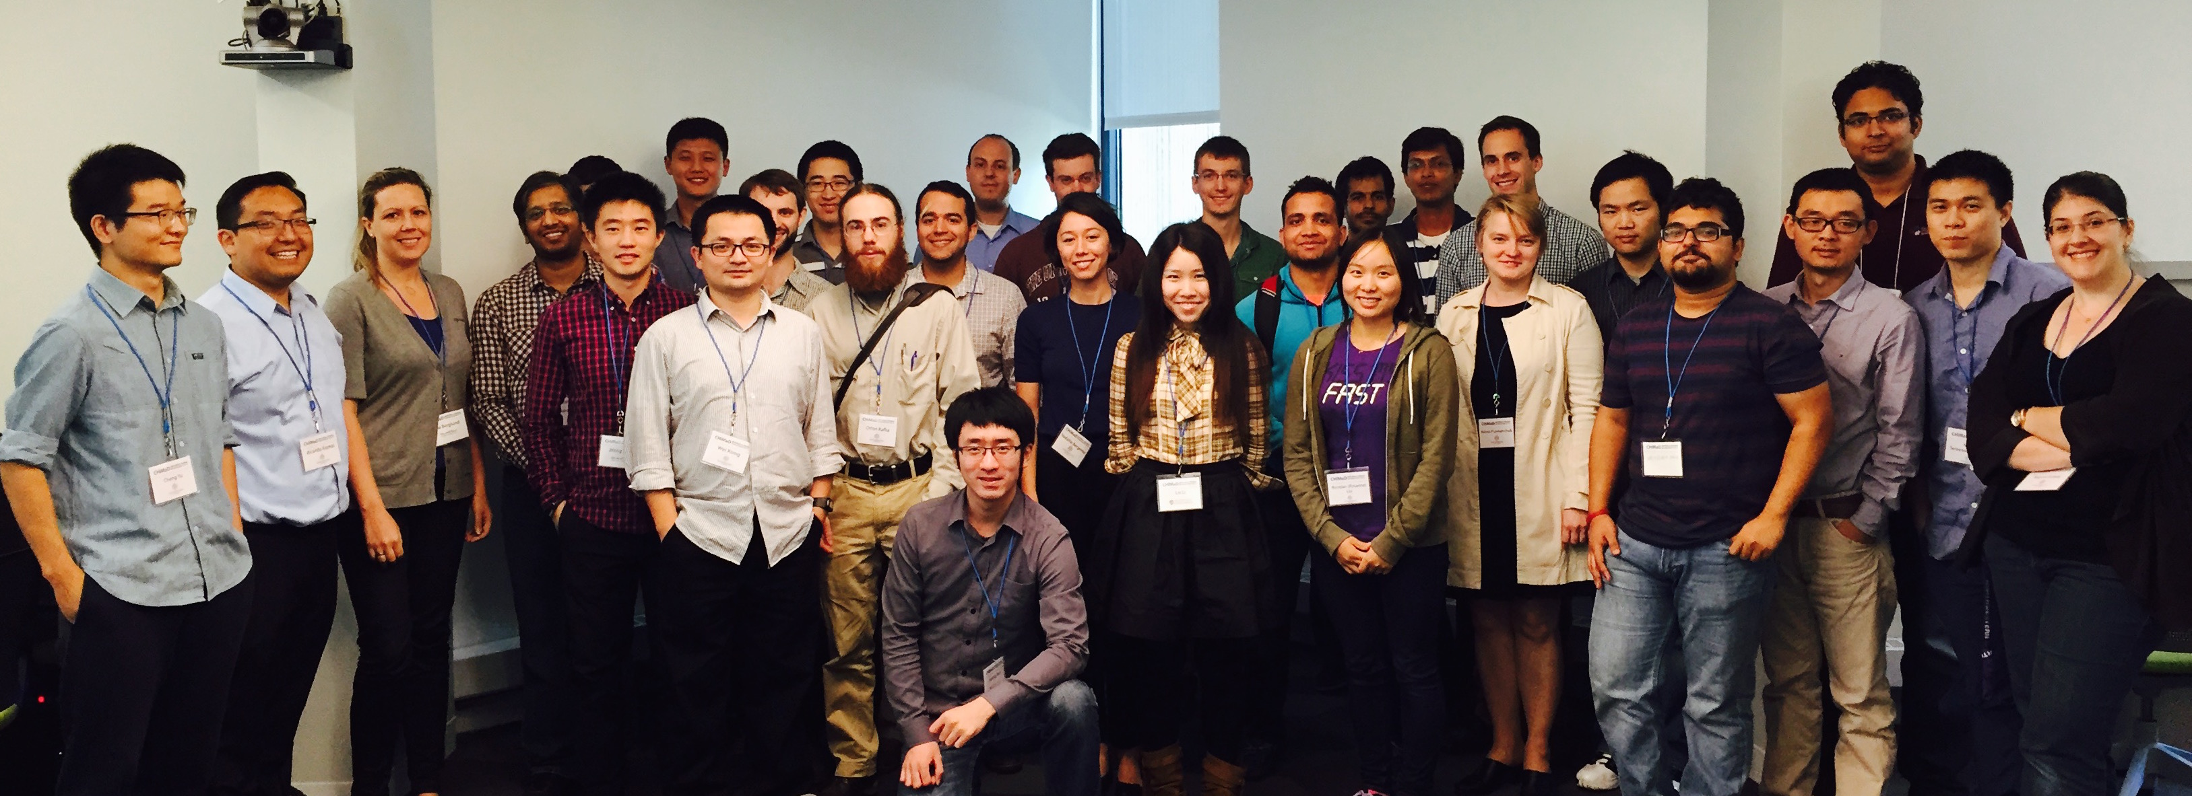
Community Standard Building: Materials Design Workshop I - II
Sep 24-25 | Mar 3-4
Olson
Komai / Xiong/ Gulsoy

Slide 12
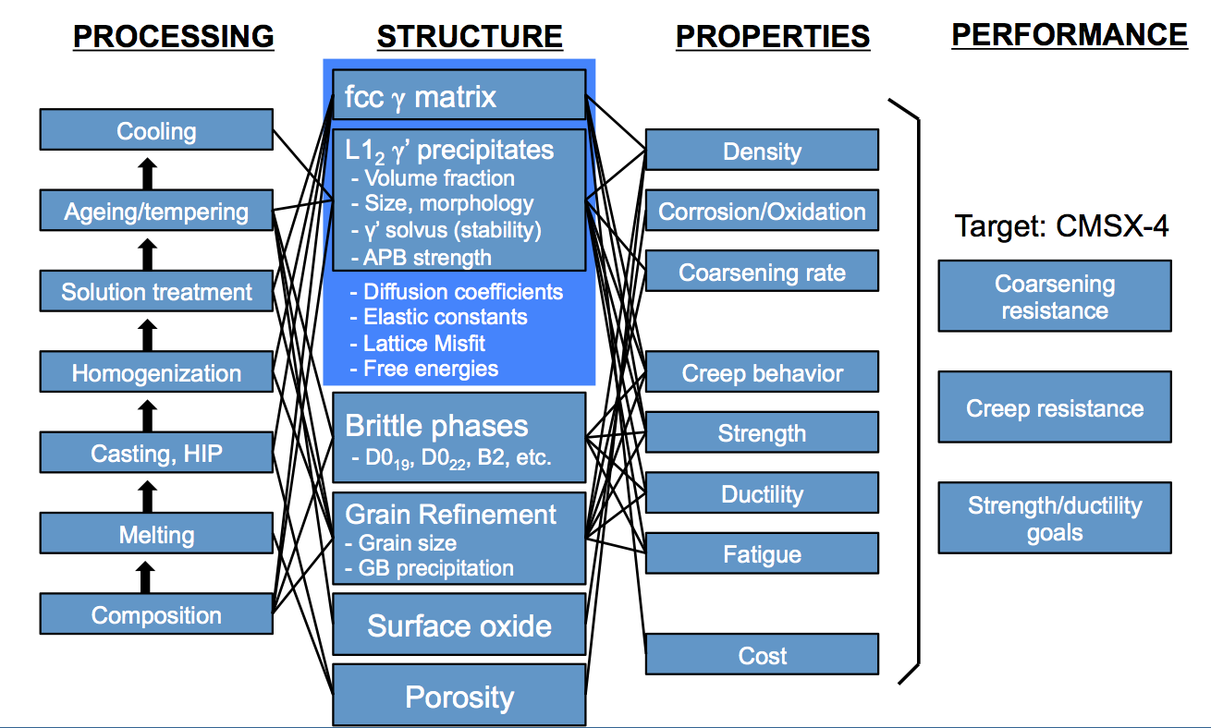
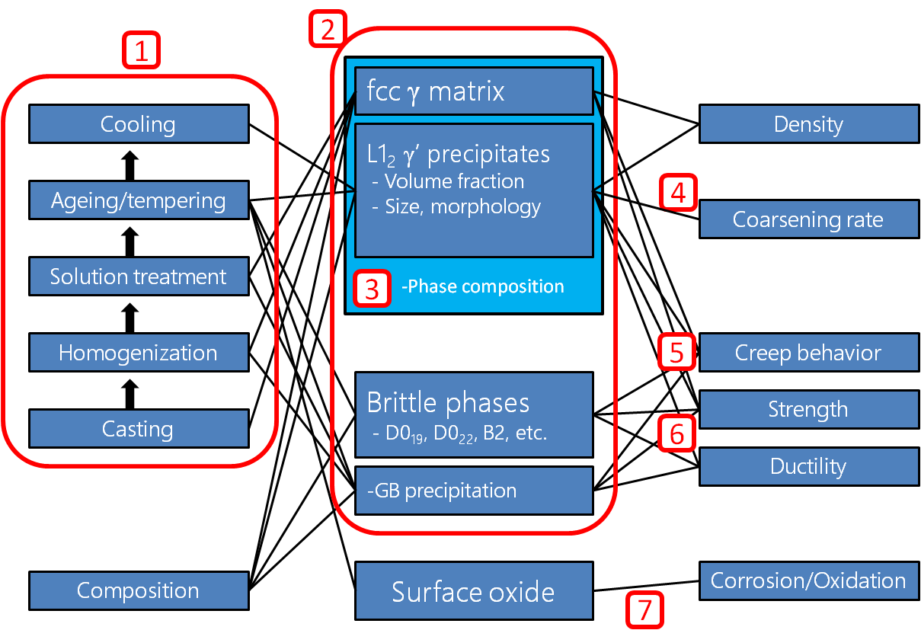
Community Standard Building: Materials Design Workshop I - II
Sep 24-25 | Mar 3-4
Olson
Komai / Xiong/ Gulsoy
Workshop I
33 attendees
10 System Design Charts
6 Material Summaries
2 days of Lectures and Working Sessions
1 Report
Workshop II
21 attendees
4 System Design Charts refined
Subsystems identified
2 days of Working sessions and Presentations
1 Report (in progress)
OPV & Data Mining Collaboration
Workshop III @ NIST – JUN 13-14 (Campbell)
Notes:
OPV & Data Mining

Slide 13
Community Standard Building: Steel Research Group (SRG) Materials Design Consortium
31st SRG Meeting (2015) – Mar 24-25, 2015
Broadcast live for the first time!
Majority of attendees are from industry – largest attended SRG to date
32nd SRG Meeting (2015) – Mar 21-22, 2016
Broadcast live, 34 registered to virtually attend
80 registered to attend on site
Notes:
QuesTek has secured a $3.6M consortium project with CHiMaD to apply this approach to integrated compound discovery and predictive microstructural design in thermoelectric materials

Slide 14
Community Standard Building: Semi-Automated Data Base Creation course
De Pablo / Audus / Foster
Organizers have developed a model for semi-automated data base creation
Course designed for data entry “verification step” implementation
Manuscript submitted for publication

Slide 15
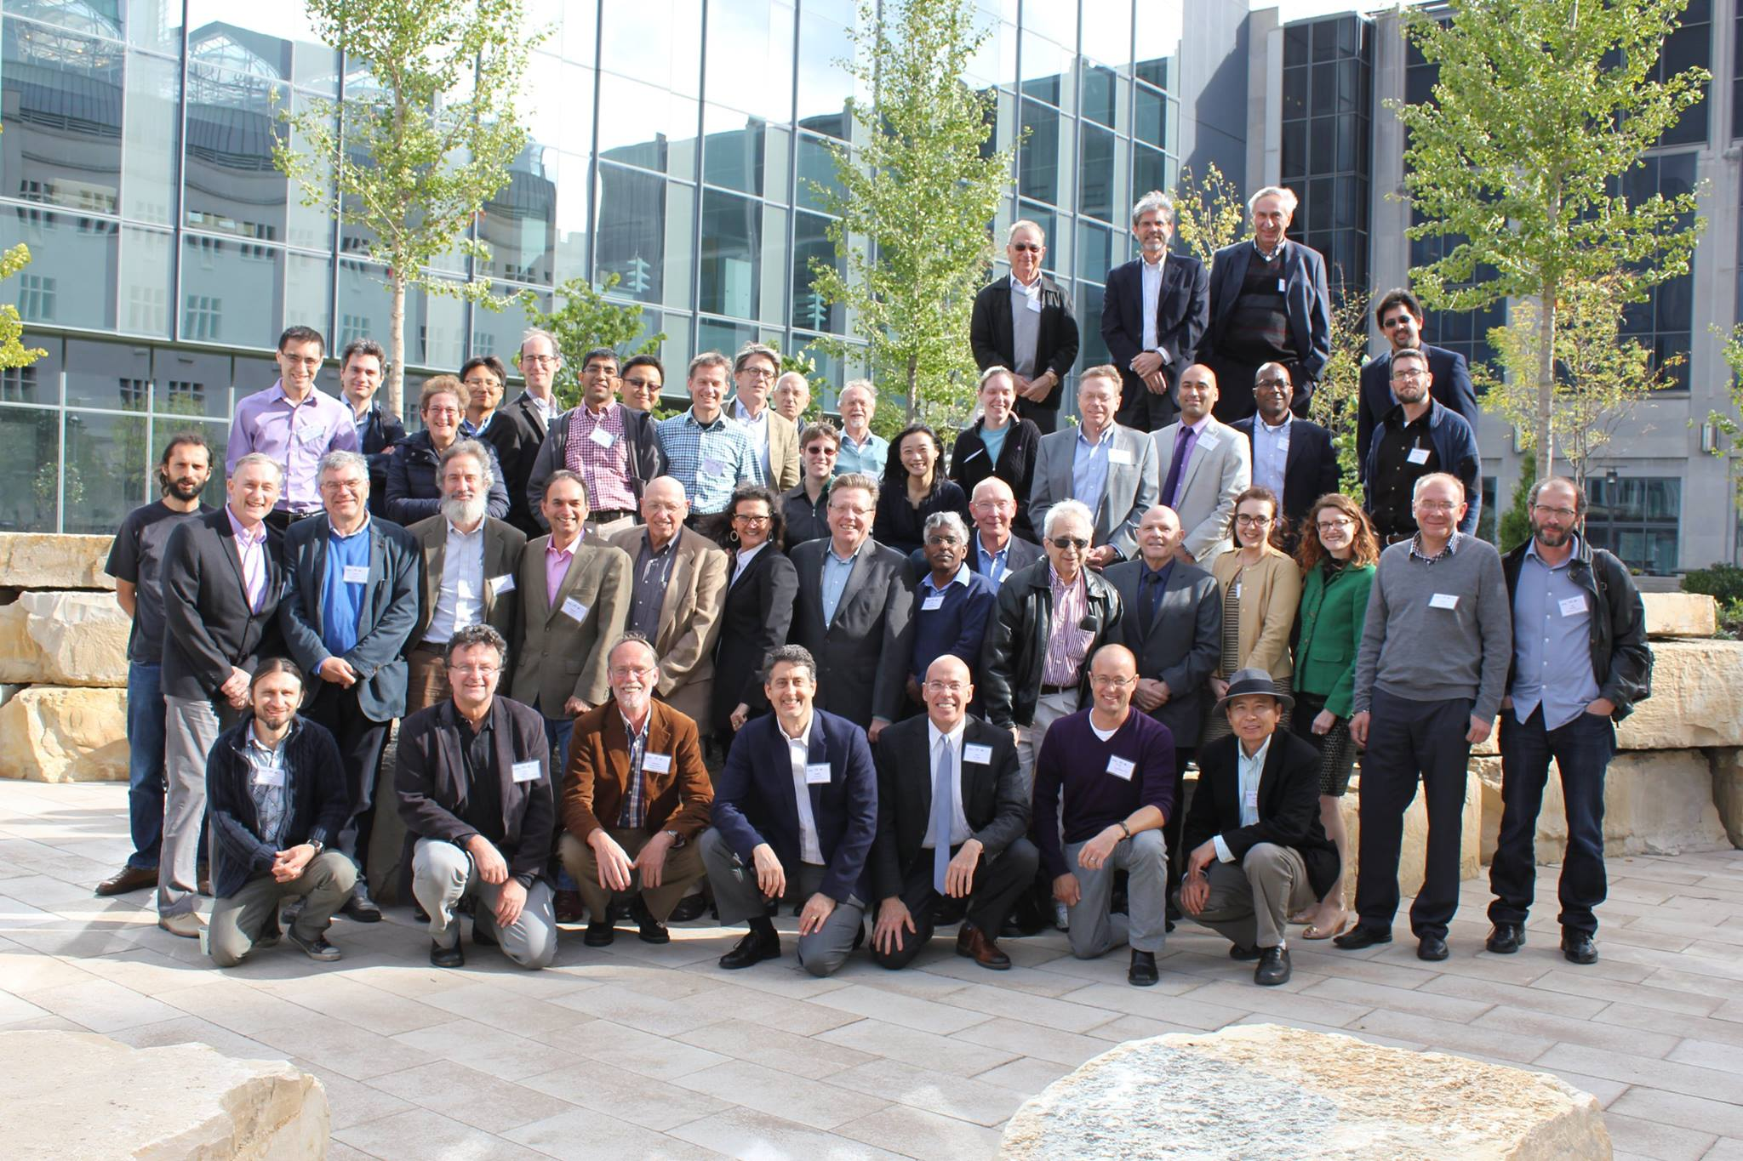
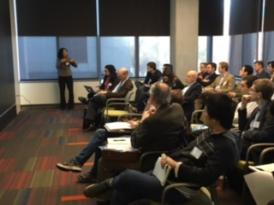
Community Standard Building: Use-case led Symposia
Scientific Symposium on Multivalent Interactions in Polyelectrolytes: New Physics, Biology and Materials
October 2-4, 2015 @ University of Chicago
Organizers: De Pablo, Gibson, Olvera de la Cruz, Prabhu, Tirrell
100 attendees, 40 Invited Talks
Special recognition:
Matthew Tirell’s accomplishments
Advances and Challenges in
Soft Matter Photovoltaic Research
Nov 13-14, 2015 @ University of Chicago
Organizers: Yu, Marks, Richter
> 50 attendees, 11 Invited Talks

Slide 16
Community Standard Building: Data & Databases
Bartolo
Warren, Foster, Campbell
Workshop I – Jan 25-26, 2016
CHiMaD Data, Database & Discovery Workshop
CHiMaD & NIST Efforts
Data management practices to support data discovery, exchange, and re-use
6 Working groups: MDCS, Dspace, MRR, MDF, Experimental Data, Schemas for Polymer Nanocomposites, Natural Language Processing, DFT, Calphad proto-databases
BD-SPOKE Proposal – Midwest Consortium
Workshop II – May 2, 2016
Building an Interoperable Materials Data Infrastructure
4 Working groups: materials design research, tools & services, infrastructure,
interoperability
Workshop III – Oct 31-Nov 2, 2016
NIST/CHiMaD Materials Data Summit
Bring significant national and international materials efforts together with government funding agencies and potential industrial partners to make progress on the discovery, interoperability, and federation of materials data

Slide 17
Outreach to Under Represented Groups: Fayetteville State University
Materials Design Course (MAT 390 – NU/Olson) was broadcast to FSU
Two students & two faculty followed the course lectures in Spring 2015
a 3-year license to Materials Genome Toolkit was negotiated with Thermo-Calc, provided to FSU, at no cost to FSU
Nana Ofori-Opoku gave a CHiMaD seminar at FSU (October 2015)
sponsored a spot at the NU-MRSEC REU Program (Summer 2016) for an FSU student to work on a materials design project with the Precipitation-Strengthened Alloys use-case group
Samuel Cabrera (UC Irvine) will join NU-MRSEC REU Program (Summer 2016) to work on a materials design project with the Precipitation-Strengthened Alloys use-case group*
*joined the SRG Broadcasting on March 21-22, 2016
Notes:
Following the course, we aimed to extend and improve our interaction.
License was provided to FSU and a spot at REU program was sponsored. – to get an FSU student to spend a summer at NU working with precipitation-strengthened alloys use-case researchers. There were no takers so we extended the invitation to other institutions through the CAMP (California Louis Stokes Alliance tor Minority Participation) program, as well as others in CA system and got applications. One of the advantages is those schools also have quarter system which makes it difficult to participate on other REU programs. Two showed interest in CHiMaD project (one applicant from University of Pittsburgh and one from UCIrvine) and Samuel was chosen. He has a indicated an interest in the advertised project and had a very strong application that seemed to align well with an interest in applying for graduate school.

Slide 18
Outreach to Under Represented Groups: Chicago Area
Collaborating with The University of Chicago Collegiate Scholars Program
Led by CHiMaD Director Juan de Pablo
a 3-year program that aims to prepare talented Chicago Public Schools students in grades 10-12 for admission and success at the nation’s top colleges and universities
100% attend four-year colleges
70% attend most or highly selective colleges and universities
College Success: 73% graduate within 4 years; 93% graduate within 6 years
https://collegiatescholars.uchicago.edu
Notes:
Following the course, we aimed to extend and improve our interaction.
License was provided to FSU and a spot at REU program was sponsored. – to get an FSU student to spend a summer at NU working with precipitation-strengthened alloys use-case researchers. There were no takers so we extended the invitation to other institutions through the CAMP (California Louis Stokes Alliance tor Minority Participation) program, as well as others in CA system and got applications. One of the advantages is those schools also have quarter system which makes it difficult to participate on other REU programs. Two showed interest in CHiMaD project (one applicant from University of Pittsburgh and one from UCIrvine) and Samuel was chosen. He has a indicated an interest in the advertised project and had a very strong application that seemed to align well with an interest in applying for graduate school.

Slide 19
Outreach to Under Represented Groups: Chicago Area
Collaborating with The University of Chicago Collegiate Scholars Program
Led by CHiMaD Director Juan de Pablo
2-week summer school on Materials Design in July 2016
Organizing instructors: Juan de Pablo and Ricardo Komai
CHiMaD PIs will also support this effort
https://collegiatescholars.uchicago.edu
Notes:
Following the course, we aimed to extend and improve our interaction.
License was provided to FSU and a spot at REU program was sponsored. – to get an FSU student to spend a summer at NU working with precipitation-strengthened alloys use-case researchers. There were no takers so we extended the invitation to other institutions through the CAMP (California Louis Stokes Alliance tor Minority Participation) program, as well as others in CA system and got applications. One of the advantages is those schools also have quarter system which makes it difficult to participate on other REU programs. Two showed interest in CHiMaD project (one applicant from University of Pittsburgh and one from UCIrvine) and Samuel was chosen. He has a indicated an interest in the advertised project and had a very strong application that seemed to align well with an interest in applying for graduate school.

Slide 20
Upcoming Events
MAY 2: CHiMaD Data, Database & Discovery Workshop II:
Building an Interoperable Materials Data Infrastructure
(Warren, Foster, Campbell, Bartolo)
MAY 3: Materials Data Curation System Training @ CHiMaD HQ
MAY 3: CHiMaD Phase Field Methods Hackathon
MAY 4-5: CHiMaD Phase Field Methods Workshop III
JUN 13-14: CHiMaD Materials Design Workshop @ NIST
JUL 6-8: Thermo-Calc Training @ CMU
OCT 31-NOV 2: CHiMaD Materials Data Summit
CHiMaD Listserv –
To join please email me (e-gulsoy@northwestern.edu)
chimad.northwestern.edu/people/staff.html

