Slide 1
Cobalt Alloy Design
(Olson & Dunand, leads)

Slide 2
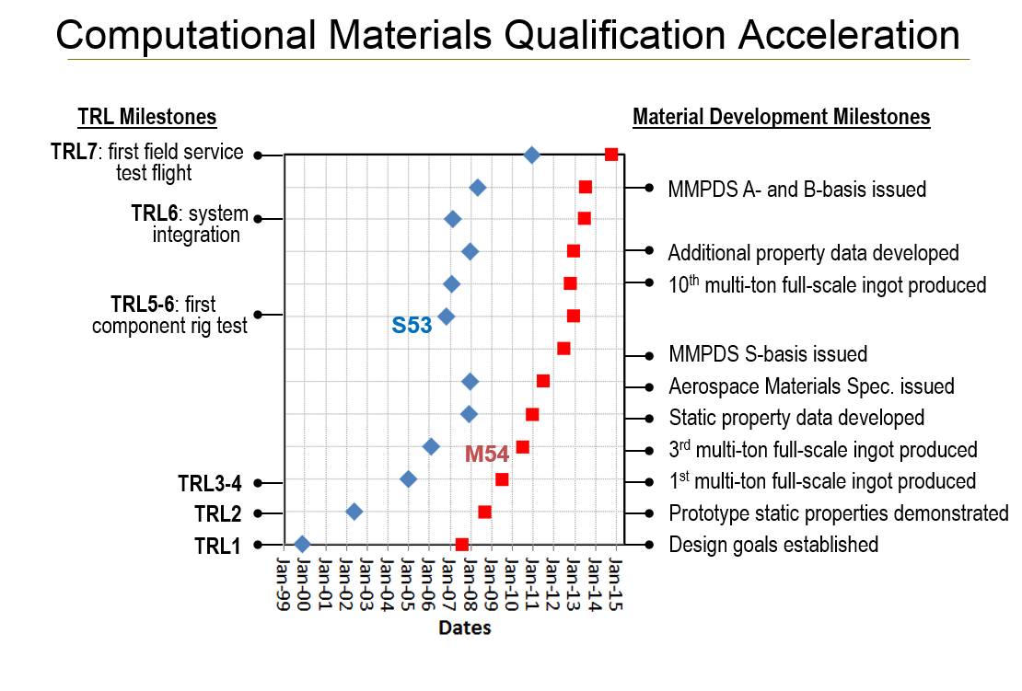


Slide 3



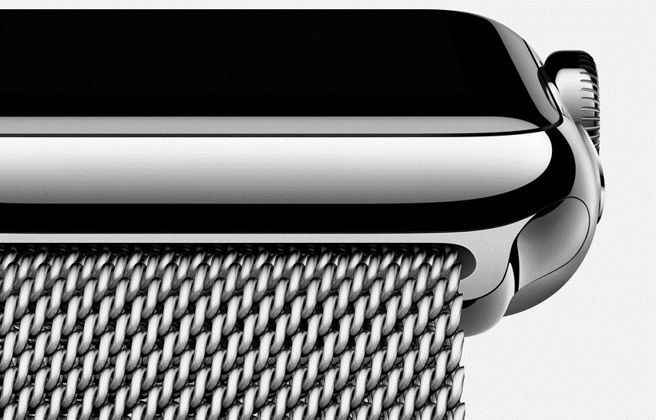
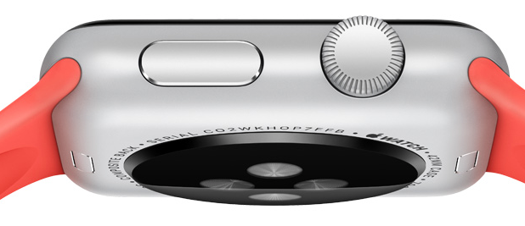
Apple watch
-Announced September 2014
Baseline: 316L Stainless Steel
High Strength 18K Gold
-Cold-forged to 40% harder
-Special purity mirror finish
-2X harder
Milanese Loop Alloy
Anodizable 7000 Aluminum
-60% stronger Al
-30% lighter than 316L
-Custom Magnetic Stainless Steel

Slide 4


Slide 5
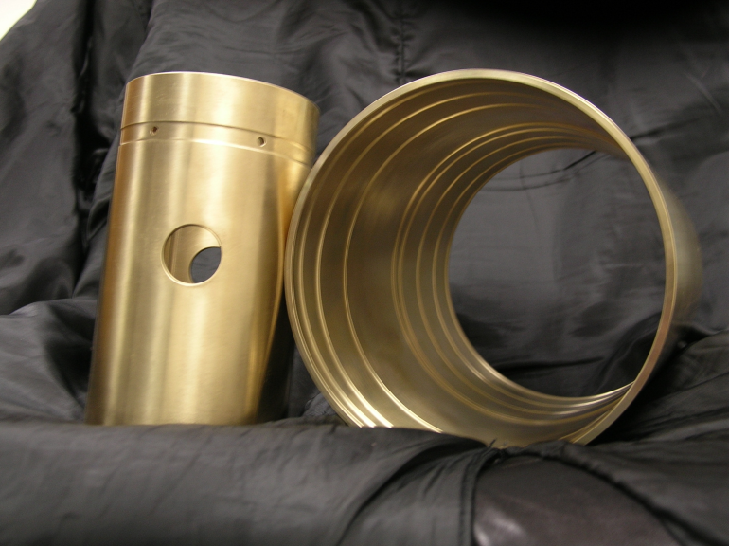
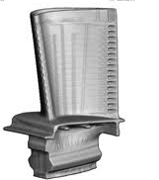
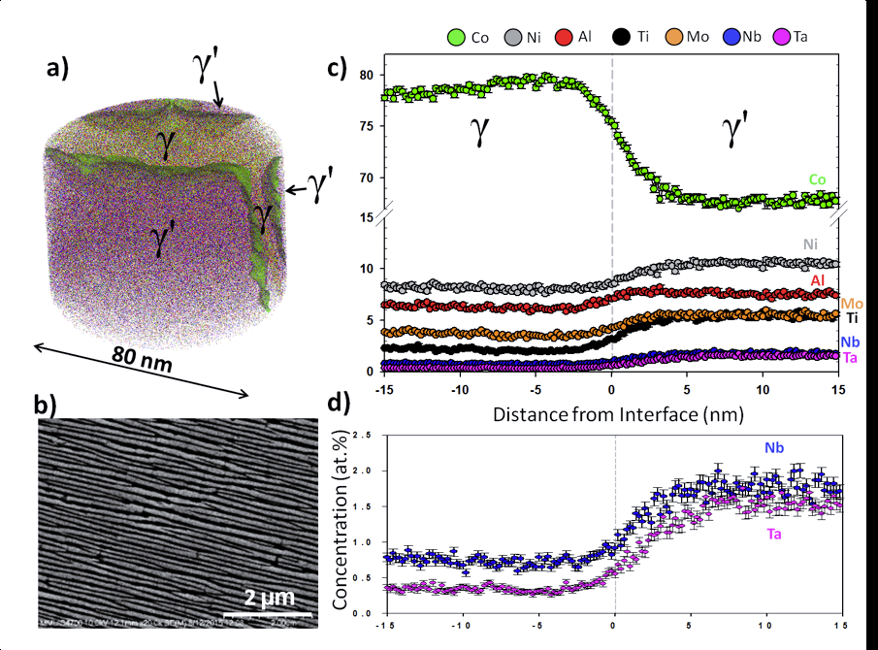
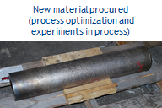
USE-CASE GROUP
G. OLSON, D. DUNAND, NU
PRECIPITATION-STRENGTHENED ALLOYS: Co-based
DESIGN GOALS
Near-term: Apply accelerated insertion of materials (AIM) approach for accelerated qualification of precipitation-strengthened Co-based bushing/actuator alloy use case
Longer-term: Apply computational design to high-temperature Co alloys
Continued refinement of Co thermodynamic and mobility databases in NIST collaboration.
Procured new 300-lb VIM/VAR heat of QT-Co bushing alloy, refined homogenization and forging conditions for completion of thermal process optimization; new QT SBIR obtained to aid AIM qualification.
Detailed microanalysis of experimental alloys quantify phase relations for high-temperature alloys and populate pre-CALPHAD data.
Search cross-plot of fundamental data prioritizes new components for high-throughput experiment and theory, supporting expanded CALPHAD assessment
New 300# VIM/VAR heat
QT-Co homogenized
& hot forged

Slide 9
Combinatorial Approach
Michael Bedzyk and Yip-Wah Chung
Investigate Co-Ti-Ta and Co-Ni-Ta ternary systems.
Magnetron sputtering combined with in-situ high temperature XRD measurements for phase information.
Quickly and easily deposit and investigate ternary alloys.

Slide 10
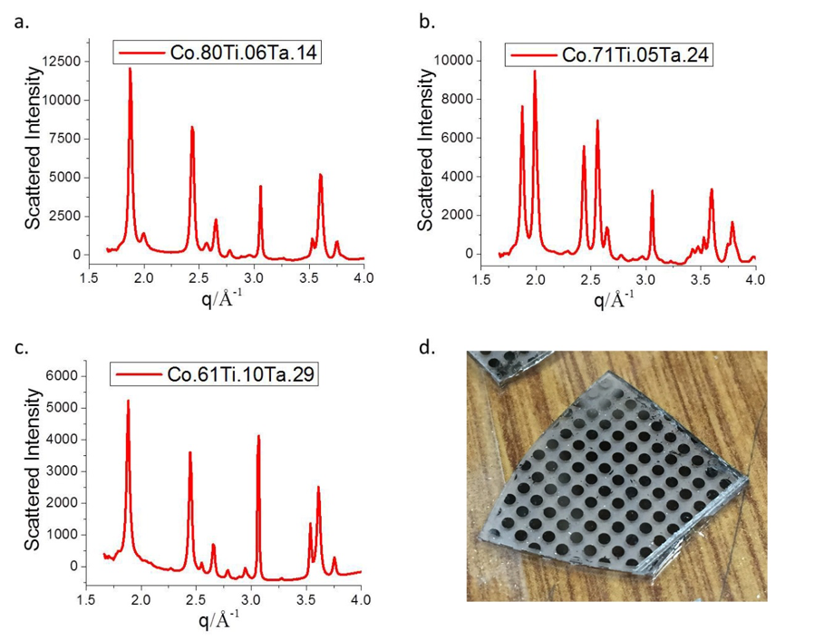

Slide 12
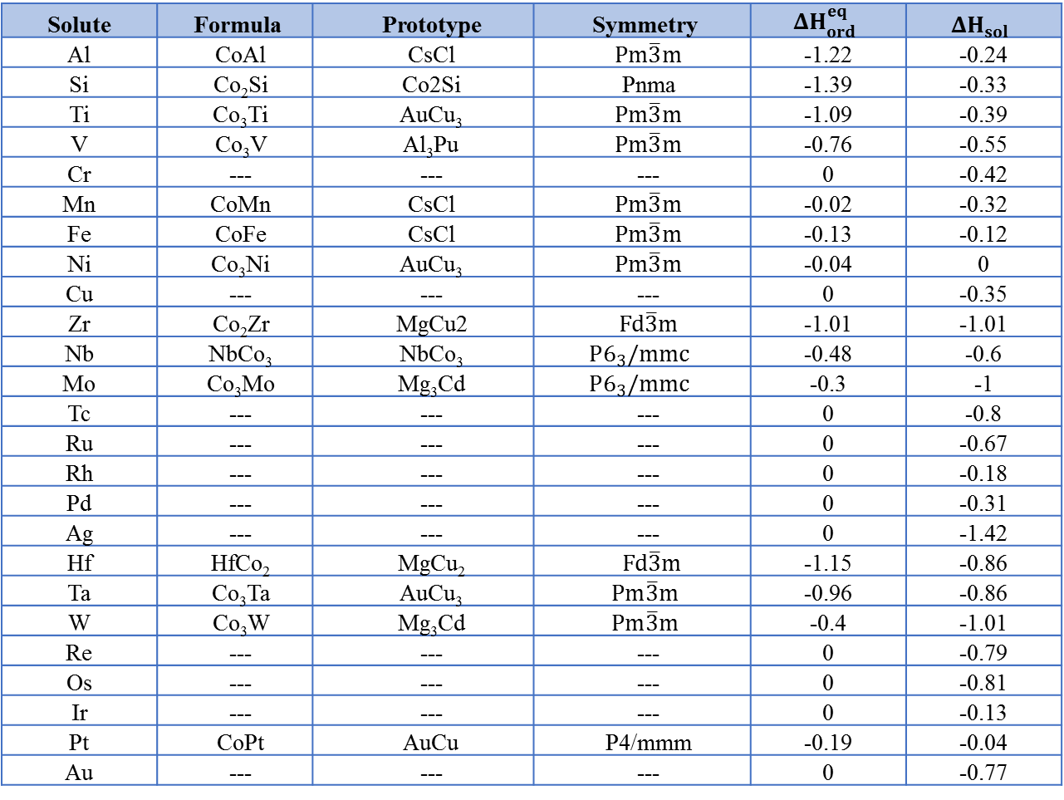
Solute | Formula | Prototype | Symmetry
Al | CoAl | CsCl |  | -1.22 | -0.24
Si | Co₂Si | Co2Si | Pnma | -1.39 | -0.33
Ti | Co₃Ti | AuCu₃ |  | -1.09 | -0.39
V | Co₃V | Al₃Pu |  | -0.76 | -0.55
Cr | --- | --- | --- | 0 | -0.42
Mn | CoMn | CsCl |  | -0.02 | -0.32
Fe | CoFe | CsCl |  | -0.13 | -0.12
Ni | Co₃Ni | AuCu₃ |  | -0.04 | 0
Cu | --- | --- | --- | 0 | -0.35
Zr | Co₂Zr | MgCu2 |  | -1.01 | -1.01
Nb | NbCo₃ | NbCo₃ |  | -0.48 | -0.6
Mo | Co₃Mo | Mg₃Cd |  | -0.3 | -1
Tc | --- | --- | --- | 0 | -0.8
Ru | --- | --- | --- | 0 | -0.67
Rh | --- | --- | --- | 0 | -0.18
Pd | --- | --- | --- | 0 | -0.31
Ag | --- | --- | --- | 0 | -1.42
Hf | HfCo₂ | MgCu₂ |  | -1.15 | -0.86
Ta | Co₃Ta | AuCu₃ |  | -0.96 | -0.86
W | Co₃W | Mg₃Cd |  | -0.4 | -1.01
Re | --- | --- | --- | 0 | -0.79
Os | --- | --- | --- | 0 | -0.81
Ir | --- | --- | --- | 0 | -0.13
Pt | CoPt | AuCu | P4/mmm | -0.19 | -0.04
Au | --- | --- | --- | 0 | -0.77

Slide 13
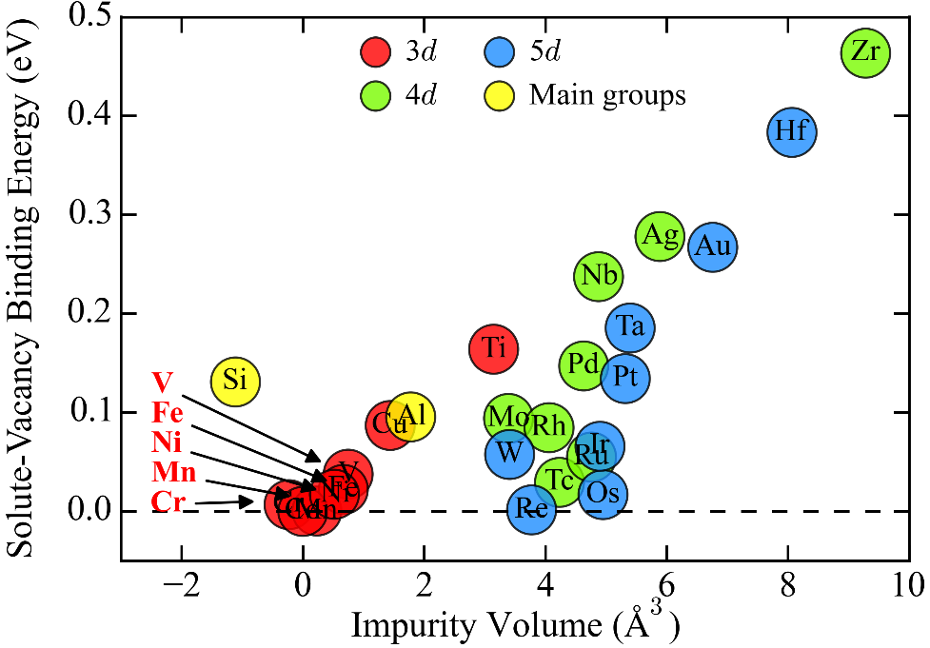

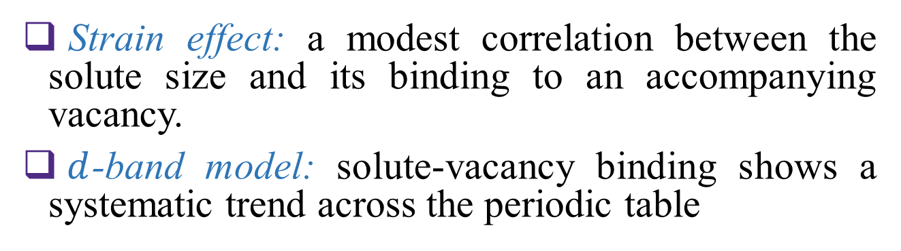
Wolverton: Solute-Vacancy binding in Co
Strain effect: a modest correlation between the solute size and its binding to an accompanying vacancy.
$d$-band model: solute-vacancy binding shows a systematic trend across the periodic table

Slide 14
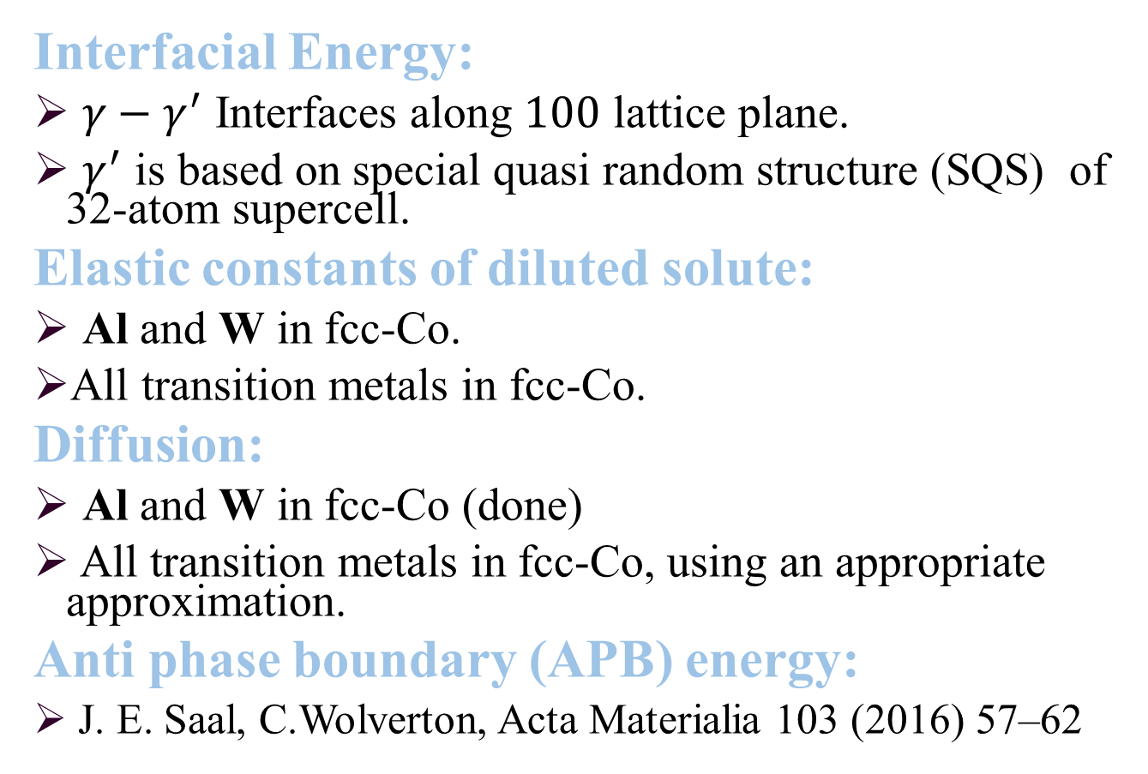
Wolverton Ongoing Projects
Interfacial Energy:
$γ−γ^{′}$ Interfaces along $100$ lattice plane.
$γ^{′}$ is based on special quasi random structure (SQS) of 32-atom supercell.
Elastic constants of diluted solute:
Al and W in fcc-Co.
All transition metals in fcc-Co.
Diffusion:
Al and W in fcc-Co (done)
All transition metals in fcc-Co, using an appropriate approximation.
Anti phase boundary (APB) energy:
J. E. Saal, C.Wolverton, Acta Materialia 103 (2016) 57–62

Slide 15
Co Database Components
Co-Al-W-Ni-Ti-Ta-Nb-B-Cr-Fe-V-Mn
Initial focus
2nd focus
3rd level focus
(Bushing alloy applications?)
Co-Al-W (NIST/CHiMaD w/ThermoCalc (N. Dupin)
Co-Ta-Ni NIST
Co-Ti-Ni (Cacciamani G)
Co-Ta-Ti NIST/CHiMaD - use same Co-Ti as Co-Ni-Ti ?
Co-Al-Ni Dupin thesis (1995)
Co-Al-Ta
Co-Al-Ti
Co-W-Ni Férnandez Guillermet (1988)
Co-W-Ti
Co-W-Ta

Slide 16

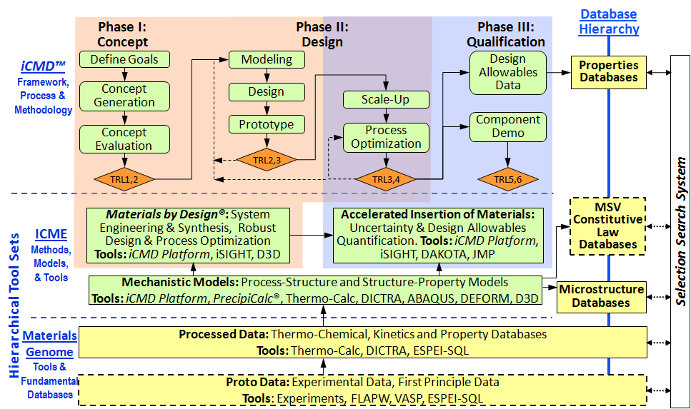
Center for Hierarchical Materials Design

Slide 17
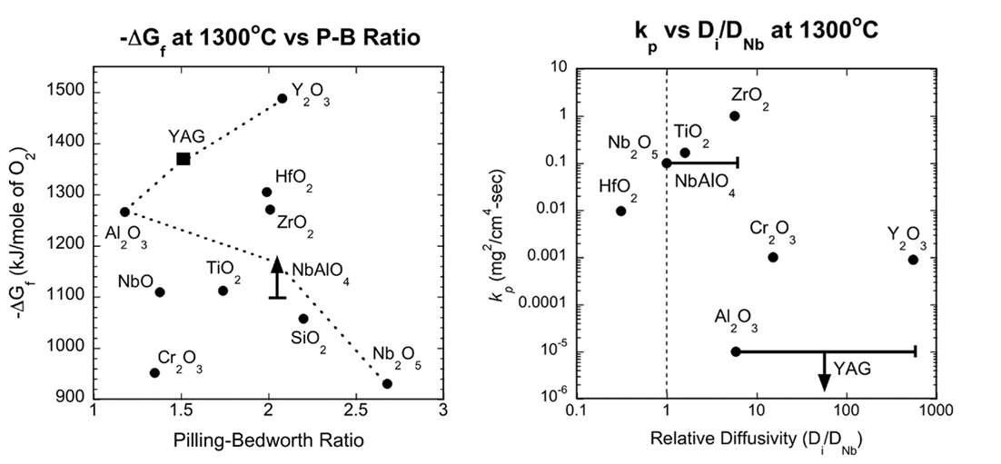
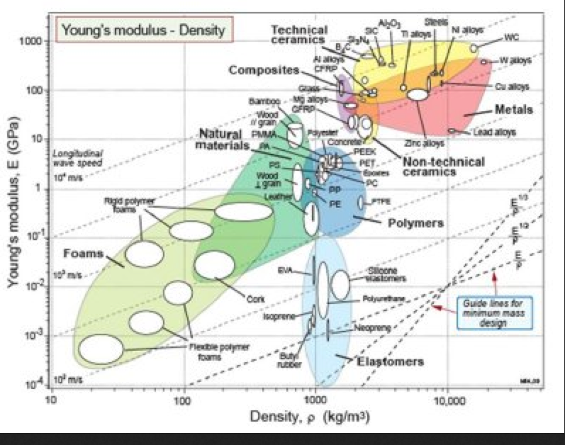
Expanding Ashby Plots: Granta Search of CALPHAD Proto Data
Property Selection for YAG
Scale for Oxidation Resistant Nb
Thermodynamics
Kinetics
G. B. Olson, Northwestern: AF-MEANS project.
Notes:
Apply Ashby plots phase-based property design criteria

Slide 18
Co Alloy γ-γ’ Partitioning and Transport (800C)

Slide 19
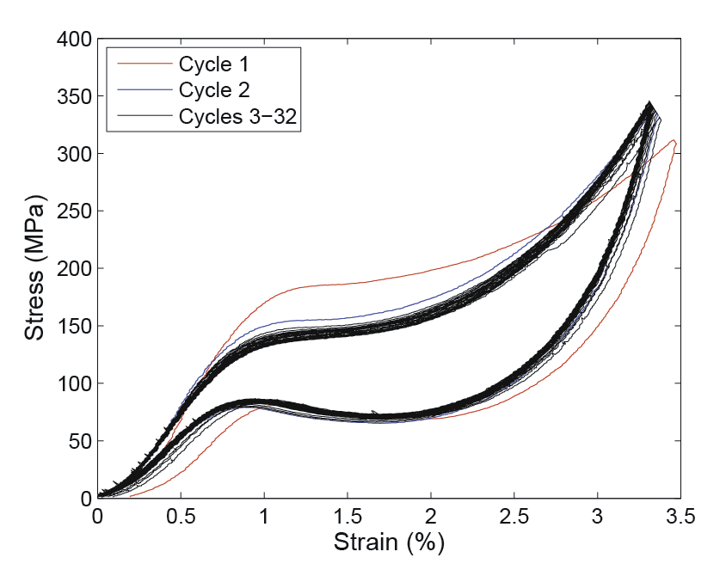
USE-CASE GROUP
G. OLSON, NU
PRECIPITATION-STRENGTHENED ALLOYS: SMAs
DESIGN GOALS
Characterize phase relations, kinetics, and strengthening behavior in L2₁ Heusler strengthened low-Ni, high-strength “hybrid” (Pd,Ni)(Ti,Zr,Al) and Ni-free (Pd,Fe)(Ti,Al) alloy systems for SMA design with enhanced cyclic stability.
Employ FEA simulation of fatigue nucleation to predictively optimize inclusion distribution for enhanced minimum UHCF fatigue performance.
-Completed doctoral thesis of Dr.Dana Frankel (MSE) demonstrated superelastic peak-strengthened Ni-free alloy with high thermal cyclic stability and low hysteresis. Transformable low-Ni Pd-Zr hybrid prototype calibrated role of misfit in strengthening efficiency. Overview paper published in new SMA journal.
-FEA modeling performed in student team collaboration with Dr. John Moore (ME) used an image-based mesh to predict 2X minimum UHCF fatigue property improvement with 3X inclusion size refinement. Publication in press.

Slide 20
Shape Memory Alloy Database
Components:
Ti-Zr-Hf-Ni-Pd-Pt-Fe-Co-Ni-Al-O-C
Phases:
B2 matrix, L21 aluminide, Ti4Ni2O oxide, M(C,O) carbide, B19 and B19’ martensites

Slide 21
Ni-free PH SMA
Pd-Fe-Ti-Al, Af+25C

Slide 22
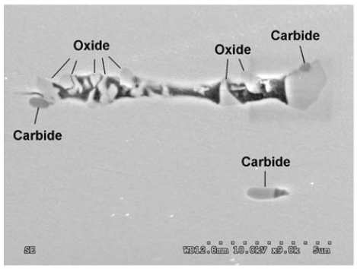
TiNi SMA Inclusions: Ti4Ni2O vs TiC
Characterization of Non-Metallic Inclusions in Superelastic NiTi Tubes,
A. Toro et al., JMEPEG, 2009, vol 18, 448-458

Slide 23
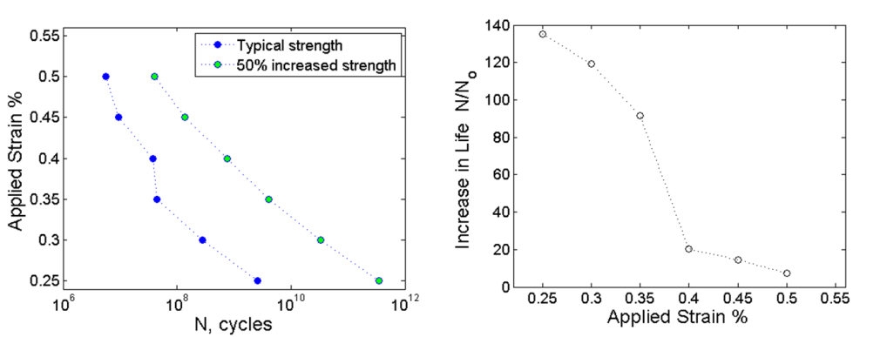
SMA Fatigue Life Prediction:
Effect of Increased B2 Strength
Increased life (N) of strengthened alloy compared typical life (N_{o})
50% increase in matrix strength results in increase in fatigue limit (at 10⁹ cycles) from 0.27% to 0.39%
Benefit of B2 strengthening increases as applied strain decrease

Slide 24
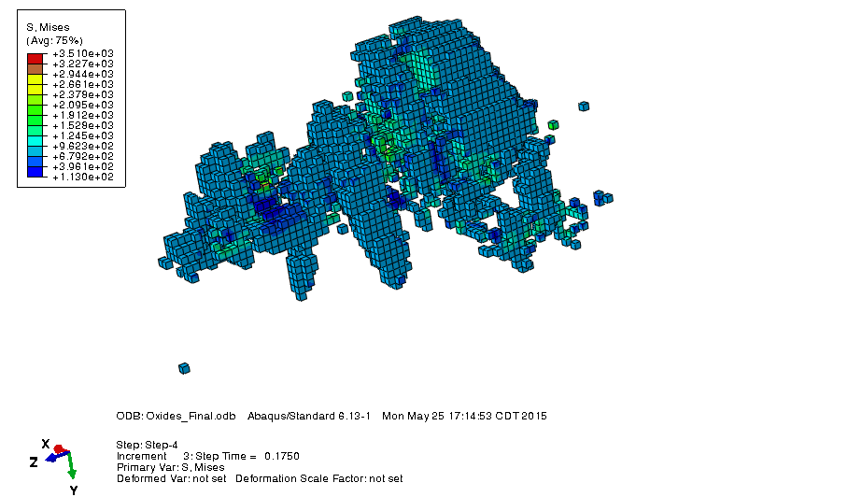
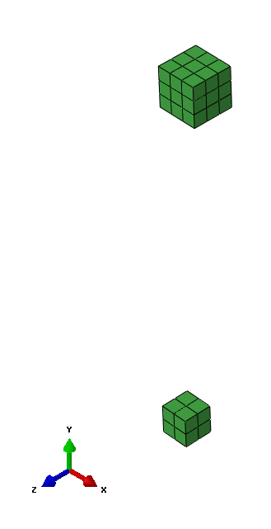
Effect of Oxide Size
Relative size of averaging volume
2x increase in fatigue strain for a 1/3 reduction in inclusion size.
Notes:
The non local averaging volume was changed to simulate different oxide sizes.
60 x increase in fatigue life for a 1/3 reduction in inclusion size
The increase in Fatigue Life due to size reduction of inclusions was seen to be independent of the applied strain level.

Slide 26

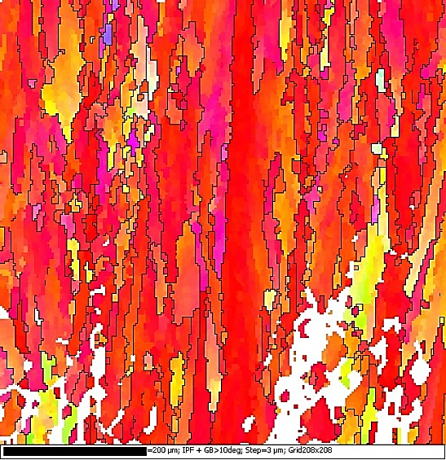
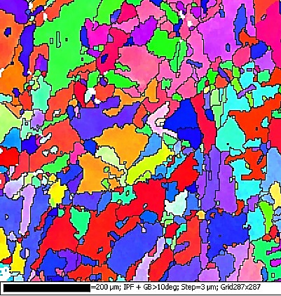
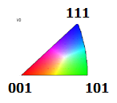
718+ Recrystallization vs.T (1.5hr)
As-built
1800°F
1835°F
200 μm scale
1850°F
1900°F
1950°F
Original Build
direction
δ solvus 1885°F

Slide 27
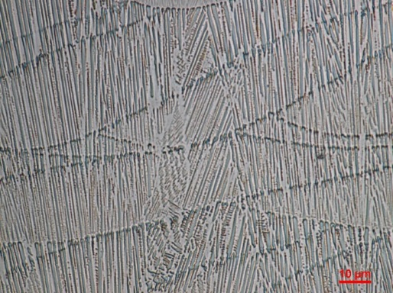
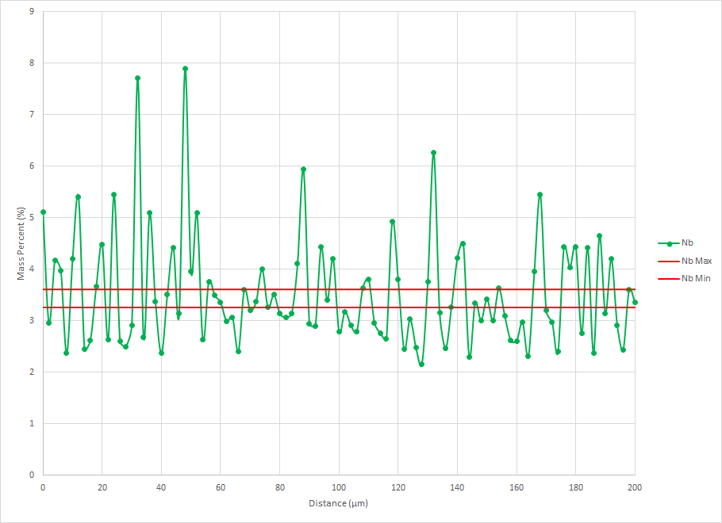
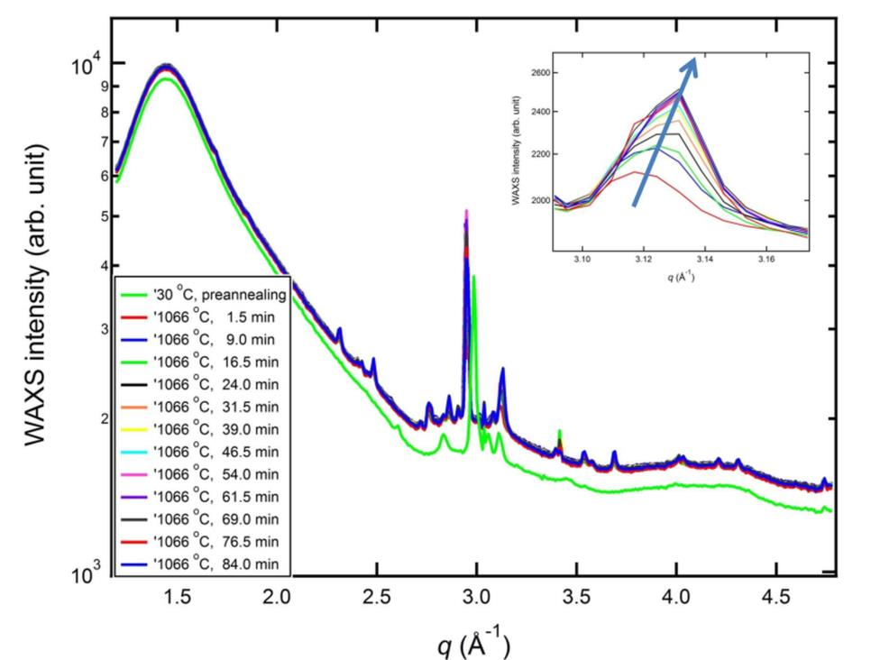
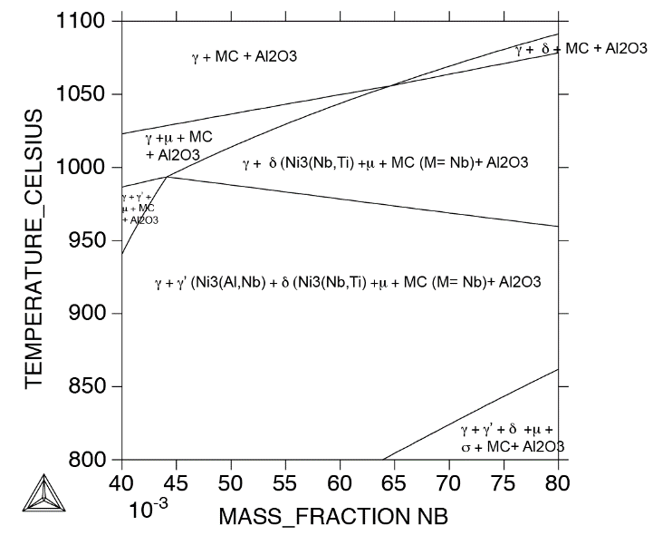
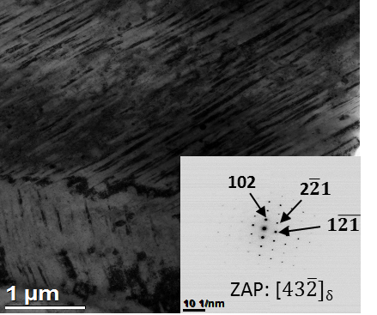
NIST Highlight: Unusual Phase Formation in 718Plus
-Lyle Levine
Optical Microscopy
Backscatter Electron
EDS - Nb
TEM - BF
WAXS
(211)_{δ}
1066
  Additive process leads to dendritic microstructure with extreme compositional inhomogeneity
  →
  Typical annealing treatment of 1066 °C for 1.5 h doesn’t dissolve the δ-phase, but rather promotes its formation and growth (when Nb > 6.8 % molar fraction). This is verified through in-situ Synchrotron experiments.
  promotes the unpredicted formation of the deleterious δ-phase.
Notes:
Slide Note Sections:
Talking Points: DMLS produces a part with a dendritic microstructure as denoted by Optical (OM) and Backscatter Electron (BSE) Microscopy. The EDS results show microsegregation of Nb, which can possibly form the deleterious delta, Ni3Nb, phase, which is confirmed in the as-built TEM micrograph. A typical annealing treatment is 1066 C for 1.5h, which normally dissolves the delta phase, but the Nb isopleth shows at high concentrations of Nb (above 6.8 % molar fraction), it will actually causes delta growth. USAXS/SAXS/WAXS data shows in-situ proof of the growth, and different annealing treatments will be necessary as compared to conventional.
Descriptions of figures: Give credit to QuesTek for the OM micrograph. OM micrograph shows the textured dendritic microstructure; the BSE micrograph shows microsegregation at the interdendritic regions; the EDS graph shows the local variability of the niobium concentration, which is identified as microsegregating; the TEM micrograph identifies delta precipitate formation in the as-built microstructure that normally does not form, the Nb isopleth shows for a normal annealing treatment (1066C at 1.5 h), it will promote formation and growth of the delta phase when Nb concentrations about 6.8 % molar fraction; WAXS graph shows in-situ X-ray diffraction of an annealing treatment of 1066C for 1.5 h where delta precipitate growth is observed.
Contact: Yaakov Idell, 642.05 (Materials Science and Engineering Division)
LIST OF CUSTOMERS AND PARTNERS:
QuesTek Innovations, LLC, Greg Olson, Chief Science Officer, Evanston, IL
References:
Y. Idell¹, L.E. Levine¹, A.J. Allen¹, F. Zhang¹, C.E. Campbell¹, G.B. Olson², J. Gong², D.R. Snyder²
Unexpected δ-Phase Formation in Additive-Manufactured Ni-based Super Alloy
^{1.} National Institute of Standards and Technology, Gaithersburg, MD, USA
^{2.} QuesTek Innovations, LLC., Evanston, IL, USA
Invited paper for upcoming special Additive Manufacturing issue of JOM (through WERB)
Date: 9/11/2015

Slide 28






DARPA-SIMPLEX:
Data-driven Discovery for
Designed Thermoelectric Materials
G. B. Olson, PI
James Saal, Project Coordinator

Slide 29









Thermoelectric Materials Design
Processing
Structure
Properties
Initial Alloy
Composition
Matrix Phase
Carrier dopant
Band-shifting element
$$g\left(E_{F}\right)$$
$$S$$
$$μ$$
$$σ$$
Ingot Casting
$$n,p$$
2nd-Phase Nanostructures
Band-alignment
element
$$ZT$$
$$L$$
$$κ_{el}$$
Anneal
$$κ_{lat}$$
Spark Plasma
Sintering
Grain Refinement

Slide 30
Metals Processing Facility
1801 Maple
3800 sq ft
Facility Director: Paul Adler
Initial Equipment:
1 lb Arc Melter
Rolling Mill
Swage
Hot Press
Incremental Forming System

Slide 31
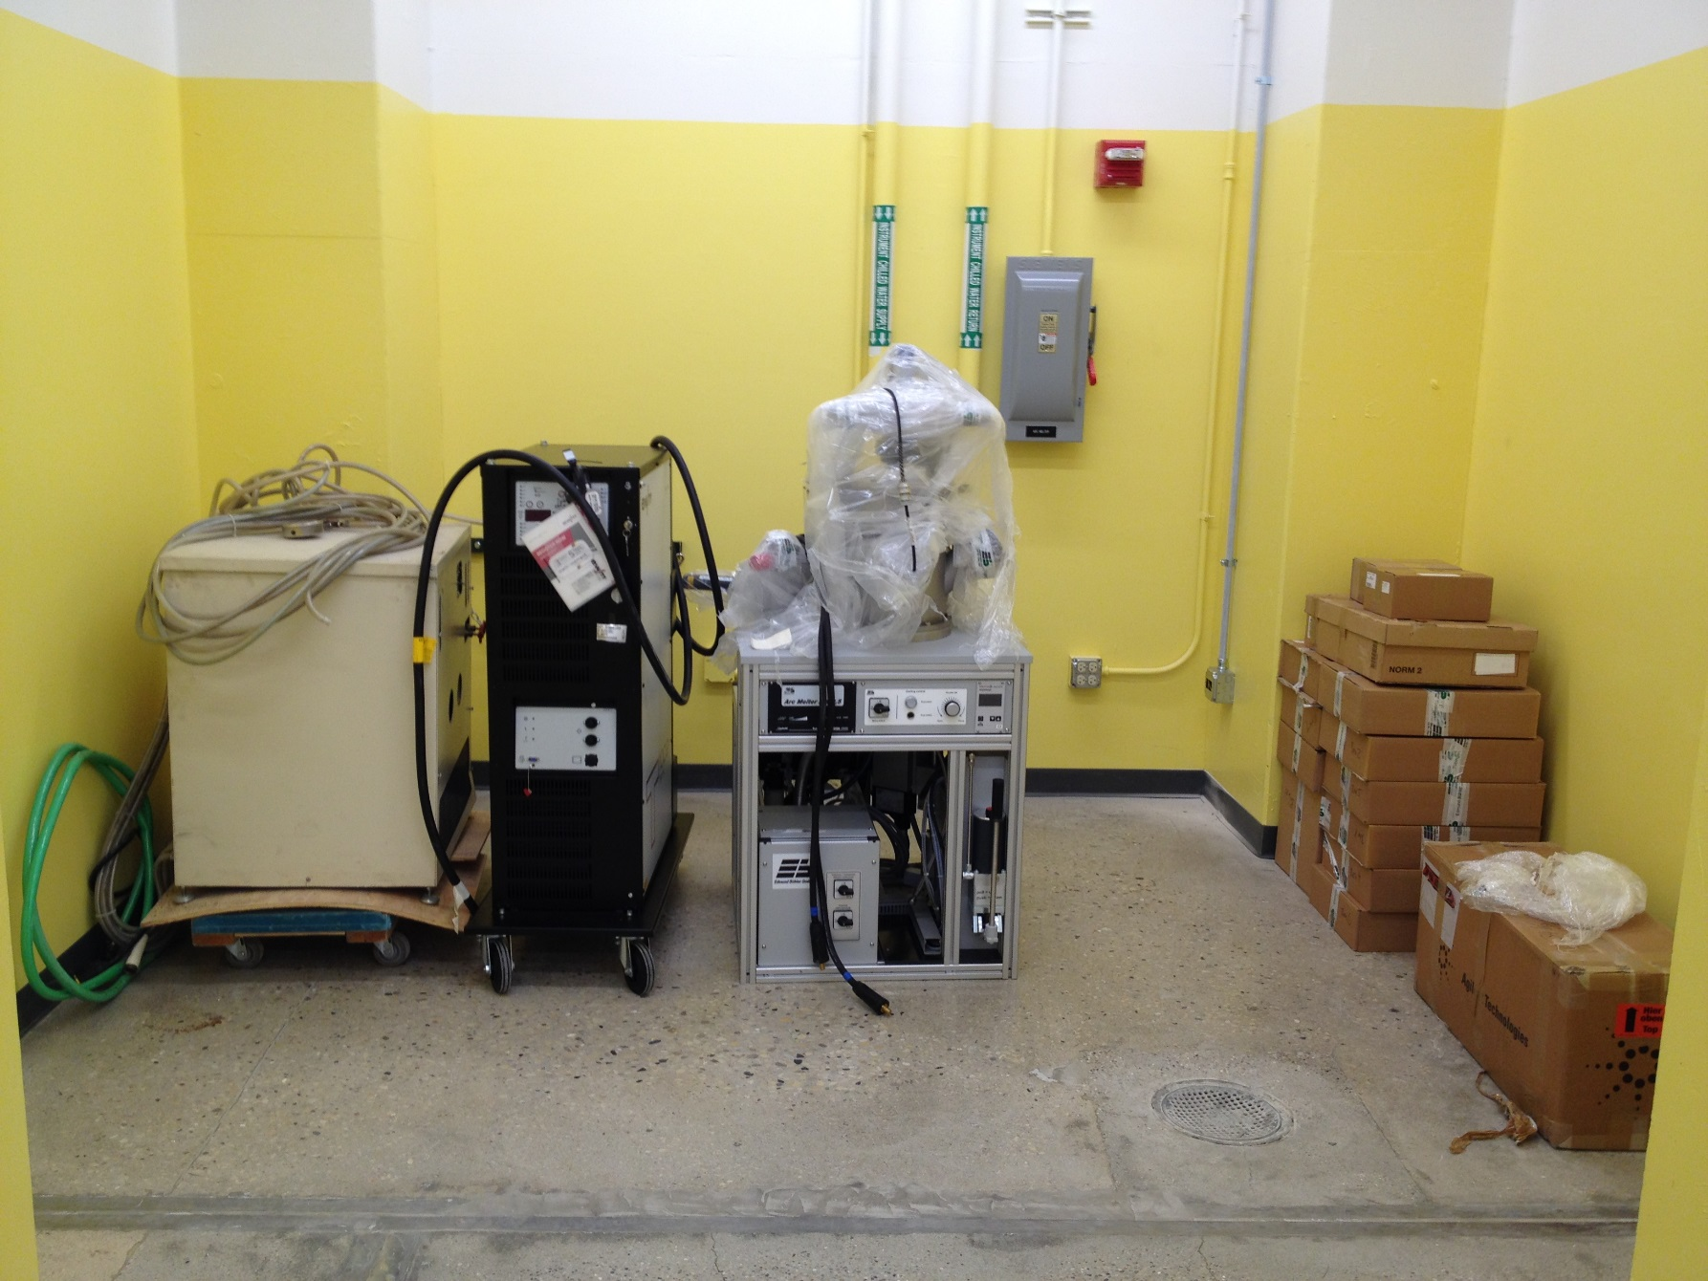
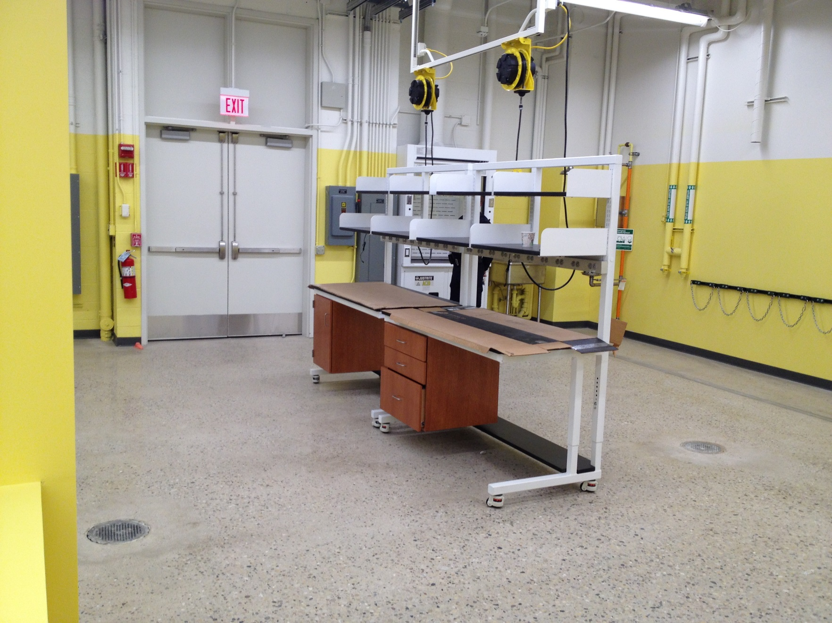

Slide 33
Co Database Phases
FCC_A1 & FCC_L12 order/disorder model (4 sublattices)
BCC_A2 & BCC_B2 order/disorder model (4 sublattices)
Sigma: 3 sublattices (reduce from 5 by using polynomial fits)
Mu (μ): 4 sublattices ?
C15 Laves: 2 sublattices
C14/C36 Laves: 3 sublattices
Delta (D0_{a}, Ni3Ta, δ): 3 or 2 sublattices (semi-stoichiometric) ?
D0₁₉: 4 sublattices (?) – hcp order/disorder
D0₃ (part of A2&B2) – requires 4 sublattices

