Slide 1





Low-Dimensional Nanoelectronic Materials Use-Case Group
Mark Hersam, NU
Lincoln Lauhon, NU
Albert Davydov, NIST
Francesca Tavazza, NIST
Arunima Singh, NIST

Slide 2
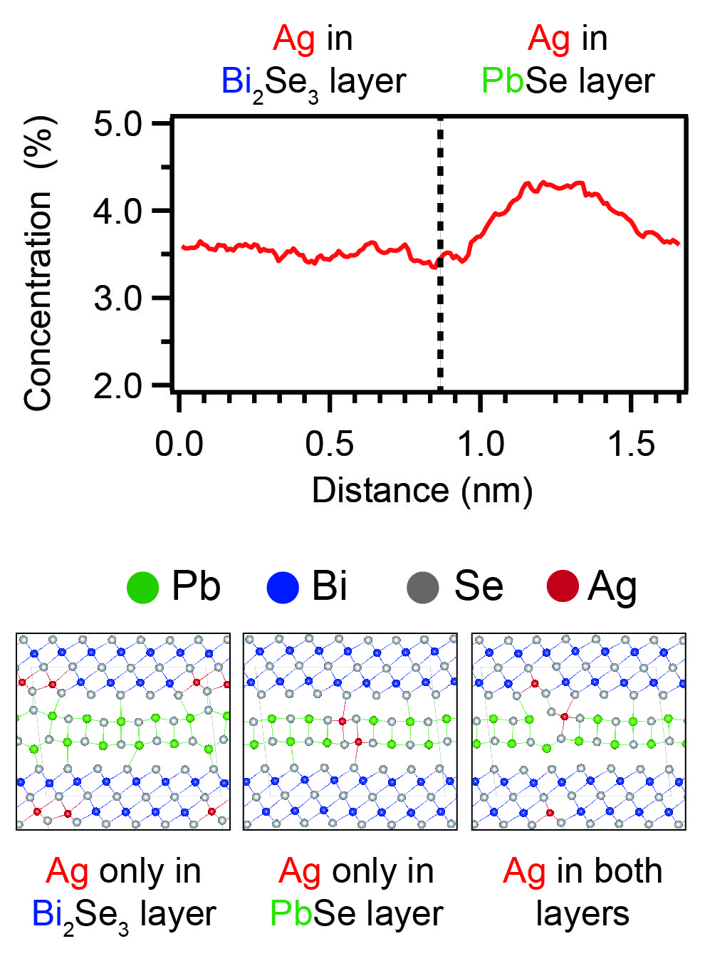
Use-Case Group Overview and Design Goals
Vision Statement: Understand and realize p-type and n-type doping in the low-dimensional limit
Functions: rectification, light emission, photoresponse, photovoltaic
Design goals:
  Control doping and carrier concentration in the low-dimensional limit
  Realize heterostructures from low-dimensional nanoelectronic materials
Experimental methods:
  Charge transport (automated wafer prober)
  Optical spectroscopy (e.g., PL, Raman)
  Scanning probe methods
  Atom probe tomography
Computational methods:
  Multi-scale modeling
  Molecular dynamics, DFT
  Finite element methods

Slide 3
Use-Case Group System Design Chart
PROCESSING
STRUCTURE
PROPERTIES
PERFORMANCE
Luminescence
Encapsulation
Thickness
Regrowth
Band Gap
Optoelectronics
Microstructure
Grain boundaries
Grain size
Grain orientation
Annealing
Etching
Charge Transport
Carrier type
Carrier concentration
Carrier mobility
Transistor
Chemical Functionalization
Composition:
Stoichiometry
Doping
Growth Method
Air Stability
Memristor
CVD
CVT
ALD
Defect Migration
Substrate

Slide 4


Design Sub-Goal:
Substitutional Doping
PROCESSING
STRUCTURE
PROPERTIES
PERFORMANCE
Chemical Vapor Transport
Atom Probe Tomography
Band Gap
Density Functional Theory
Charge Transport
Carrier type
Carrier concentration
Carrier mobility
Transistor
Composition:
Stoichiometry
Doping
Growth Method:
Chemical Vapor Transport
NU: Ren, Lauhon
NIST: Singh, Tavazza, Davydov

Slide 5
Y2 Accomplishments:
Atom Probe and DFT of Substitutional Doping
Accomplishments:
Demonstrated dopant analysis in 2-D materials by atom probe tomography for the first time.
Resolved the distribution of substitutional dopants between chemically distinct sites.
Employed density functional theory calculations to understand preferred doping configurations.

Slide 6
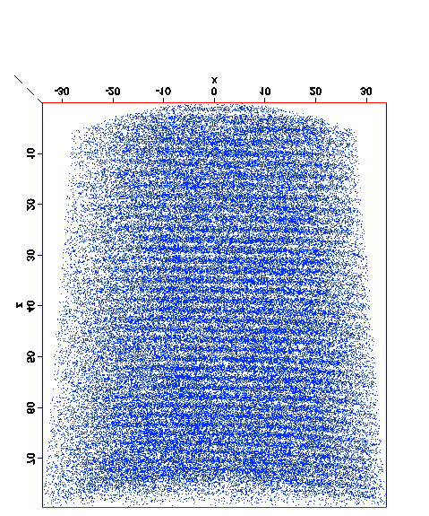
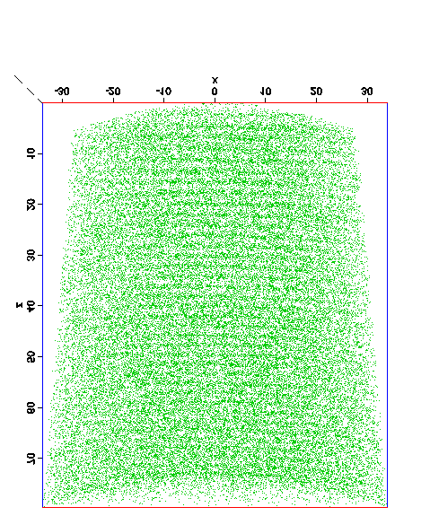
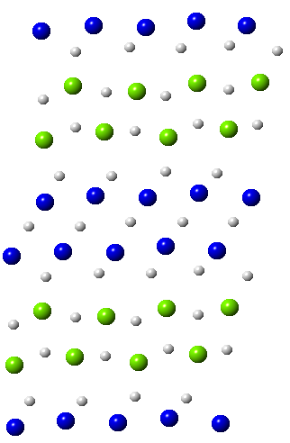
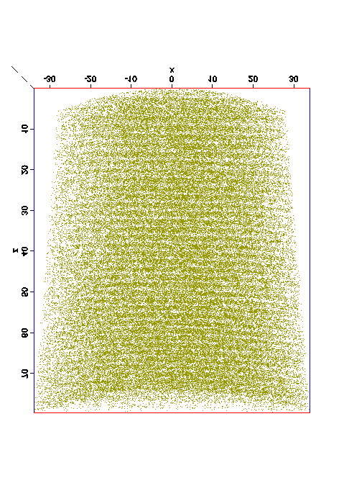
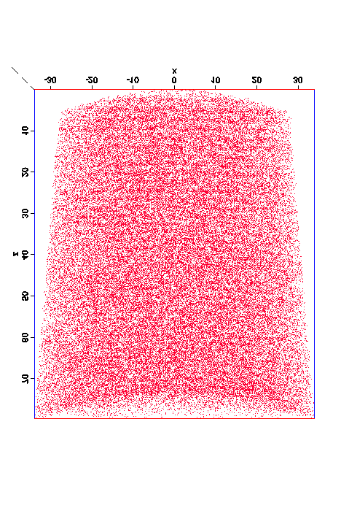
Atom Probe Tomography of (PbSe)₅(Bi₂Se₃)₃
Ag doping changes material from metal to superconductor, providing an approach to engineer novel heterojunctions.
Ag is expected to dope only the PbSe layer. Can dopant location be resolved by APT?
Bi
Pb
10 nm
10 nm
PbSe
Se
Ag
1.65 nm
Bi₂Se₃
10 nm
10 nm
Samples grown by Kanatzidis Group @NU

Slide 7
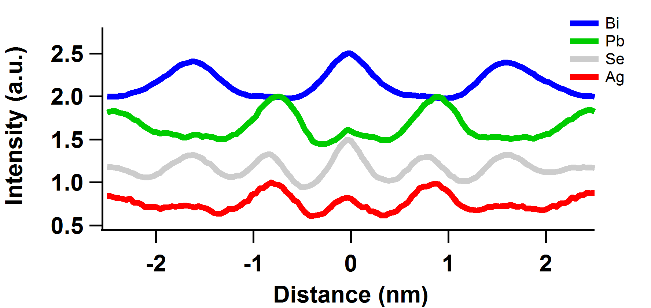
Ag Dopes Both the Pb and Bi layers
Spatial Distribution Map
1.65 nm
Bi₂Se₃
PbSe
Ag in Pb-Se layer
Ag in Bi-Se layer
SDM identifies location of Ag dopant atoms relative to Bi, Pb.
Composition profile gives the dopant concentration in each layer.

Slide 8
DFT Calculation of Favorable Ag Configurations
  66 configurations
  44 configurations
  120 configurations
Ag-Ag pairs have lowest defect formation energy.
# configurations + low energy → highest probability.

Slide 9
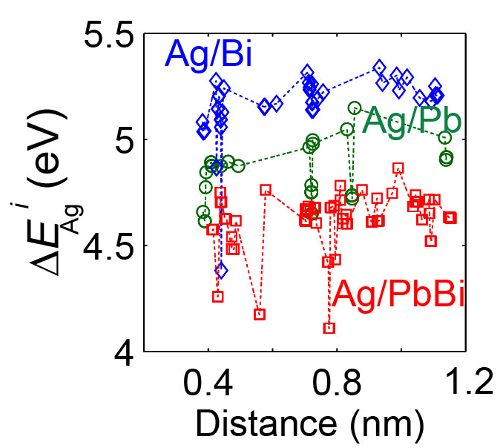
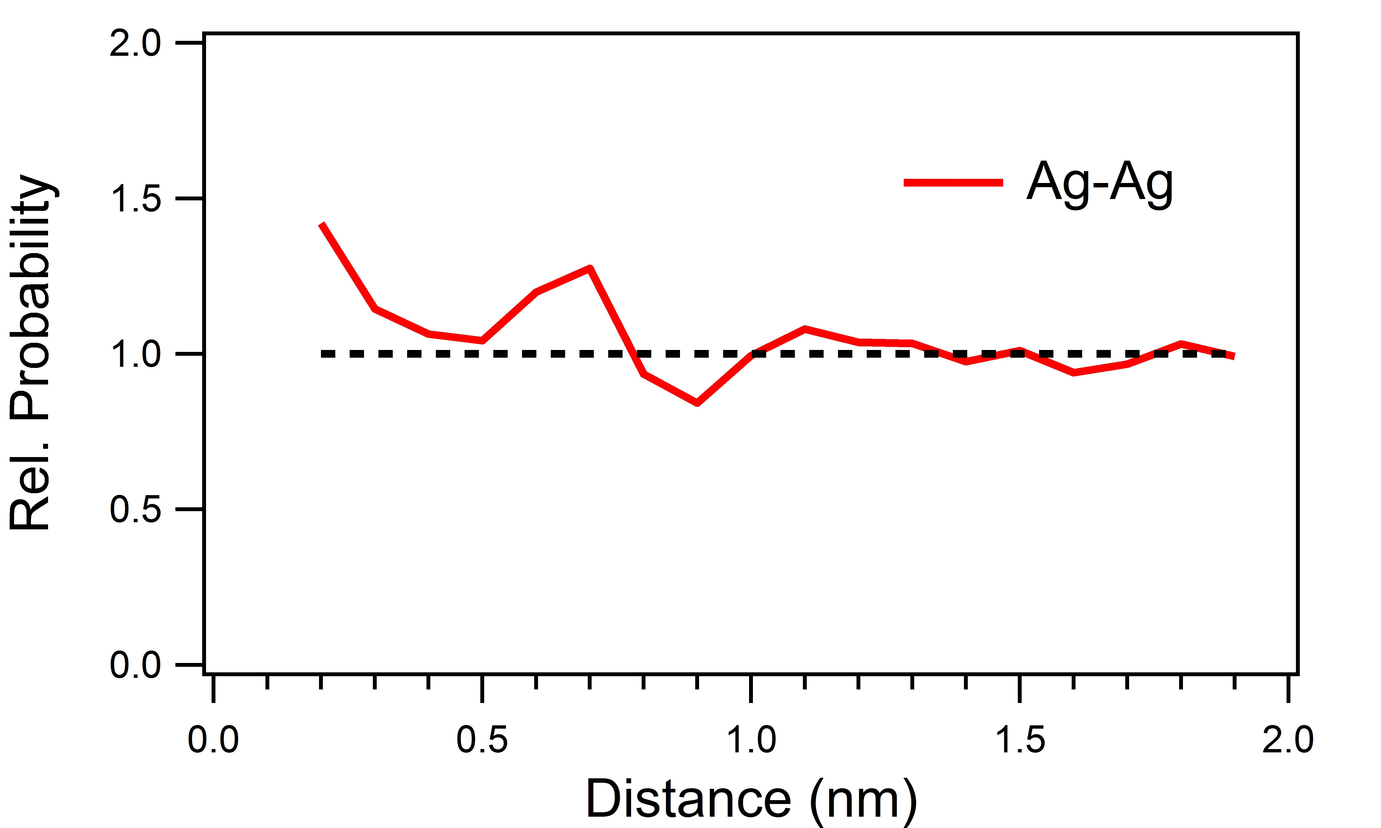
DFT Calculation of Favorable Ag Configurations
Defect Formation Energies
Radial Distribution Function
DFT calculation confirms that Ag doping in both layers is energetically favorable.
RDF from APT provides evidence of the Ag-Ag pairing/clusters.
Significance: Demonstrated capability to predict and measure substitutional dopant locations in 2D materials.

Slide 10
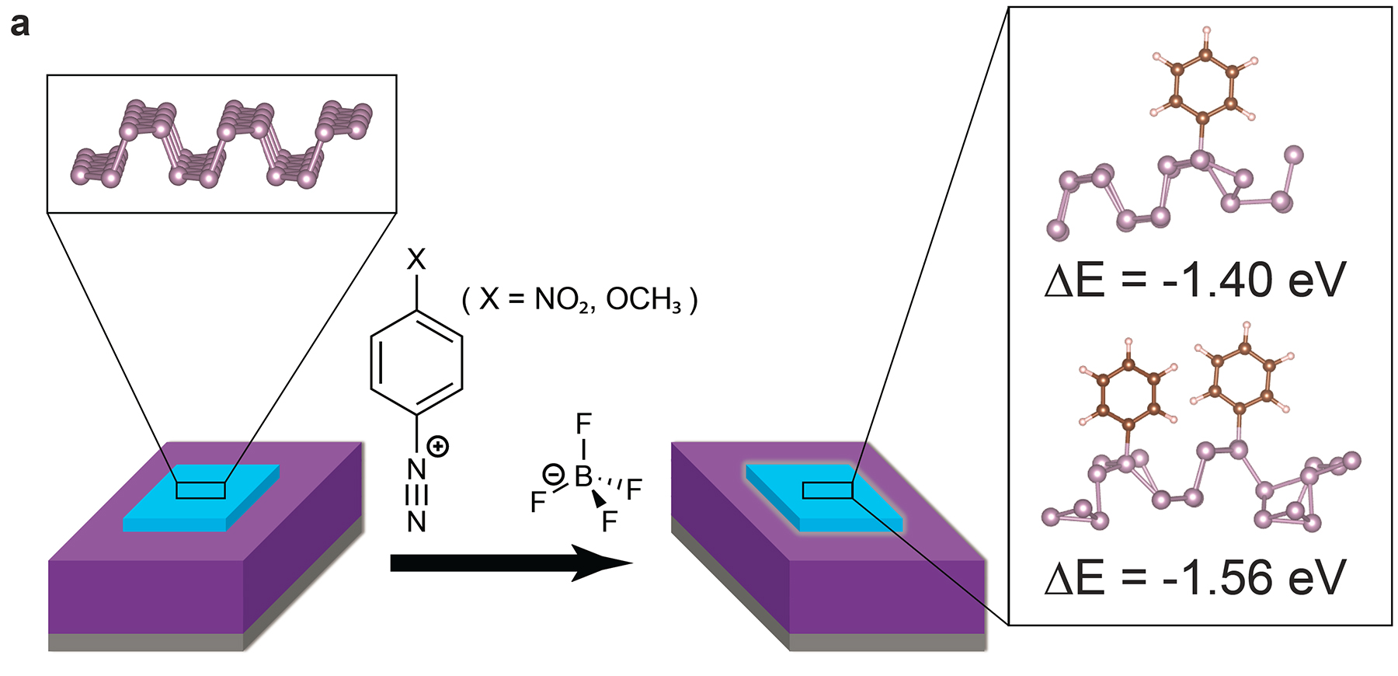
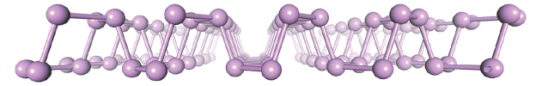
Design Sub-Goal:
Chemical Functionalization Doping
PROCESSING
STRUCTURE
PROPERTIES
PERFORMANCE
Chemical Functionalization
Doping of Two-Dimensional
Black Phosphorus:
Charge Transport
Carrier type
Carrier concentration
Carrier mobility
Chemical Functionalization
Transistor
Composition:
Stoichiometry
Doping
Air Stability

Slide 11
Y2 Accomplishments:
Diazonium Functionalization of Black Phosphorus
M. C. Hersam, T. J. Marks, et al., Nature Chemistry, in press, 2016.
Accomplishments:
First covalent modification of 2D black phosphorus has been achieved with diazonium chemistry.
Ambient stability of 2D black phosphorus is significantly improved following functionalization.
Functionalization leads to controlled p-type doping and improved transistor metrics (e.g., mobility and on/off ratio).

Slide 12
DFT Predicts Stable Arylation of Black Phosphorus
M. C. Hersam, T. J. Marks, et al., Nature Chemistry, in press, 2016.
DFT predicts stable covalent bonding of diazonium aryl radical intermediates to black phosphorus

Slide 13
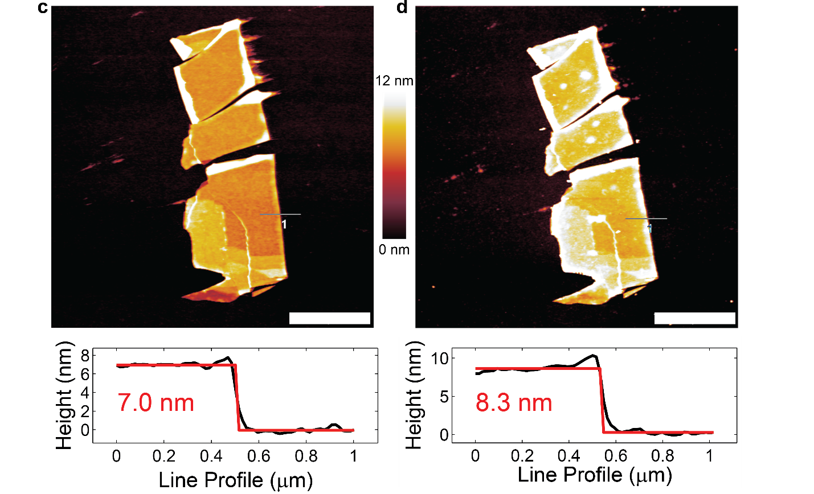
Experimental Confirmation of Arylation of Black Phosphorus
M. C. Hersam, T. J. Marks, et al., Nature Chemistry, in press, 2016.
2 μm
2 μm
Atomic force microscopy shows an increase in black phosphorus flake height consistent with arylation
(corroborated by XPS and Raman)

Slide 14
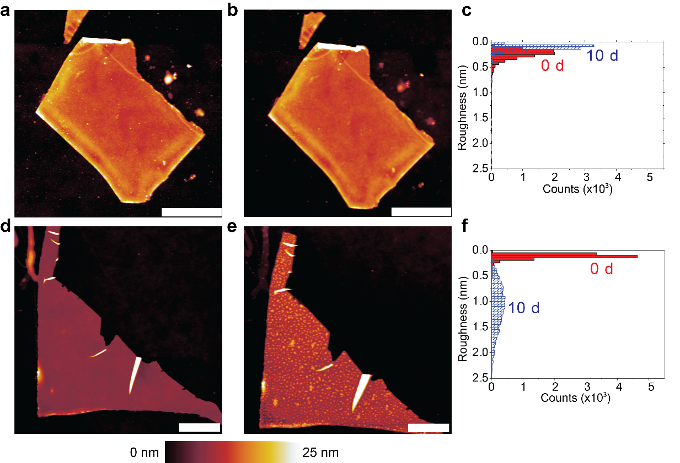
Chemical Functionalization Improves the Ambient Stability of Two-Dimensional Black Phosphorus
M. C. Hersam, T. J. Marks, et al., Nature Chemistry, in press, 2016.
0 days
10 days
With covalent
functionalization:
2 μm
2 μm
0 days
10 days
Without covalent
functionalization:
2 μm
2 μm
Chemical functionalization achieves the design goal of improving the ambient stability of 2D black phosphorus

Slide 15
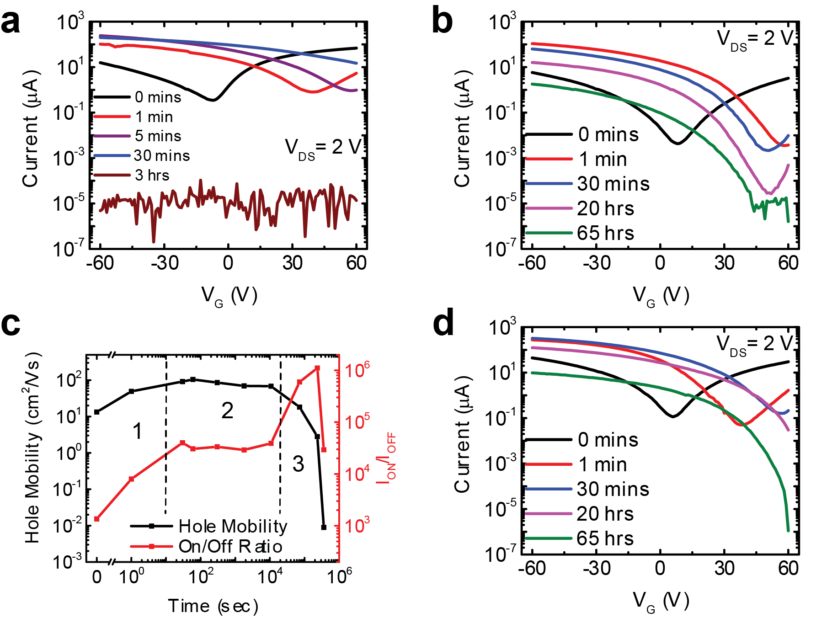
Chemical Functionalization Leads to Controlled p-type Doping and Improved Device Metrics
M. C. Hersam, T. J. Marks, et al., Nature Chemistry, in press, 2016.
Covalent functionalization leads to controlled p-type doping as evidence by rightward shift in transistor transfer curves.
Transistor metrics (e.g., mobility and on/off ratio) are optimized at intermediate functionalization conditions.

Slide 16
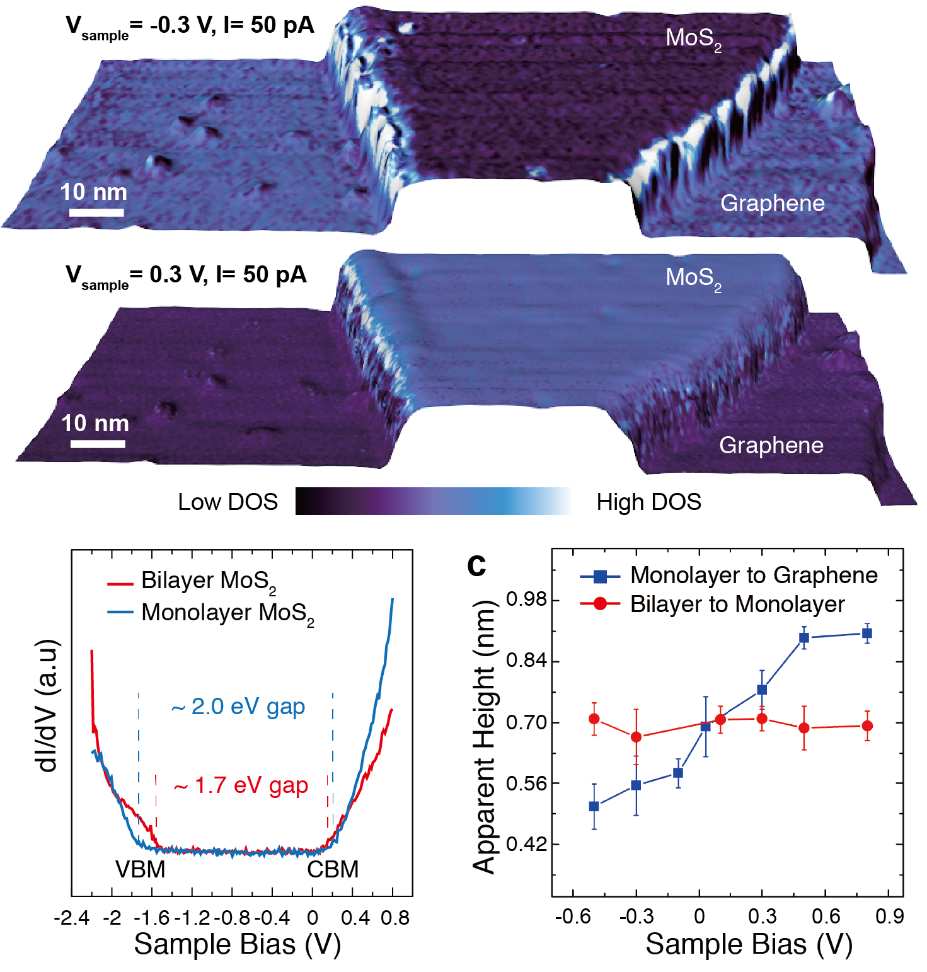
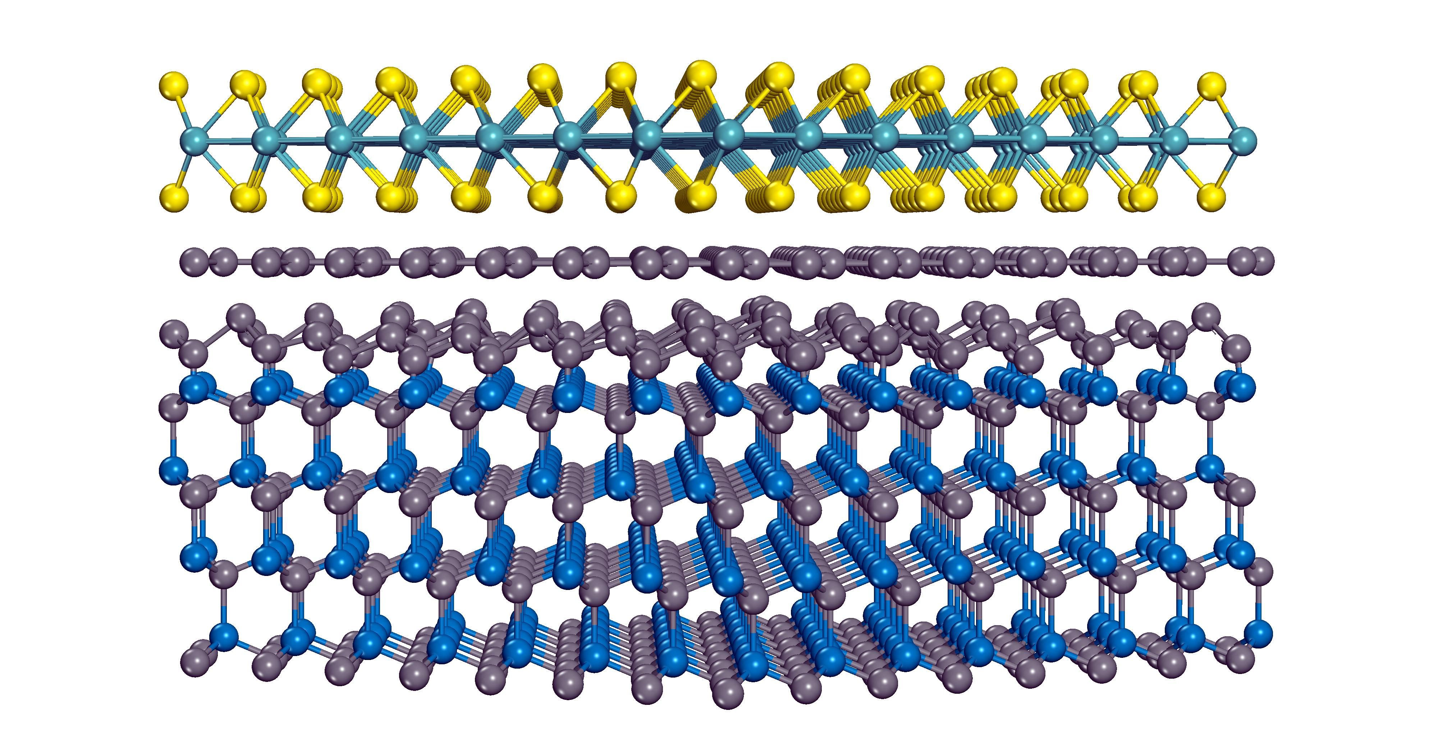
Design Sub-Goal:
Growth of Nanoelectronic Heterostructures
PROCESSING
STRUCTURE
PROPERTIES
PERFORMANCE
MoS₂/Graphene
Heterostructures:
Microstructure
Grain boundaries
Grain size
Grain orientation
Growth Method
Memristor
Chemical Vapor Deposition
Defect Migration
Substrate

Slide 17
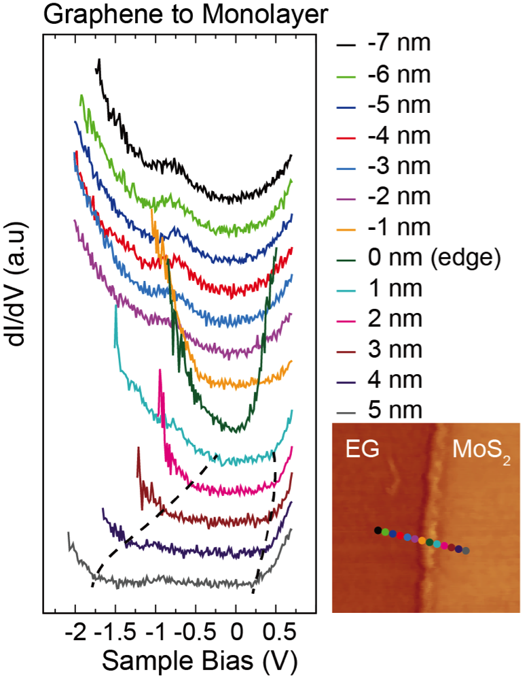
Y2 Accomplishments:
MoS₂/Graphene Heterostructures
M. C. Hersam, M. J. Bedzyk, et al., ACS Nano, 10, 1067 (2016).
Accomplishments:
Rotationally commensurate growth of MoS₂ on epitaxial graphene on SiC by chemical vapor deposition.
CVD MoS₂ on epi-graphene shows higher hole doping and reduced strain compared to CVD MoS₂ on SiO₂.
Rotational commensurability implies only 2 possible angles (30° and 60°) for CVD MoS₂ grain boundaries on epi-graphene.

Slide 18
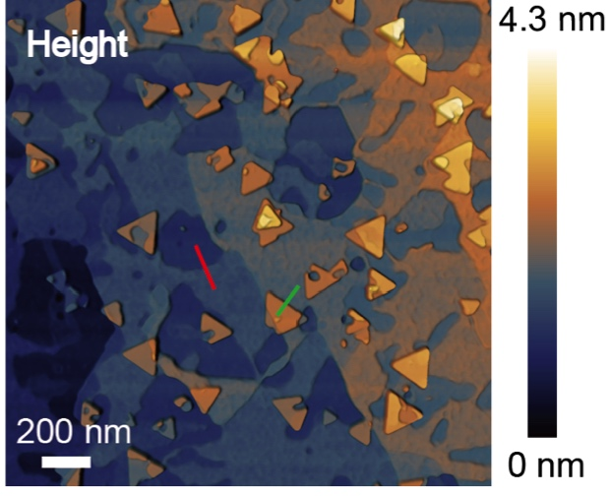
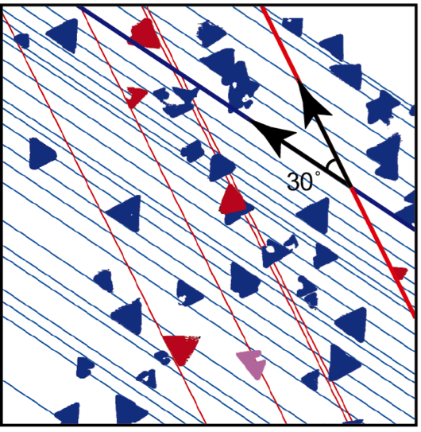
CVD Growth of MoS₂ on Epi-Graphene on SiC
M. C. Hersam, M. J. Bedzyk, et al., ACS Nano, 10, 1067 (2016).
Chemical vapor deposition growth of MoS₂ on epitaxial graphene on SiC leads to most MoS₂ flakes being rotationally aligned or 30° misaligned

Slide 19
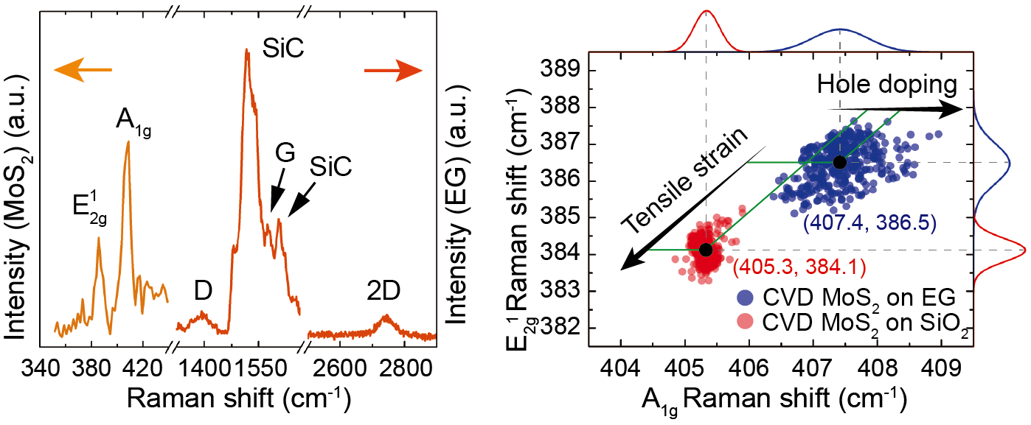
Raman Analysis of CVD MoS₂ on Epi-Graphene
M. C. Hersam, M. J. Bedzyk, et al., ACS Nano, 10, 1067 (2016).
Raman analysis shows that CVD MoS₂ on epi-graphene possesses higher hole doping and reduced strain compared to CVD MoS₂ on SiO₂

Slide 20
Electronic Structure of CVD MoS₂ on Epi-Graphene
M. C. Hersam, M. J. Bedzyk, et al., ACS Nano, 10, 1067 (2016).
Scanning tunneling spectroscopy reveals strong contrast between zero bandgap epi-graphene and the ~2 eV bandgap of single-layer MoS₂

Slide 21
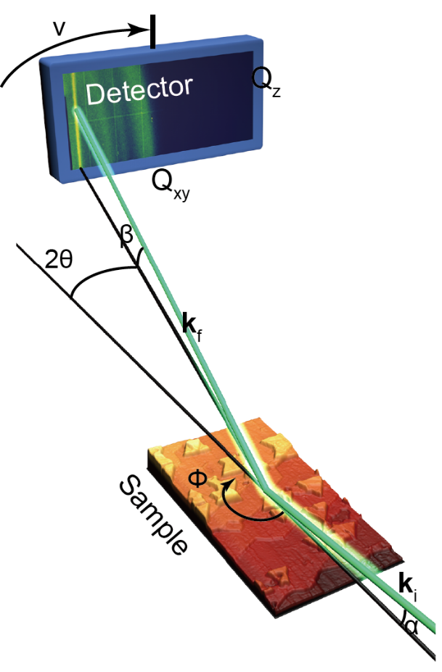
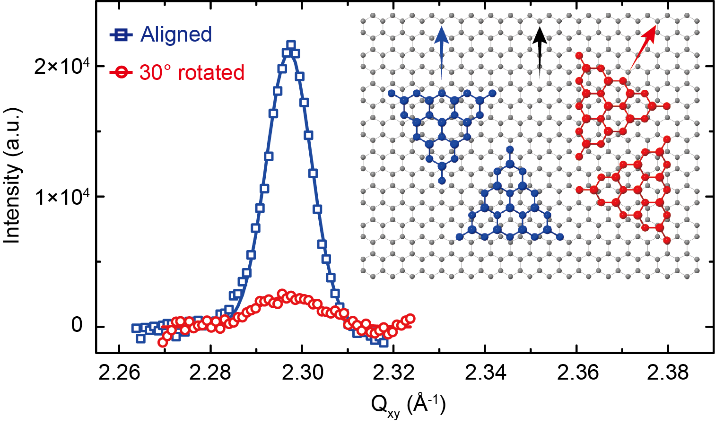
GIWAXS of CVD MoS₂ on Epi-Graphene
M. C. Hersam, M. J. Bedzyk, et al., ACS Nano, 10, 1067 (2016).
86 % 14 %
Synchrotron grazing-incidence wide-angle X-ray scattering (GIWAXS) reveals rotational commensurability between CVD MoS₂ and epi-graphene

Slide 22
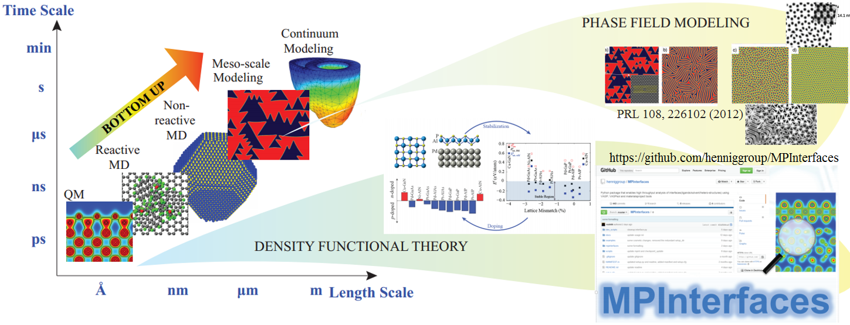
NIST Collaboration: Multi-Scale Modeling of 2D Material Growth and Heterostructures
  Developed DFT framework and python-based tool to automate high-throughput screening of substrates for synthesis and functionalization of 2D materials
  In-progress: Integrating with phase-field models for bottom-up design of 2D materials with controllable structural, mechanical and electronic properties
NIST: Singh, Tavazza

Slide 23
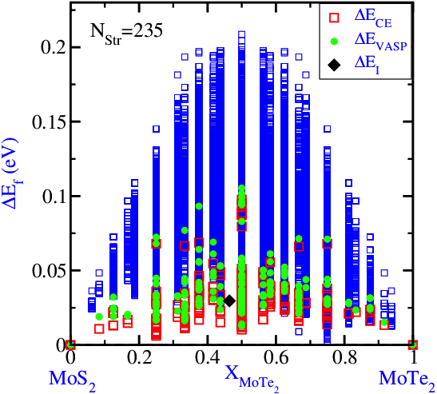
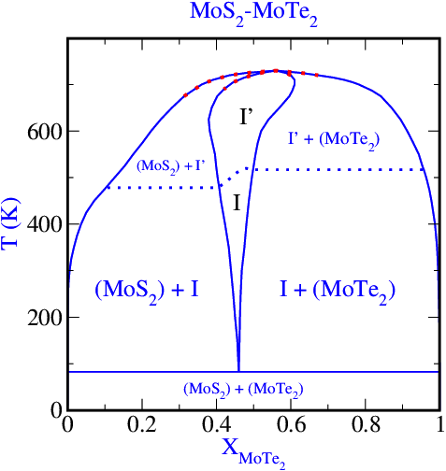
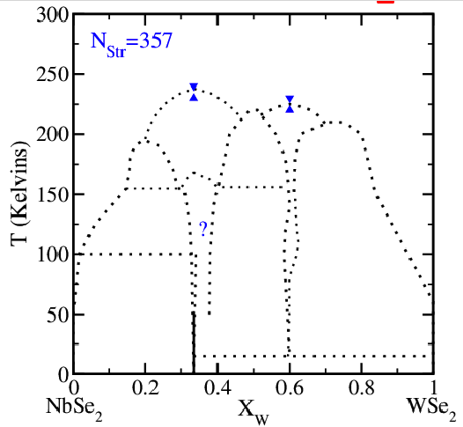
NIST Collaboration: Modeling of Alloy Phase Diagrams for Band-Gap Engineering
Case 1: Alloying on Chalcogen sublattice - MoS_{2(1-x)}Te_{2x}
Case 2: Alloying on Metal sublattice - Nb_{(1-x)}W_{x}Se₂
Nb is а p-type dopant
(1) Calculate DFT formation energies
(2) Fit Cluster Expansion Hamiltonian:
H_{CE} = E(σ₁…σ_{n}) = Σ_{{i,j}}J_{ij}σ_{i}σ_{j} + Σ_{{i,j,k}}J_{ijk}σ_{i}σ_{j}σ_{k} + …
H_{CE}=Σ_{α}J_{α}σ_{α}
(3) Calculate phase diagrams (via MC simulation):
NIST: Singh, Tavazza
МоS₂
МоТе₂

Slide 24
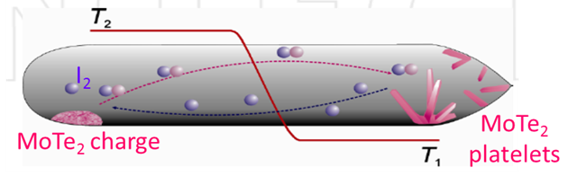
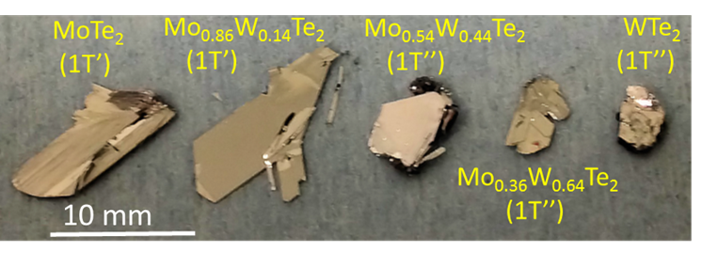
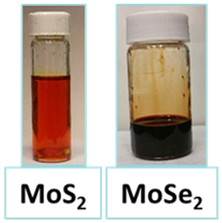
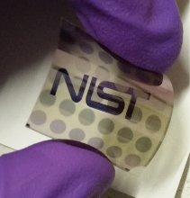
NIST Collaboration: Benchmarked Library of
Two-Dimensional Nanomaterials
CVT single crystal growth:
  2D Library for developing controlled doping (computational + experim. database)
  NbSe₂; MoTe₂; Mo_{1-x}W_{x}Te₂, WS_{2(1-x)}Te_{2x}, GaSe
CVD wafer-scale growth:
  Metal sulfurization: Mo + S₂ → MoS₂
  Chloride-chemistry CVD: MoCl₅ + H₂S → MoS₂ (Year 3)
  Pulsed MOCVD/ALD: EDNOMo + DEDS → MoS₂
Low-temperature solution growth (to complement NU’s graphene inks)
  “MoS₂” ink → anneal → 3D printing of MoS₂/graphene devices
NIST: Davydov, Krylyuk, Maslar, Debnath

Slide 25
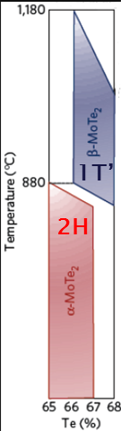
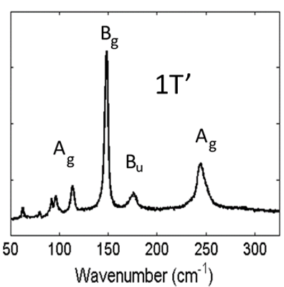
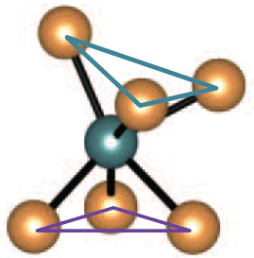
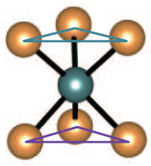
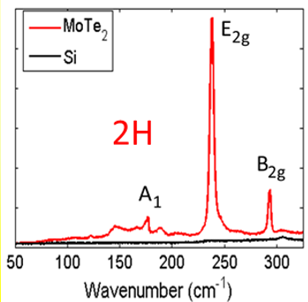
NIST Collaboration:
2D Semiconductor/Metal Phase Change
Phase Diagram
Raman Spectra
Transistor Transfer Curves
1T’
2H
NIST-grown 2D MoTe₂ layers show semiconductor/metal phase transition
NU + NIST device fabrication and testing to understand charge transport
NU: Hersam, Beck, Bergeron
NIST: Davydov, Krylyuk, Sharma

Slide 26

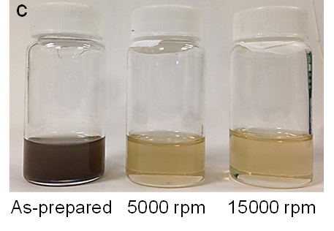

Industrial Collaborations
Three graphene inks (inkjet, gravure, and screen printable) are being distributed by Sigma
Black phosphorus inks have been delivered to IBM T. J. Watson Research Center (Mathias Steiner, Michael Engel) for device testing

Slide 27
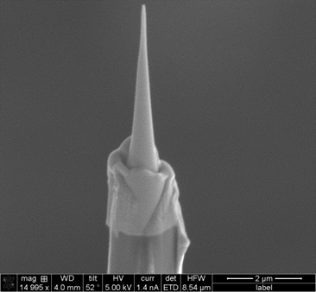
Future Work:
Substitutional Doping
Work at NIST on growth and processing of S-doped WTe₂ for metal-semiconductor junctions. X. Ren (NU student) will visit NIST.
Develop sample preparation methods to facilitate atom probe analysis of transition metal dichalcogenides (TMDs).
With NIST, correlate dopant/alloying in TMDs and electrical properties both experimentally (APT) and from first principles (DFT).

Slide 28
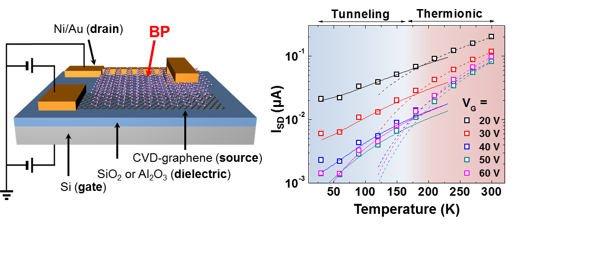
Future Work:
Chemical Functionalization Doping
Explore variable temperature charge transport in black phosphorus vertical field-effect transistors.
Perform 1/f noise characterization of black phosphorus transistors (initial devices sent to NIST).
Elaborate chemical functionalization doping to other nanoelectronic materials (e.g., transition metal dichalcogenides and IV-VI compounds).

Slide 29
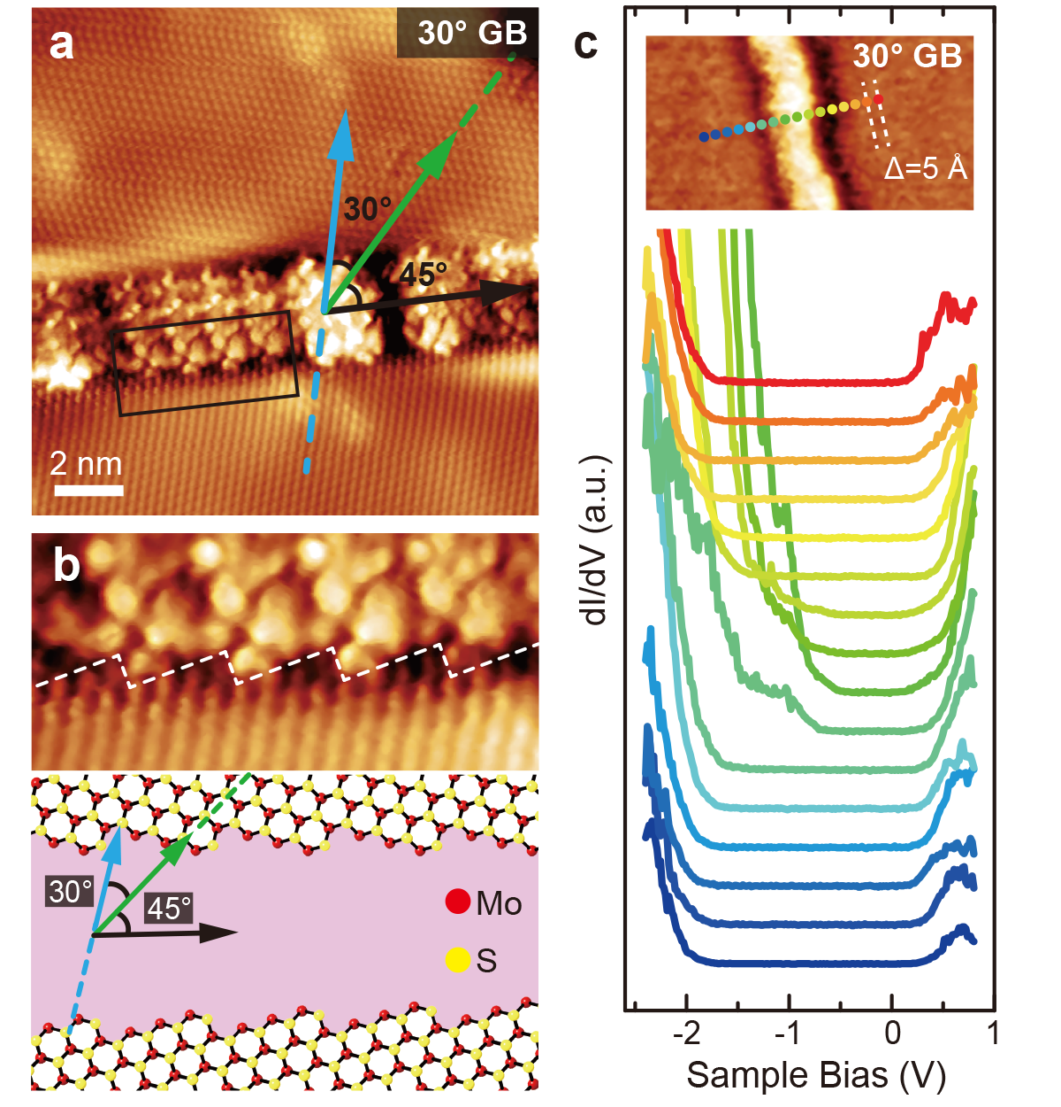
Future Work:
Growth of Nanoelectronic Heterostructures
Explore grain boundary physical and electronic structure for rotationally commensurate MoS₂/graphene heterojunctions.
Develop seeded growth methods to control the position and orientation of grain boundaries.
Study the effect of engineered grain boundaries on charge transport (e.g., memristors).

