Slide 1

Soft Matter Design Based On Charge Complexation
Matthew Tirrell
University of Chicago
Argonne National Laboratory

Slide 2
Polymer charge complexation applied to biomaterials
Multivalent electrostatic interactions are an effective and underexploited tool in molecular self-assembly, e.g., to make hydrogels with tunable moduli and other desirable characteristics of biomaterials.
Easy incorporation of particles to make composites
Design goals for biomaterials
  Tune the modulus to match tissue of interest
  Self-healing is helpful for cell migration and injectability
  Add biofunctionality where needed
  How we determine bulk properties of biomaterials from macromolecular size and charge?

Slide 3
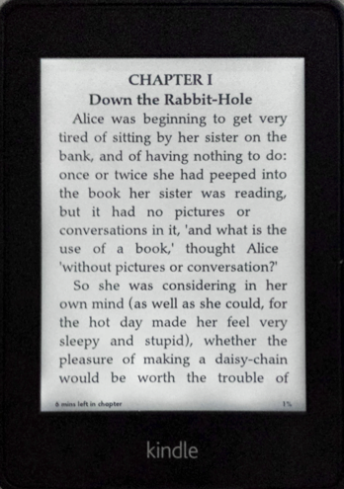
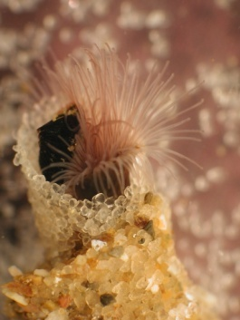
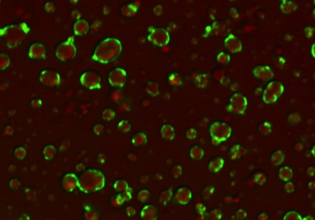
Polyelectrolyte Complexation
Polyelectrolyte complexes (PECs) form when oppositely charged
polyelectrolytes are mixed in aqueous solution (electrostatic interactions)
Polyanion solution
Polycation solution
Polyelectrolyte complex (PEC)
Marine organisms
Protective shell
from excreted proteins
Stable particle dispersions
Membrane-less
compartments
Srivastava & Tirrell, Advances in Chemical Physics, 2016

Slide 4

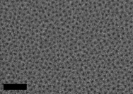
Platform for ‘Soft’ Material Design
Drug Delivery, Tissue Engineering, Encapsulation, Multi-Responsive Materials, Adhesives
Range of
Applications
Bulk Complexes
Complex-core Micelles
Crosslinked Hydrogels
Versatile Materials
PEC micelles & hydrogels
PEC stabilized biocomposites
Membrane-less compartments
Developing theoretical and computational underpinning for design
Controllable Assembly
100 nm
PDMAEMA
PAA
fPAGE-b-PEG-b-fPAGE
fPAGE
Designer Polymers
Plys
Plys-b-PEG-b-PLys
PGlu
PAH
fPAGE-b-PEG
PEG-b-PLys
Polyelectrolytes
Notes:
Key Advantages
Self-assembled hybrid materials
Aqueous environment
Easily tunable interactions
Designer properties

Slide 5
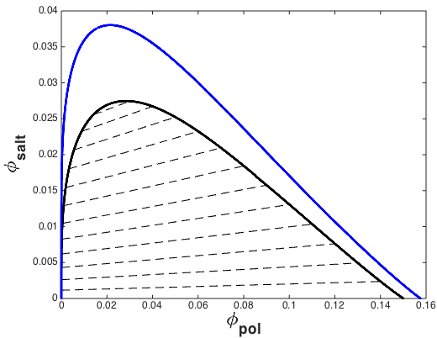
PEC Phase Diagram
N = 200
N = 400
Driving forces
Electrostatic interactions between the polyelectrolyte chains
Release of counter ions associated with the polyelectrolyte chains
Binodal phase behavior predicted by Voorn-Overbeek mean field model
Experiments
Coarse-Grained MD Simulations
Li, Srivastava, Tirrell
Andreev, de Pablo
Lines are guides to the eye
Experimental data from Spruijt et al., Macromolecules, 2010
Combination of various experimental techniques
Meticulous investigation with an emphasis on:
  Salt partitioning in two phases
  Slope of the tie-lines
Bead-spring chain with soft Coulomb for short range and Ewald Sum for long range interactions
Comparison with experiments (filled symbols) with varying chain lengths

Slide 6
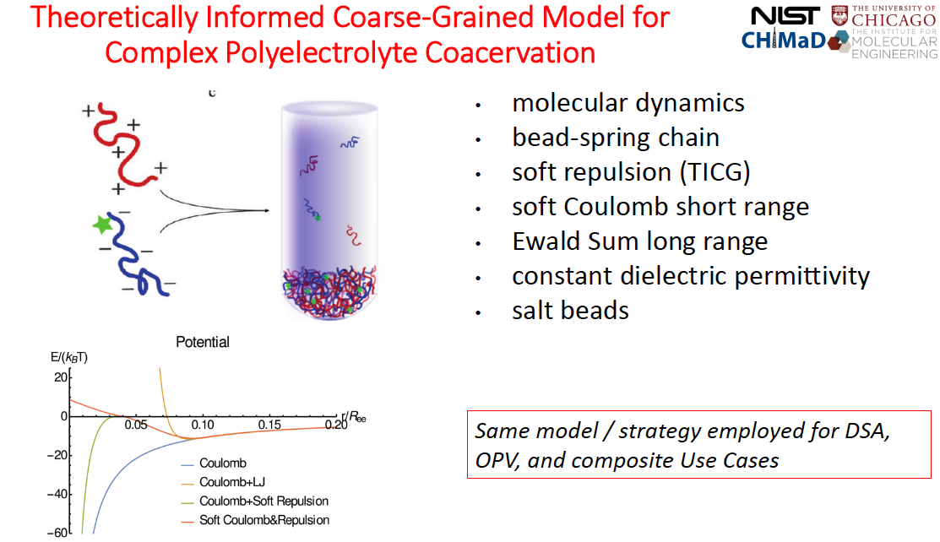

Slide 7
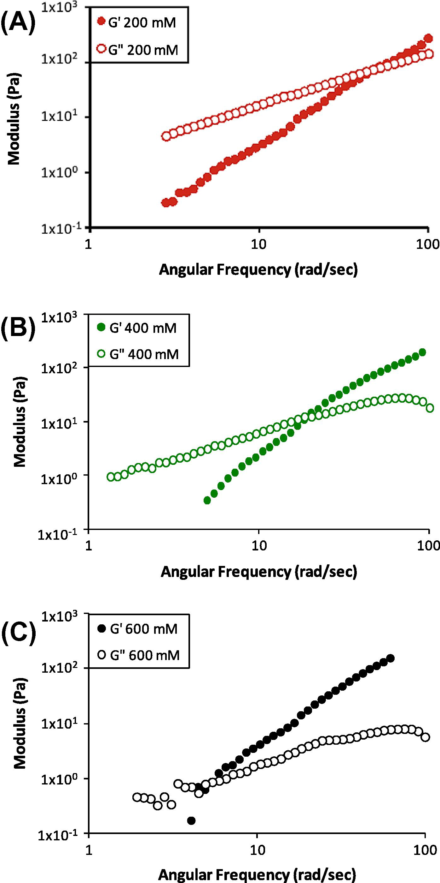
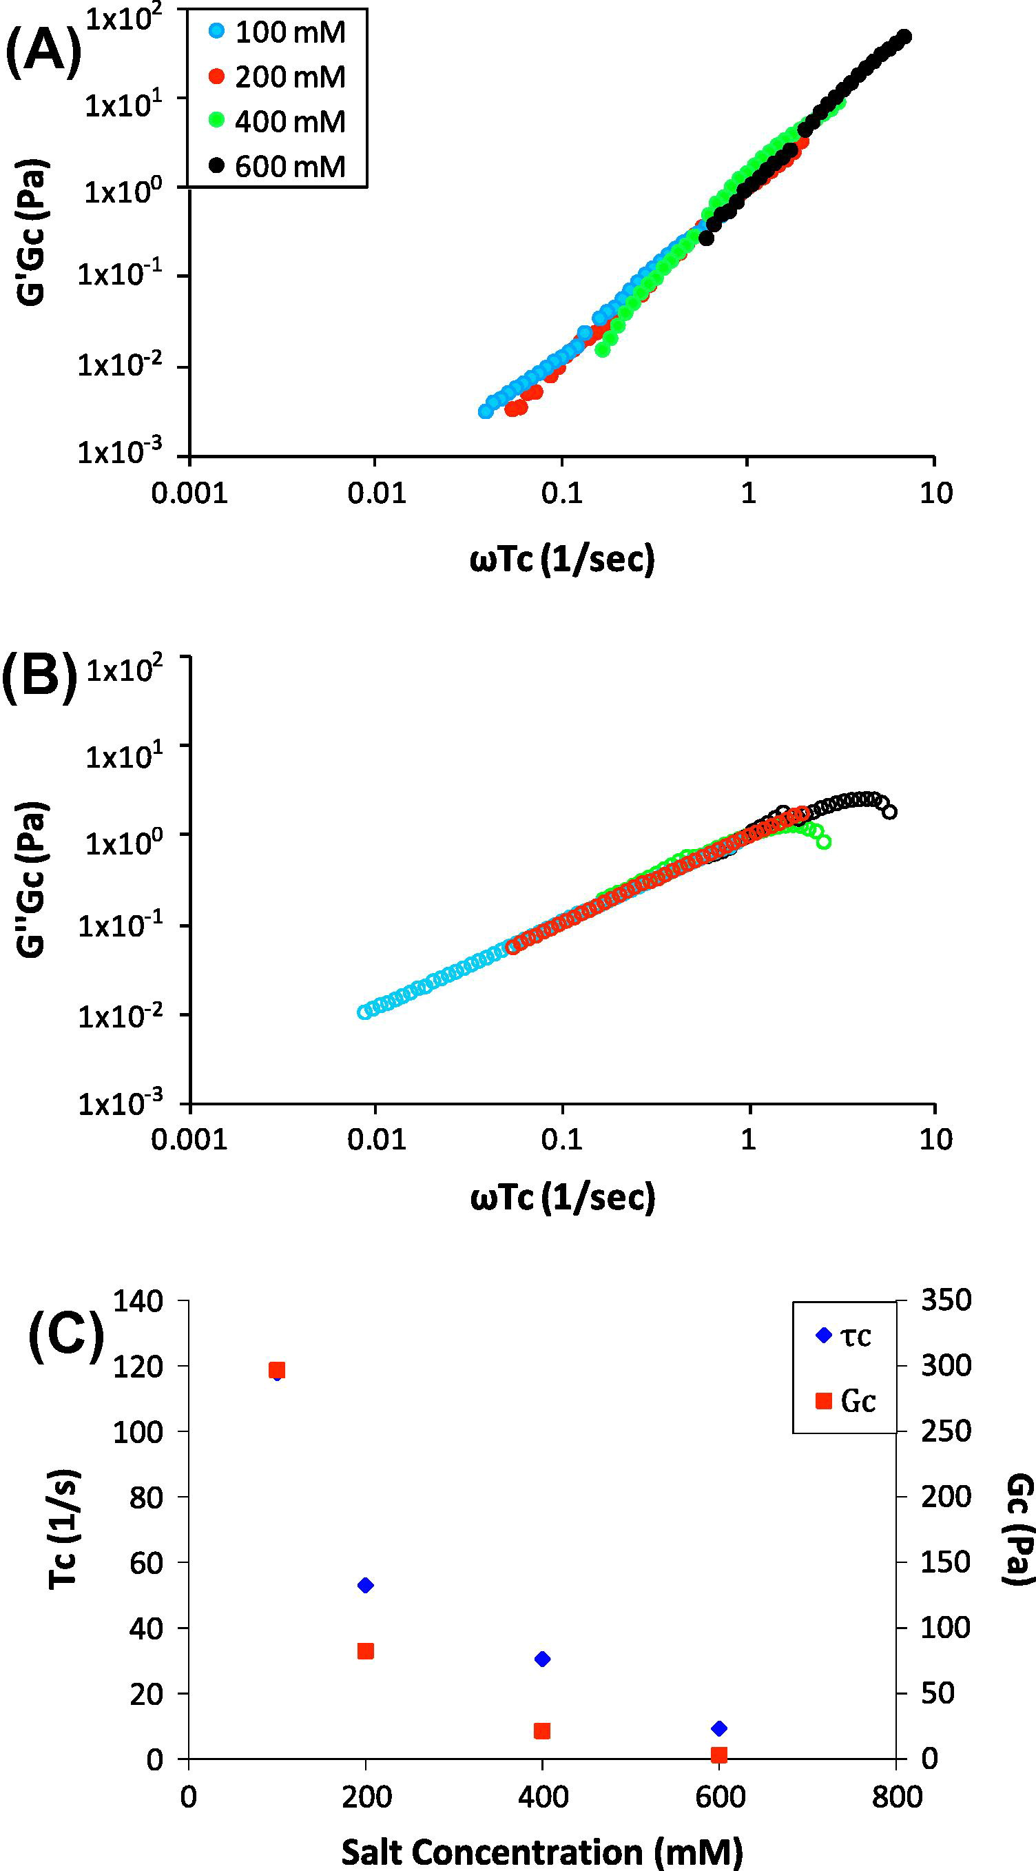
Rheology: Salt-Frequency Superposition
sec
Priftis and Tirrell

Slide 8
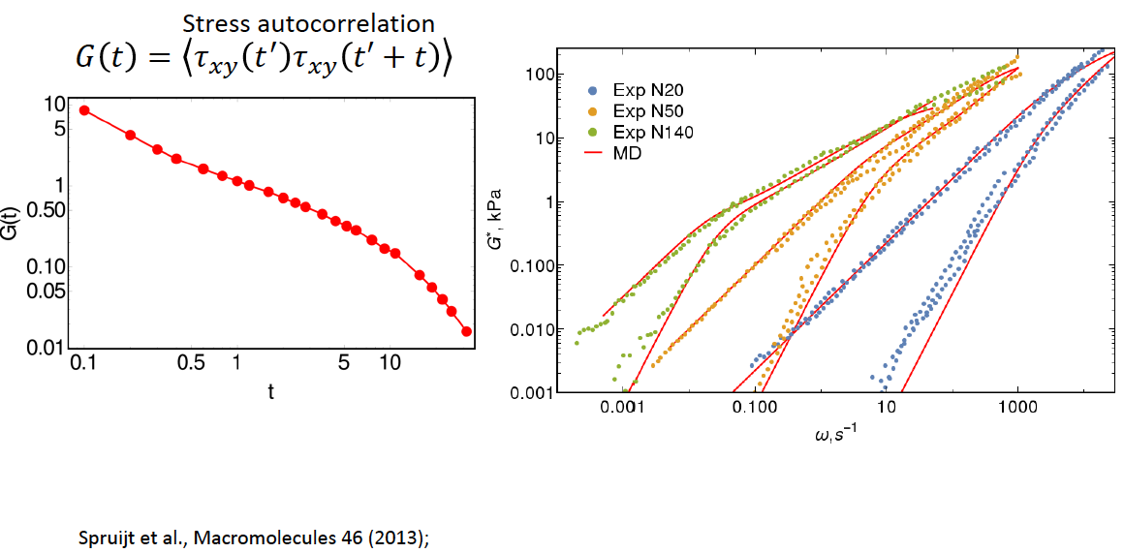
Rheology: Salt-Frequency Superposition
MD anticipates the existence of
salt-frequency superposition
but theoretical understanding
of shift factors is still needed.
Spruit, et al
Andreev, de Pablo

Slide 9
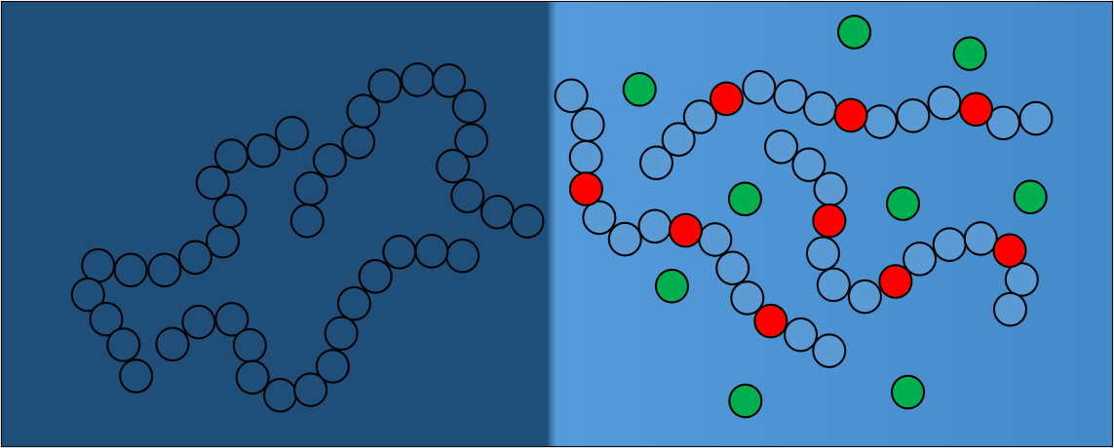
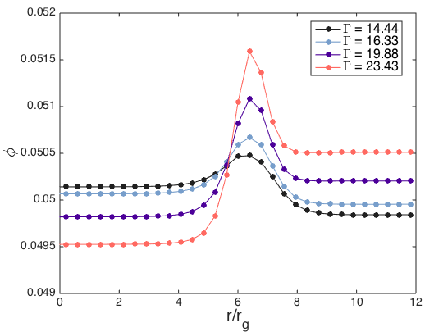
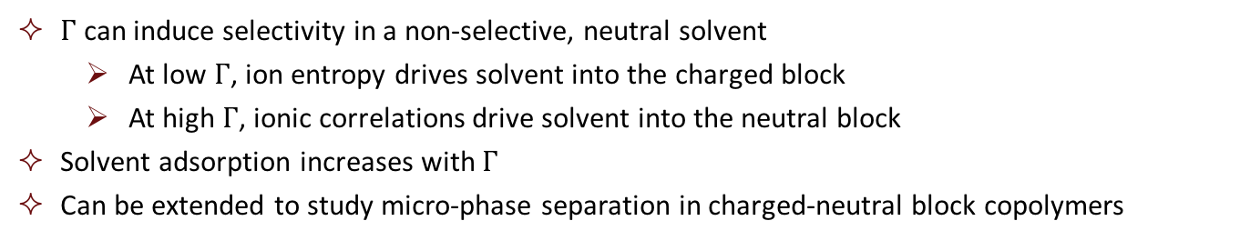
Electrostatics Induced Solvent Selectivity
Olvera de la Cruz
Blends of charged and neutral polymers
Strength of electrostatic interactions
Charged polymer-rich
Neutral polymer-rich
Charged Polymer
Neutral Polymer
$Γ$ can induce selectivity in a non-selective, neutral solvent
  At low $Γ$, ion entropy drives solvent into the charged block
  At high $Γ$, ionic correlations drive solvent into the neutral block
Solvent adsorption increases with $Γ$
Can be extended to study micro-phase separation in charged-neutral block copolymers
polymer phase
polymer phase

Slide 10
Electrostatics Induced Solvent Selectivity
Olvera de la Cruz
Blends of charged and neutral polymers
Strength of electrostatic interactions
Charged polymer-rich
Neutral polymer-rich
Charged Polymer
Neutral Polymer
$Γ$ can induce selectivity in a non-selective, neutral solvent
  At low $Γ$, ion entropy drives solvent into the charged block
  At high $Γ$, ionic correlations drive solvent into the neutral block
Solvent adsorption increases with $Γ$
Can be extended to study micro-phase separation in charged-neutral block copolymers
?

Slide 11
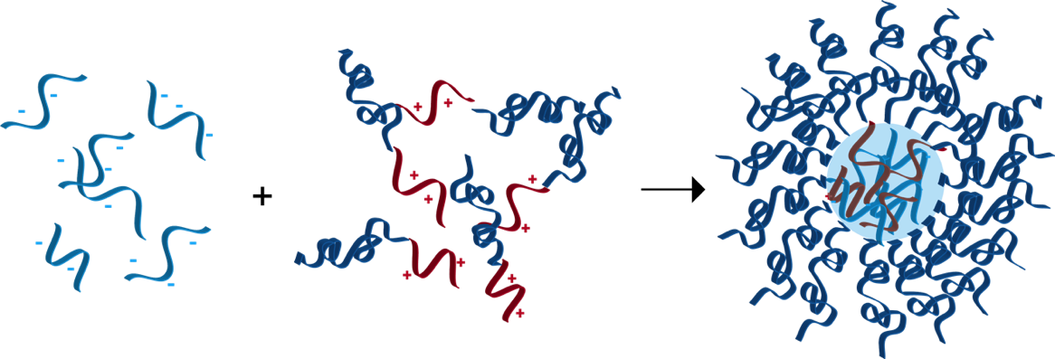
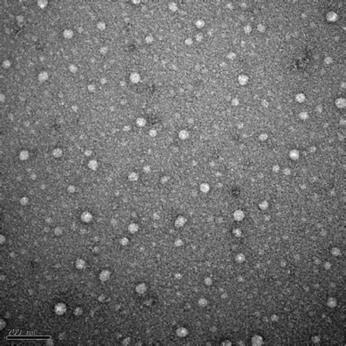
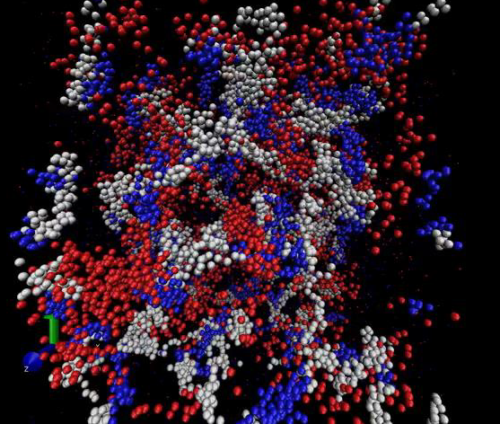
Polyelectrolyte Complex Micelles
Microphase Separation
Micelles with hydrophilic cores
Complexation drives microphase separation
Cores can either be solid or liquid complexes
Excellent for drug and nucleic acid delivery

Slide 12
Coarse-Grained Model for PEC Micelles
Andreev, de Pablo
Diblock PEG polylysine + miRNA micelles
Large interfacial regions observed in density profiles
Contribute to better design and enhanced delivery efficiency

Slide 13
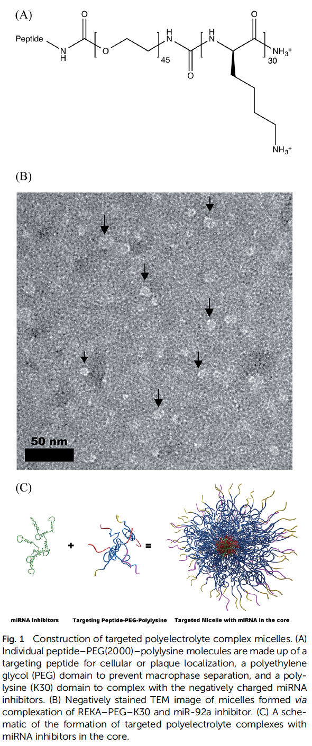
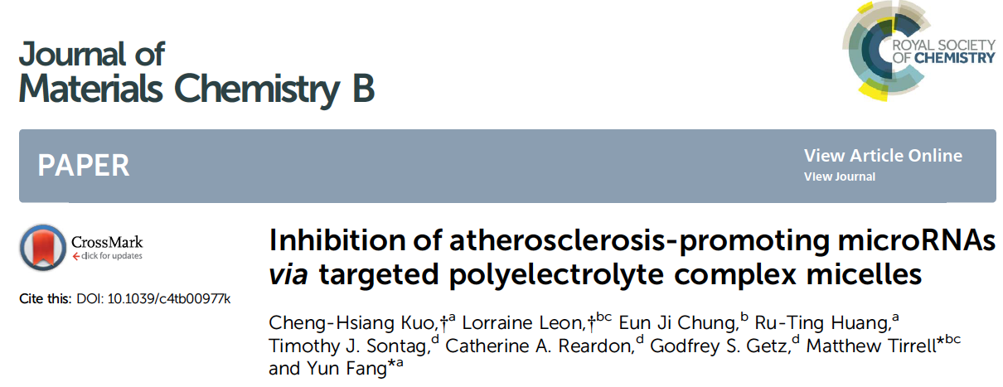
Lesion reduction by miR-92a inhibitor in complex with endothelium-targeted micelles
PBS
Naked
miR-92a inhibitor
Micelle/
inhibitor Ctl
Micelle/
miR-92a inhibitor

Slide 14
PEC Hydrogels: Self-Assembled Hybrids
Drug Delivery and
Tissue Growth Platforms
Hydrophilic cores
Excellent encapsulation
propensities
Tunable chemistry & properties
Hunt, J. N. et. al., Adv. Mater. 2011, 23, 2327
Krogstad, D. V. et al. Macromolecules 2013, 46, 1512

Slide 15
Low Concentration Structures
Spherical Micelles vs. Connected Clusters
P(AGE₂₆-EO₄₅₅-AGE₂₆)
Guan.
P(AGE₂₆-EO₄₅₅-AGE₂₆)
Sulf.
Srivastava, Tirrell
P(EO₂₂₇-AGE₂₆)
Guan.
P(EO₂₂₇-AGE₂₆)
Sulf.
PEG₂₂₇ Midblock
(larger charged fraction)
PEG₄₅₅ Midblock
50%
40%
2%
2%
vs.
5%
Diblocks
Diblocks
Diblocks
Triblocks
Triblocks
1%
Triblocks
1%
Configurational entropy of micelles in the solution vs. conformational entropy of the neutral chain
Diblock copolymers are useful for individual micelles, triblock copolymers are useful for tough gels

Slide 16
Triblock Copolymers Form Clusters
Wei, Prabhu
Srivastava, Tirrell
Low conc.
P(AGE₂₆-EO₄₅₅-AGE₂₆), Guan. + Sulf.
P(AGE₅₁-EO₄₅₅-AGE₅₁), Guan. + Sulf.
-2
-2
-3
-1
No plateau at low q large clusters > 100 nm
Low q slope fractal dimension of clusters
Correlation peak position is independent of conc. Conc. independent PEC domain spacing
Correlation peak intensity increases with increasing conc. Domain number density increases with conc.

Slide 17
Multiple Relaxation Modes
Wei, Prabhu
Srivastava, Tirrell
Low conc.
Dynamic light scattering: multiple modes
Micelles, clusters & cooperative modes
PAGE₂₆-PEG₄₅₅-PAGE₂₆
T = 25 C
Fast cooperative
mode
C = 15 wt%
C^{0.47}
Micelle
Slow cluster-mode
PAGE₂₆-PEG₄₅₅-PAGE₂₆
Multiple modes of relaxation corresponding to various relaxation processes in clusters
PEC Core: Scattering (R_{g} = 13 nm) consistent with a diffusive mode by DLS (R_{H} = 15.3 nm)
Cluster concentration-independent diffusion coefficient D_{t} of the slow mode
Correlation length within cluster exhibits diffusive dynamics D_{coop} ~ C^{0.47} similar to neutral semidilute polymer solution predictions

Slide 18
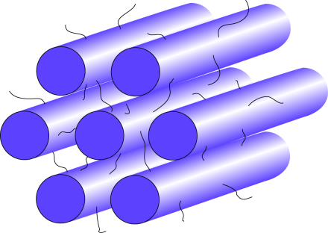
Hydrogels: PEC Domain Arrangements
P(AGE₆₀-EO₄₅₅-AGE₆₀)
Guan.
P(AGE₆₀-EO₄₅₅-AGE₆₀)
Sulf.
Srivastava, Tirrell

Slide 19
Coarse-Grained Model for PEC Micelles
PAGE₁₅-PEO₄₅₅-PAGE₁₅
SAXS Investigations
PAGE₆₀-PEO₄₅₅-PAGE₆₀
Srivastava, Tirrell
Increasing
Charged Block
Length
PAGE₂₆-PEO₄₅₅-PAGE₂₆
PAGE₅₁-PEO₄₅₅-PAGE₅₁
PAGE₃₀-PEO₄₅₅-PAGE₃₀

Slide 20
Hydrogel Morphology Phase Diagram
Srivastava, Tirrell
PEO₄₅₅ midblock
PEO₂₂₇ midblock
Guan.
Sulf.
Guan.
Sulf.
Design of Tunable Gels
Charged:neutral block ratio length determines packing morphology
Qualitatively similar phase diagrams as predicted by theory
Phase diagrams are not superimposable: mid-block effects are not trivial
SCFT-EF calculations
End-block fr.
Audus, Fredrickson et al., Soft Matter 2015
Conc.

Slide 21
Conclusions
Drug Delivery, Tissue Engineering, Encapsulation, Multi-Responsive Materials, Adhesives
Versatile Materials Built via Electrostatic Self-Assembly
PEC micelles and hydrogels
PEC stabilized biocomposites
Membrane-less compartments
Developing theoretical and computational underpinning for design
International Symposium on Multivalent Interactions in Polyelectrolytes: New Physics, Biology and Materials. Sponsored by CHiMaD and IME. University of Chicago, October 2-4, 2015. Co-Organizers: Juan de Pablo, Sheng Lin-Gibson, Vivek Prabhu, Monica Olvera de la Cruz, Matthew Tirrell

Slide 22
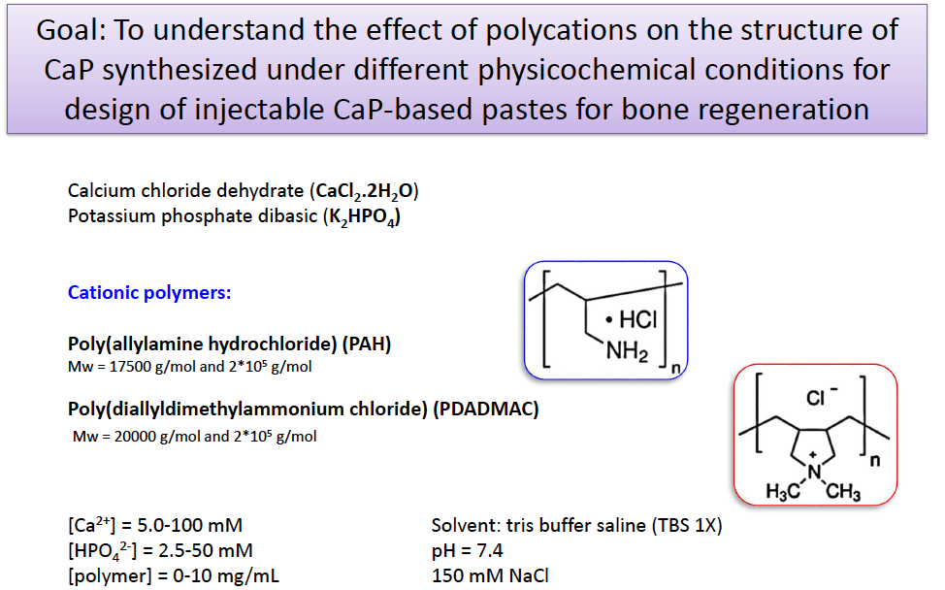
Polyelectrolyte effects on CaP structure

Slide 23
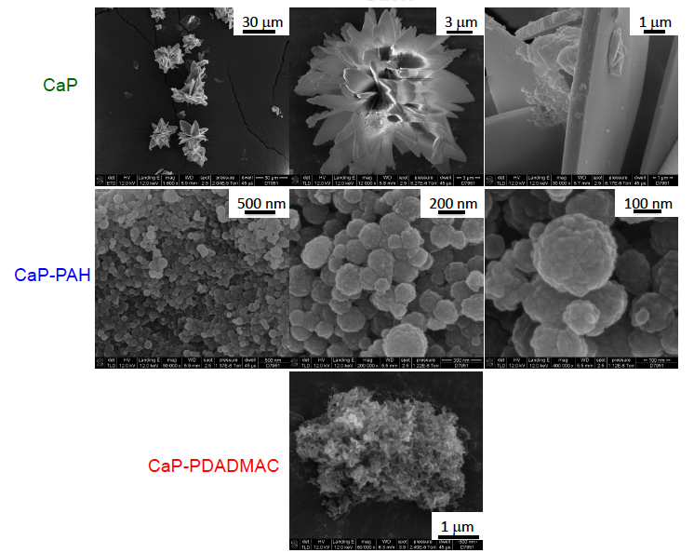
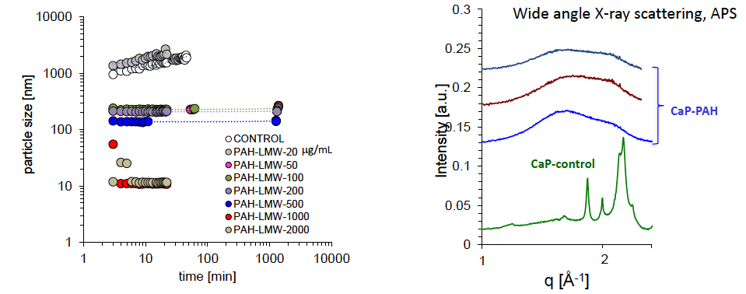

Polyelectrolyte effects on CaP structure

Slide 24
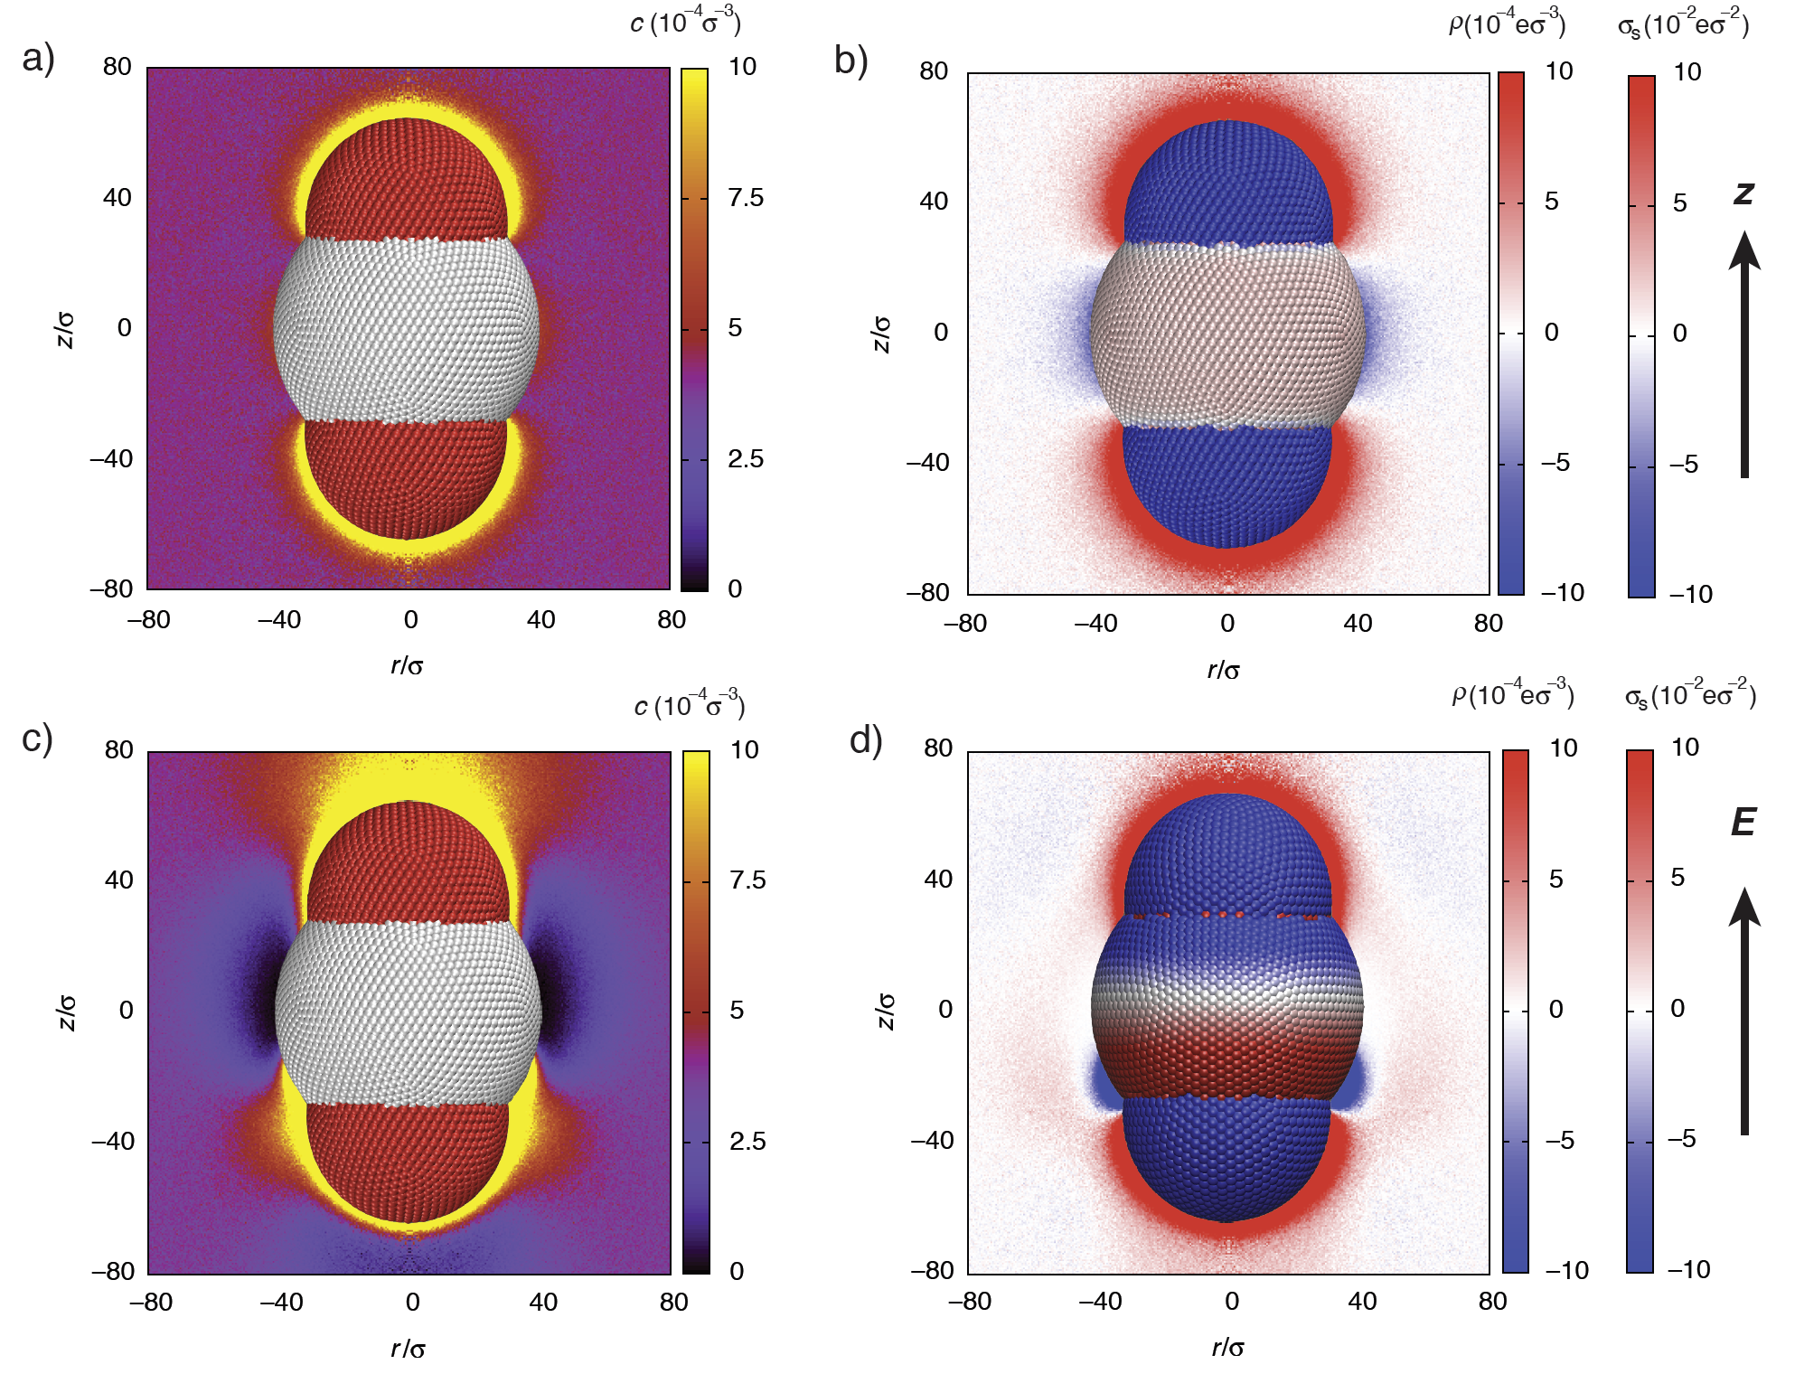
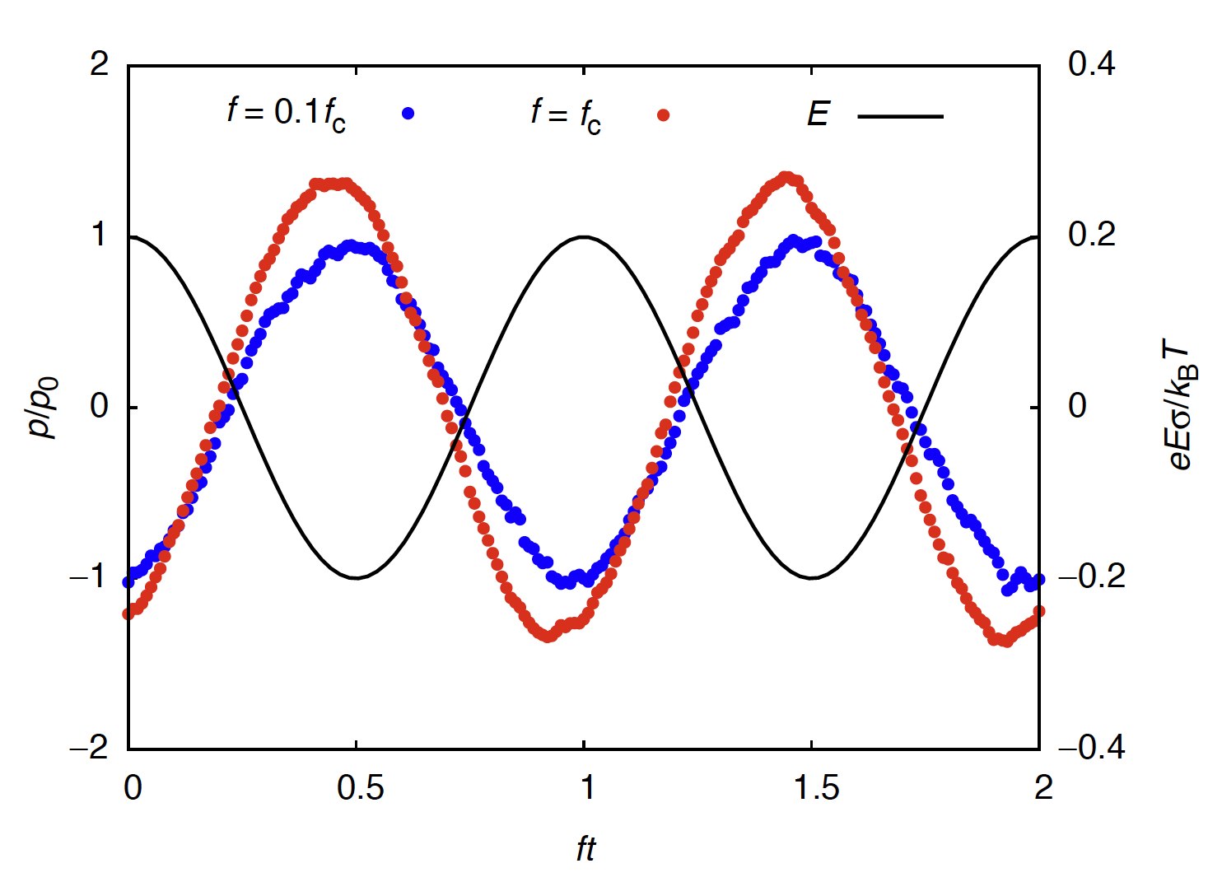
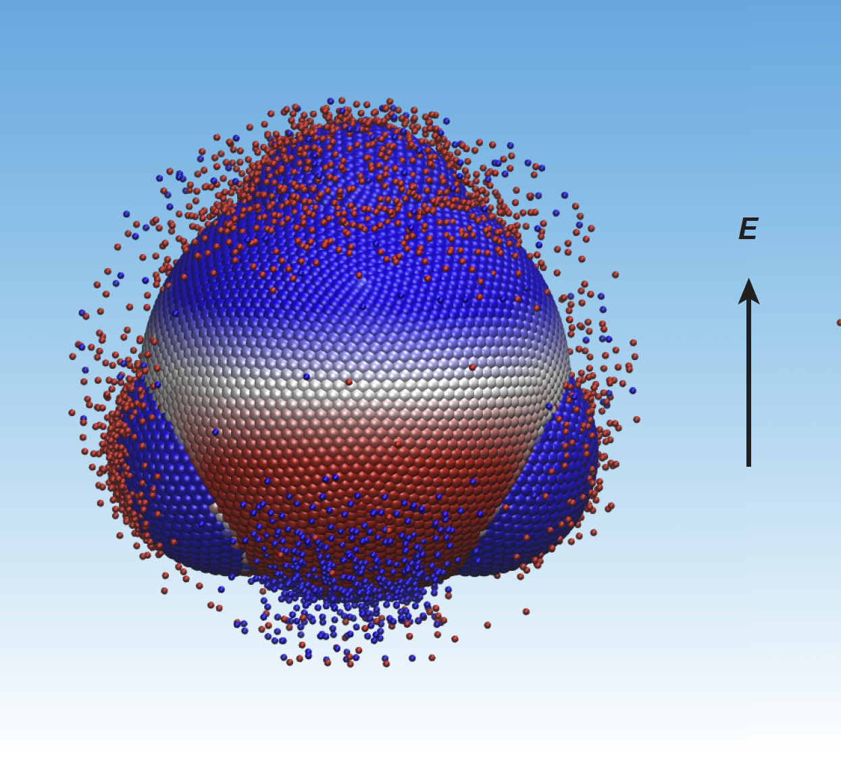
Electric double layer of anisotropic dielectric colloids under electric fields
Field-directed assembly of patchy colloids gives a broad range of biomimetic patterns, from microtubes to double helices
The aggregation is driven by induced dipole moments, which arise from an interplay between dielectric effects and the EDL
Our newly developed method now makes it possible to solve this problem in simulations for colloids in both DC and AC fields
We use our findings to make experimentally important predictions on the role of field strength and frequency and on the preferred orientations for various particles
This work opens pathways toward predictive capabilities for polarizable building blocks for the field-directed assembly of new biomimetic materials
M. Han, H. Wu and E. Luijten
Eur. Phys. J., submitted
Notes:
Anisotropic colloidal particles constitute an important class of building blocks for self-assembly directed by electrical fields. The aggregation of these building blocks is driven by induced dipole moments, which arise from an interplay between dielectric effects and the electric double layer. For particles that are anisotropic in shape, charge distribution, and dielectric properties, calculation of the electric double layer requires coupling of the ionic dynamics to a Poisson solver. We apply recently proposed methods to solve this problem for experimentally employed colloids in static and time-dependent electric fields. This allows us to predict the effects of field strength and frequency on the colloidal properties.

